Slide 1
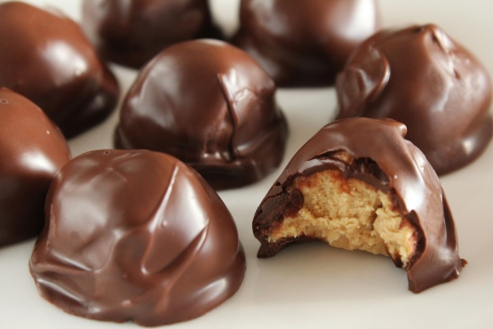
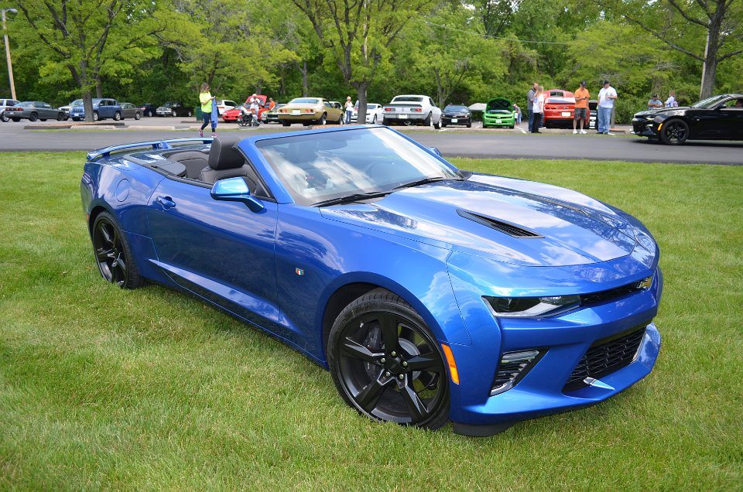
Coconut Peanut Butter Cookies
Total time: 1hr + chilling
Servings: 24
Ingredients
2 cups powdered sugar
1 cup peanut butter
1 cup chopped walnuts
10 tablespoons butter (melted)
¼ teaspoon salt
1 cup coconut angel flakes
¼ cup paraffin
12 ounce package dark chocolate chips
Contributed by:
Kathy and Mark Naylor
Directions
Chop the nuts to a fairly small size. They should be smaller than the chopped size found in the store.
Melt the butter in a microwave a few seconds at a time, stirring frequently. The butter should be more of a transparent yellow color (clarified) and not just soft.
Mix the first six ingredients well and shape into 1-inch balls. Place the cookies on a parchment-lined baking sheet and freeze the cookies for at least 30 minutes.
In the meantime, melt the paraffin and dark chocolate chips in a double boiler over medium heat. It is best if the hot water does not touch the bottom of the pan. Turn the heat to low after everything has melted.
Remove cookies from the freezer and dip them in the chocolate. Place the cookies back on the parchment-lined cookie sheet.
For best results, place the cookies back in the freezer to harden, about another 30 minutes. Once hardened, the cookies can be set out to eat, but for longevity, refrigerate any remaining cookies.
2016 Hyper Blue Metallic Convertible
“Maximus”
Gateway Camaro Club
2016

Slide 2
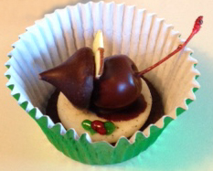
Christmas Eve Mice
Cookies
Total time: 1hr + chilling
Servings: 24
Ingredients
24 double-stuffed Oreo cookies
1 cup (6 ounces) dark chocolate chips
2 teaspoon shortening
24 red maraschino cherries with stems, well drained
24 dark chocolate kisses
48 sliced almonds
1 small tube green decorative icing gel
1 small tube red decorative icing gel
Contributed by:
Kathy and Mark Naylor
Directions
Carefully twist the cookies apart; set aside the halves with cream filling. Save the plain halves for another use.
In a microwave, melt chocolate chips and shortening; stir until smooth. Holding each cherry by the stem, dip in melted chocolate, then press onto the bottom of a chocolate kiss. Place the mouse on the cream filling of a cookie, with the cherry stem extending beyond cookie’s edge.
For the ears, place slivered almonds between the cherry and the kiss. Refrigerate until set. With green gel, pipe holly leaves on the cream. With red gel, pipe holly berries between leaves. Store in an airtight container at room temperature.
2016 Hyper Blue Metallic Convertible
“Maximus”
Gateway Camaro Club
2016

Slide 3
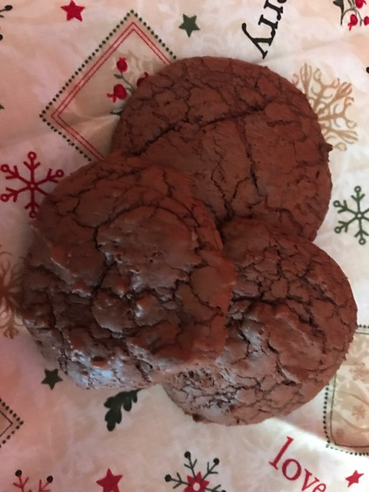
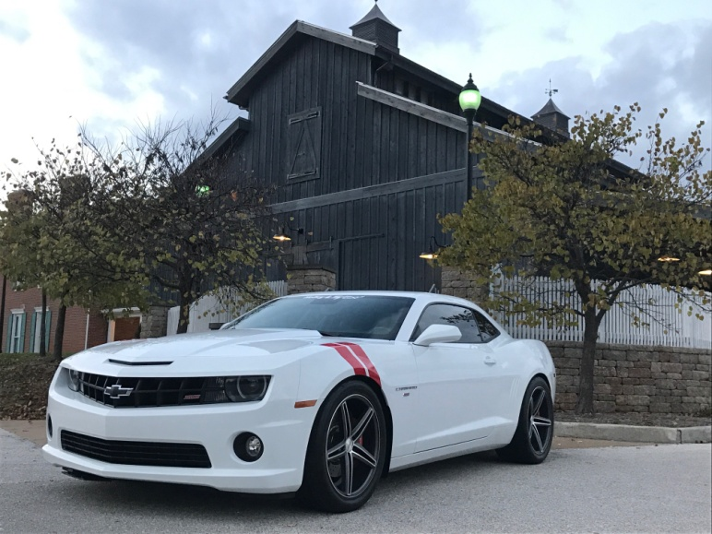
Brownie Cookies
Servings: 36 cookies
Ingredients
12 ounce bittersweet chocolate chips (60%-70% cacao)
½ cup butter
3 large eggs
1 cup granulated sugar
¼ cup brown sugar
1 tablespoon vanilla extract
½ teaspoon baking powder
½ teaspoon salt
¾ cup all-purpose flour
¼ cup unsweetened cocoa powder
1 cup pecans (optional)
½ cup mini semisweet chocolate chips
Contributed by:
Anna Thacker
Directions
Preheat oven to 350°F.
Melt bittersweet chocolate chips and butter in a heavy saucepan over low heat, stirring constantly until melted and well-combined. Remove from heat and set aside.
In the bowl of a stand mixer, beat the eggs, vanilla, baking powder and salt on high speed for about 5 minutes, or until the mixture is thick and creamy. (Recommend the full 5 minutes.)
Reduce the speed to low, and mix in the melted chocolate and butter until well-combined.
With speed still on low, stir in flour and cocoa powder just until combined.
Add semisweet chocolate chips, and nuts if desired. Stir in by hand until combined.
Cover the batter and chill in refrigerator for a minimum of 30 minutes.
Line two baking sheets with parchment paper.
Using a 1.5 Tbsp cookie scoop, drop batter onto the prepared cookie sheets about 2 inches apart.
Bake cookies 8-10 minutes. The cookie will set at the edges but still be a little wet looking in the center. Don’t over-bake or the cookies won’t be crackly and fudge-like.
Allow the cookies to cool on the baking sheets for about 10 minutes to allow the shiny, crackly crust to develop.
2010 Summit White SS
“Marilyn”
Gateway Camaro Club
2016

Slide 4
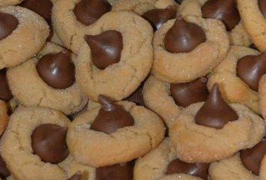
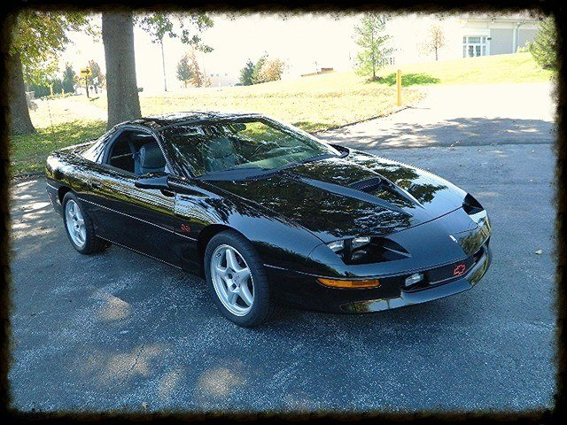
Peanut Blossoms
Servings: 36-48 cookies
Ingredients
1 ¾ cups flour
½ cup sugar
½ cup firmly packed brown sugar
1 teaspoon soda
½ teaspoon salt
½ cup butter or shortening
½ cup peanut butter
2 tablespoons milk
1 teaspoon vanilla
1 egg
36-48 milk chocolate Kisses
Contributed by:
Carol and Allen Kleinhenz
Original recipe from 1979 Minneapolis Star Tribune, Readers’ Favorite Recipe Cookbook
Directions
Preheat oven to 375°F.
Combine ingredients in a large mixing bowl. Mix at low speed until a dough forms.
Shape into balls, using a rounded teaspoon of dough. Roll the balls in additional sugar.
Place on ungreased cookie sheets. Bake in oven for 10-12 minutes.
Remove from the oven and top each hot cookie with a chocolate Kiss. Press down, so the cookie cracks around the edge.
1996 Black Camaro SS
Gateway Camaro Club
2016

Slide 5
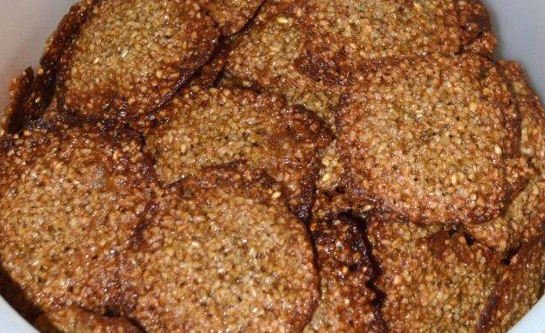
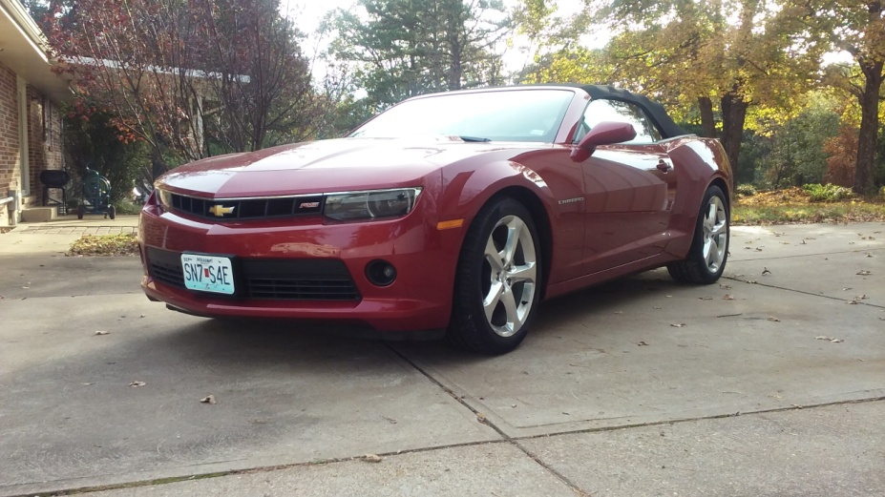
Overnight Macaroons
Servings: About 5 dozen
Ingredients
4 cups quick cooking oats
2 cups packed light brown sugar
1 cup vegetable oil
2 eggs well beaten
1 teaspoon salt
2 teaspoon almond extract
Contributed by:
Bonnie and Louis Pfleckl
Directions
Preheat oven to 325°F.
Combine oats, brown sugar, and oil. Refrigerate overnight.
The next day, mix eggs, salt and almond extract into the oats mixture.
Drop dough from a teaspoon onto a baking sheet lined with parchment paper.
Bake in the oven for 15 minutes. Remove promptly and cool on wire racks.
2015 Red Rock Metallic Convertible
“Cinnamon”
Gateway Camaro Club
2016

Slide 6
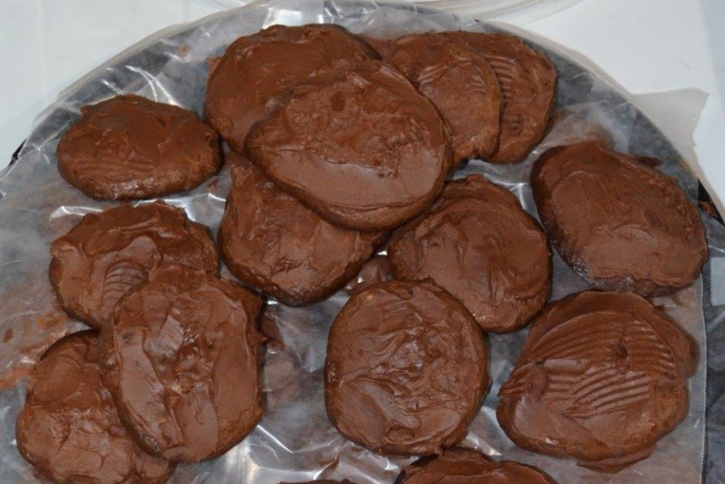
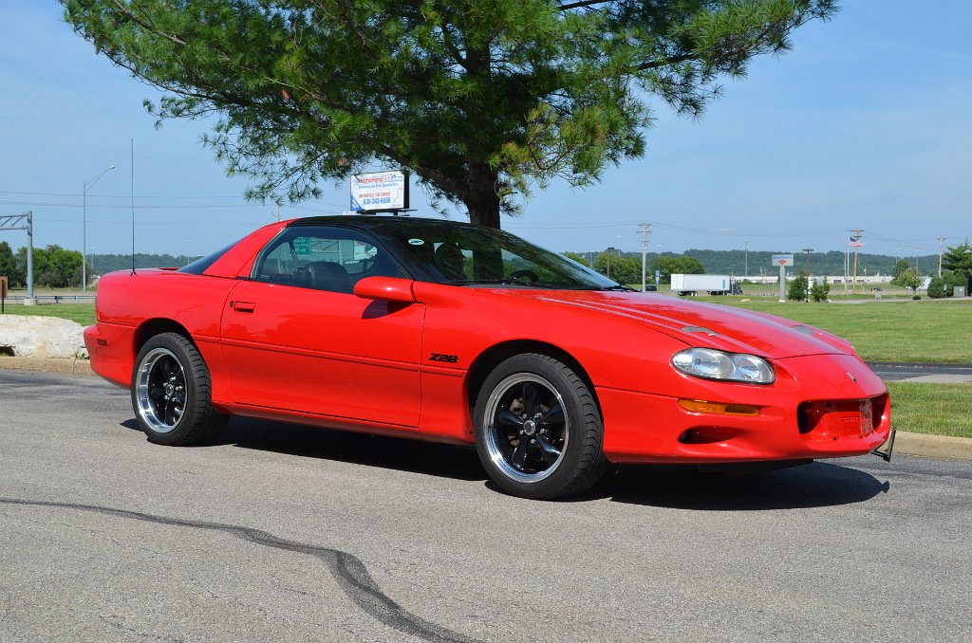
Gold Rush Cookies
Servings: 3 dozen
Ingredients
1 can of Eagle brand milk
1½ -6 ounce package chocolate chips
2 tablespoons butter
1 cup sifted flour
1 teaspoon vanilla
1 cup chopped nuts
Contributed by:
Kathy Sperry
Directions
Preheat oven to 350°F.
Melt butter and chocolate in double boiler.
Add milk. Then stir in flour, vanilla and nuts. Mix well and chill.
Drop by spoon on well greased cookie sheet.
Bake for 15 minutes.
These will not seem done. Frost with your favorite chocolate frosting. These are almost like candy.
2002 Chevy Z28 Camaro
“Red Hot Momma”
Gateway Camaro Club
2016

Slide 7
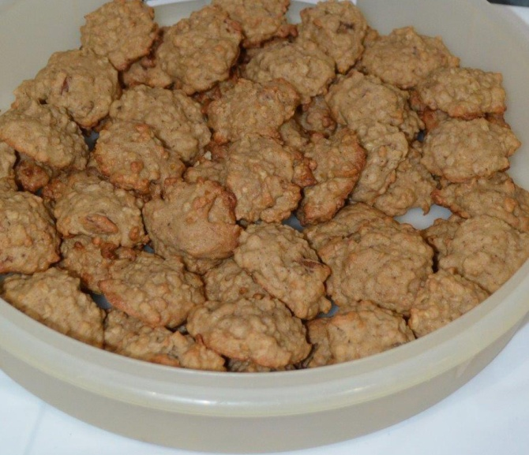
Banana Oatmeal
Cookies
Ingredients
1 ½ cups flour
½ teaspoon soda
1 teaspoon salt
¼ teaspoon nutmeg
¾ teaspoon cinnamon
1 ¾ cups quick oatmeal
¾ cup shortening
1cup brown sugar
1 egg, well beaten
1 cup ripe bananas, mashed
½ cup chopped nuts
1 teaspoon vanilla
Contributed by:
Kathy Sperry
Directions
Preheat oven to 350°F.
Cream sugars and shortening.
Add egg and vanilla and mix.
Add dry ingredients, sifted together, and banana.
Add oatmeal and nuts.
Drop by spoon on greased baking sheet. Bake for 10-12 minutes.
2002 Chevy Z28 Camaro
“Red Hot Momma”
Gateway Camaro Club
2016

Slide 8
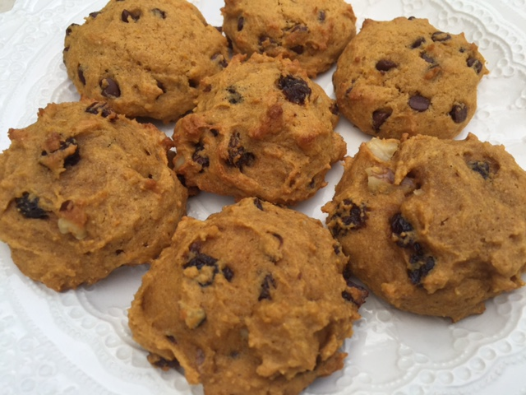
Pumpkin Cookies
Ingredients
1 cup brown sugar, packed firm
1 cup pumpkin
½ cup oil
1 teaspoon vanilla
2 cups flour
1teaspoon baking powder
½ teaspoon salt
½ teaspoon cinnamon
½ teaspoon nutmeg
¼ teaspoon ginger
1 cup raisins
Contributed by:
Kathy Sperry
Directions
Preheat oven to 350°F.
Mix sugar, pumpkin, oil and vanilla.
Add sifted dry ingredients and raisins.
Drop by teaspoons on well greased baking sheet. Bake 15 minutes
2002 Chevy Z28 Camaro
“Red Hot Momma”
Gateway Camaro Club
2016

Slide 9
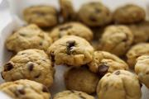
Cake Mix Pronto
Cookies
Servings: 4½ - 5 dozen
Contributed by:
Kathy Sperry
Ingredients
1 package, 2 layer size yellow cake mix (pudding type)
¼ cup butter or margarine, softened
¼ cup strong brewed coffee, cooled
1 egg
1- 6 ounce package of semi-sweet chocolate pieces
½ cup walnuts
Directions
Preheat oven to 375°F.
In a mixer bowl, combine cake mix, butter, and eggs.
Beat until smooth; stir in chocolate pieces and nuts.
Drop from well- rounded teaspoons onto greased cookie sheet.
Bake for 12 minutes.
Let stand a few minutes before removing.
2002 Chevy Z28 Camaro
“Red Hot Momma”
Gateway Camaro Club
2016

Slide 10
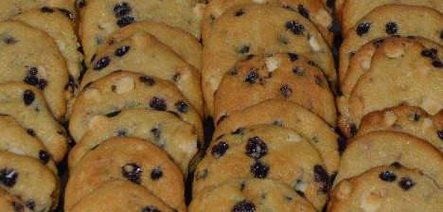
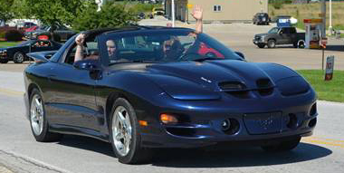
Blueberry Cheesecake
Cookies
Total time: 45 minutes
Servings: 28 cookies
Ingredients
2 boxes Jiffy Blueberry Muffin mix
4 ounces cream cheese
1 stick butter (“I Can’t Believe It’s Not Butter”)
½ cup light brown sugar, firmly packed
2 eggs
1 ½ cups white chocolate chips
Contributed by:
Linny Linnemeyer
Directions
Preheat oven to 325°F.
Cream together butter, cream cheese, and brown sugar.
Add eggs one at a time until blended.
Combine muffin mix with the butter mixture and mix well.
Fold in white chocolate chips.
Chill for at least one hour.
Drop by tablespoonfuls onto greased cookie sheet, two inches apart.
Bake for 14-15 minutes or until just turning brown around the edges.
Cool on cookie sheet for 1-2 minutes. Transfer to wire rack until completely cooled.
Note: If they come out flat, try to chill the batter for a while longer.
2000 Blue WS6 Trans Am
Gateway Camaro Club
2016

Slide 11
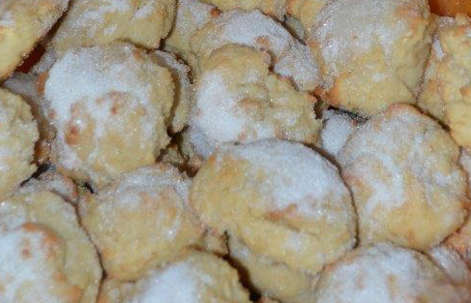
Great, Great Granny’s
Sugar Cookies
Ingredients
¾ cup butter
1 cup sugar
2 eggs
1 teaspoon vanilla
⅓ cup milk
3 ½ cups flour
1 tablespoon baking powder
¼ teaspoon salt
1 cup chopped pecans (optional)
Contributed by:
Linny Linnemeyer
Great, great Granny from Pennsylvania
Directions
Preheat oven to 425°F.
Spoon out cookie batter like drop biscuits.
Bake for 10-12 minutes.
When the cookies come out of the oven, brush the top of cookies with milk & sprinkle
with sugar right away.
1978 Black Trans Am
“My Man”
Gateway Camaro Club
2016

Slide 12
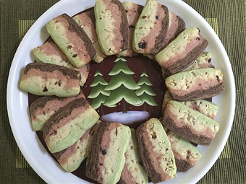
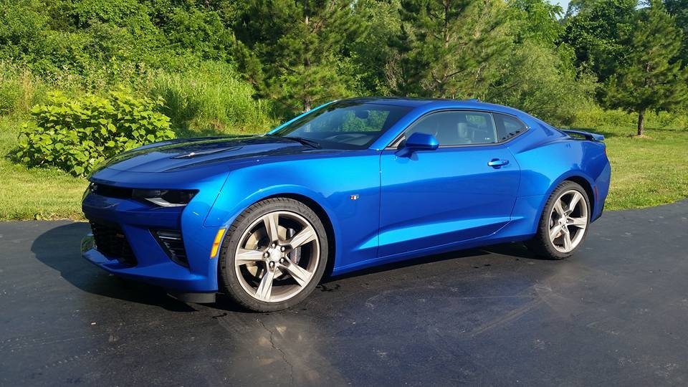
Ribbon Cookies
Ingredients
2 ½ cups sifted flour
1 ½ teaspoons baking powder
½ teaspoon salt
1 cup butter, softened
1 ½ cups sugar
1 egg, beaten
1 teaspoon vanilla
¼ cup chopped candied cherries (not maraschino)
¼ cup finely chopped pecans (optional)
1 ounce chocolate, melted (baking chocolate)
Contributed by:
Linda Kondrick
Directions
Preheat oven to 375°F.
Cream together butter and sugar, add egg and vanilla.
Sift dry ingredients together and mix in. Divide dough into three parts.
Add cherries to one part, using a little red food coloring, if desired.
Add pecans and chocolate to the second part.
Leave the third part plain.
Line an 8″ square pan with waxed paper. Press layers into pan, one at a time to form rainbow of colors. Freeze.
To bake, remove dough from the freezer and cut into four equal 2″ x 8″ portions. Cut cookies ¼″ thick.
Bake and watch carefully. The cookies should not brown or colors will be distorted.
2016 Hyper Blue Metallic
“Blue Beauty”
Gateway Camaro Club
2016

Slide 13
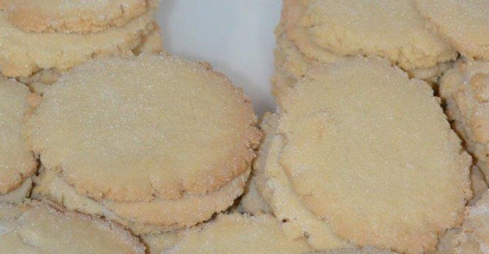
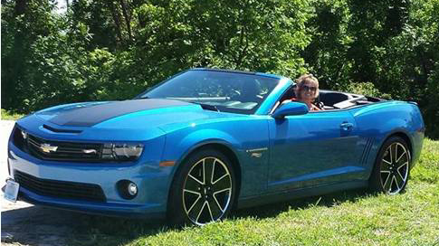
Gina’s Sugar
Cookies
Servings: 3 dozen
Ingredients
1 ½ cup sifted confectioners’ sugar
1 cup shortening (or ½ cup butter and ½ cup
shortening)
1 egg
1 teaspoon vanilla
½ teaspoon almond flavoring
2 ½ cups flour
1 teaspoon cream of tartar
1 teaspoon baking soda
Contributed by:
Gina and Greg Wilkerson
Directions
Preheat oven to 375°F.
Cream the sugar and butter. Mix in egg and flavoring.
Measure the flour by the dip and level method.
Blend in the dry ingredients.
Store the dough in the refrigerator for 2-3 hours.
Roll the dough into small balls and flatten with a glass that has been greased and dipped into sugar.
Place apart on lightly greased baking sheet. Bake about 10 minutes.
2013 Hot Wheels Special Edition
“Sizzler”
Gateway Camaro Club
2016

Slide 14
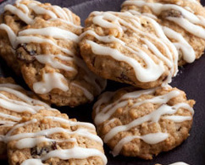
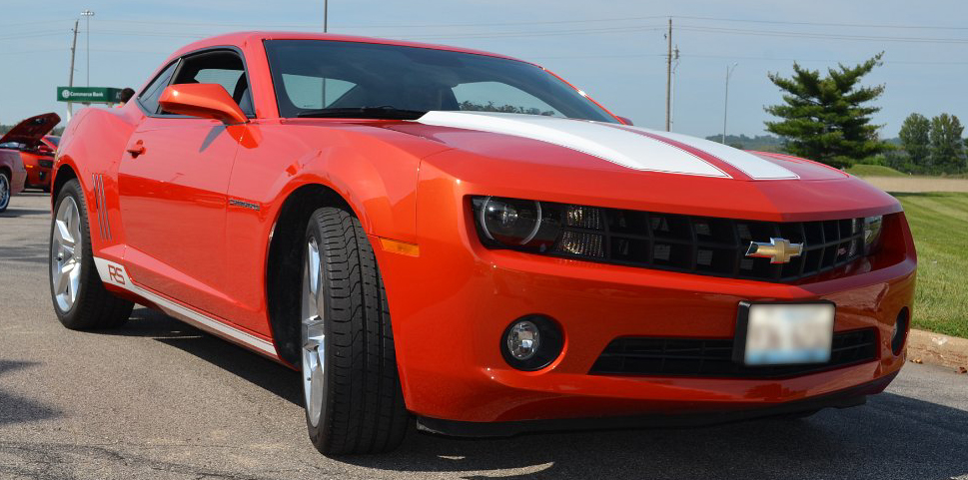
Oatmeal Raisin Cookies
Contributed by:
Vicki Schanuel and Dwayne Saul
Servings: 4 dozen
Directions
Ingredients
¾ cup of flour
¾ teaspoon salt
½ teaspoon baking soda
½ teaspoon cinnamon
¾ cup (1 ½ sticks) butter or margarine softened
¾ cup sugar
¾ cup packed light brown sugar
1 egg
1 tablespoon water
1 tablespoon vanilla, divided
3 cups uncooked quick or old fashioned oats
1 cup raisins
½ cup powdered sugar
1 tablespoon milk
Preheat oven to 375°F.
Grease cookie sheets set aside.
Combine flour, salt, baking soda and cinnamon in small bowl.
Beat butter, sugar and brown sugar in large bowl with mixer at medium speed until light an fluffy.
Add egg, water and 2 tsp of vanilla, beat well.
Add flour mixture, beat at low speed until well blended.
Stir in oats with spoon. Stir in raisins.
Drop tablespoon full of dough two inches apart onto prepared cookie sheets.
Bake 10-11 minutes or until edges are golden brown.
Let cookies stand 2 minutes on cookies sheets, transfer to wire racks to cool completely.
For glaze:
Stir powdered sugar, milk and remaining 1 tsp vanilla in small bowl until smooth.
Drizzle over cookies with fork or spoon. Store cookies tightly covered at room temperature or freeze up to 3 months.
2010 Inferno Orange RS
Gateway Camaro Club
2016

Slide 15
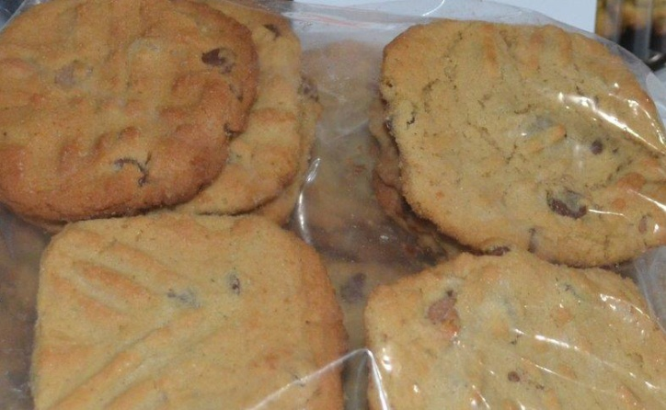
Old Fashioned Peanut Butter Cookies
Servings: 6 dozen
Ingredients
1 cup butter, softened
1 cup creamy peanut butter
1 cup sugar
1 cup firmly packed brown sugar
2 large eggs
2 ½ cups flour
2 teaspoon baking soda
¼ teaspoon salt
1 teaspoon vanilla
Sugar
Chocolate chips (optional)
Contributed by:
Vicki Schanuel and Dwayne Saul
Directions
Preheat oven to 375°F.
Beat butter and peanut butter at medium speed with mixer until creamy; gradually add sugars, beating well. Add eggs, beating well.
Combine flour, baking soda, and salt in a medium bowl, and to butter mixture, beating well.
Stir in vanilla. Cover and chill 3 hours.
Shape into 1 1/4" balls, place 3 inches apart on ungreased cookie sheets.
Dip a fork in additional sugar and flatten cookies in a crisscross pattern.
Bake for 7-8 minutes. Remove to wire racks to cool.
(We added peanut butter and chocolate chips.)
2010 Inferno Orange RS
Gateway Camaro Club
2016

Slide 16
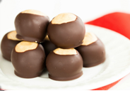
Buckeye Balls
Servings: 4 dozen
Ingredients
1 cup butter
1 cup peanut butter
16 ounce box powdered sugar
12 ounce package of semi-sweet chocolate chips
Optional ½″ x ½″ square of paraffin wax
(this will enable the chocolate shell to harden more effectively)
Contributed by:
Barb and Tim Burkemper
Directions
Melt butter and peanut butter over medium heat until smooth and creamy.
Remove from heat. Slowly stir in powdered sugar.
Roll dough into balls and place on cookie sheets. Refrigerate for two hours.
Melt chocolate chips (and ½″ x ½″ square of paraffin wax, if desired).
Remove peanut butter balls from the refrigerator and loosen each one from the cookie sheet, if necessary.
Using a toothpick, pick up each ball and insert it in the melted chocolate until just a small area on top of the ball is uncovered. Place back on cookie sheet and refrigerate for another hour.
Serve cold or room temperature.
2016 Mosaic Black 2SS
“Nightcrawler”
Gateway Camaro Club
2016

Slide 17
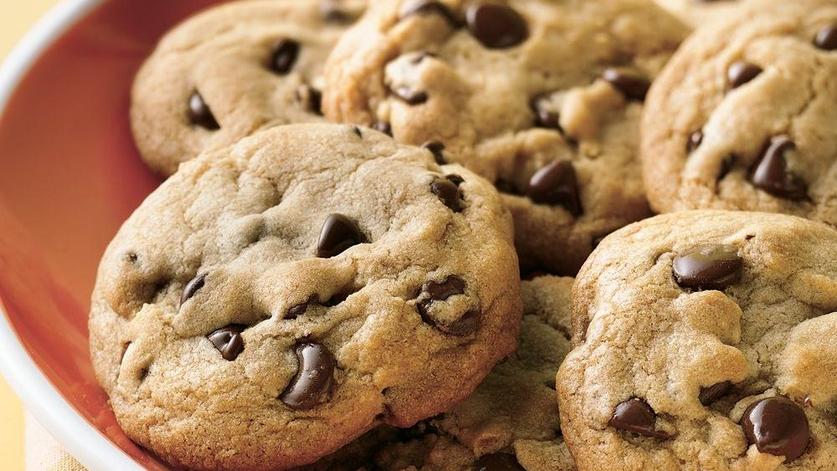
Chocolate Chip Cookies
Servings: 4 dozen
Contributed by:
Barb and Tim Burkemper
Ingredients
2 ¼ cups flour
1 teaspoon baking powder
1 teaspoon salt
¾ cup sugar
¾ cup brown sugar
1 cup real butter, melted
2 eggs, lightly beaten
3 teaspoons vanilla
½ teaspoon water
12 ounce package of semi-sweet chocolate chips
Directions
Pre-heat oven to 350°F.
Combine flour, baking powder and salt, set aside.
Melt two sticks of real butter and combine with sugar and brown sugar.
Add in beaten eggs, vanilla, and water. Mix well.
Slowly mix in flour mixture. When smooth, stir in chocolate chips by hand.
Refrigerate dough for 1-2 hours to stiffen.
Using a small scoop or spoon, drop on a greased cookie sheet. (I use air-bake cookie sheets, as the bottoms will not burn.)
Bake until the first hint of brown appears on the bottom (the middle will not quite be fully baked) for a soft, gooey cookie, or bake more thoroughly for a well-done cookie (your choice).
2016 Mosaic Black 2SS
“Nightcrawler”
Gateway Camaro Club
2016

Slide 18
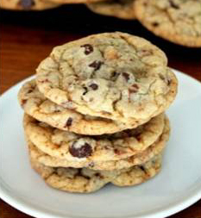
Heath Bar
Chocolate Chip Cookies
Servings: 4-5 dozen
Ingredients
2 ¼ cups flour
1 teaspoon baking soda
1 teaspoon salt
1 cup (2 sticks) butter, softened
¾ cup granulated sugar
¾ cup packed brown sugar
1 teaspoon vanilla
2 large eggs
2 cups semi-sweet chocolate morsels
1 bag Heath Milk Chocolate Toffee Bits
Contributed by:
Jeff and Tessie Duecker
Directions
Preheat oven to 375°F.
Combine flour, baking soda, and salt in a small bowl.
Beat butter, granulated sugar, brown sugar and vanilla until creamy.
Add eggs, one at a time, mixing well after each one.
Gradually, beat in flour mixture. Stir in chocolate morsels and toffee bits.
Drop rounded tablespoons onto ungreased baking sheet.
Bake 9-11 minutes or until golden brown. Wait two minutes, then transfer to a cooling rack.
1974 GM Medium Red Camaro LT
“The Sleeper”
Gateway Camaro Club
2016

Slide 19
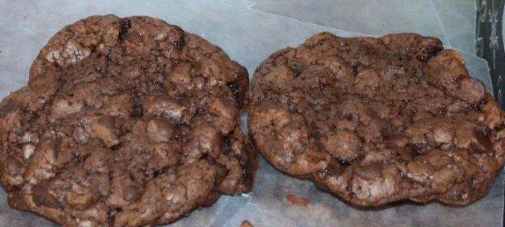
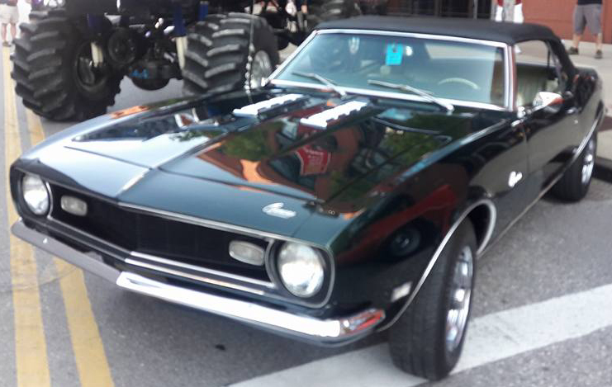
Easiest Cookie
Ever
Contributed by:
Heather and John Flaherty
Ingredients
1 box cake mix (any flavor)
½ cup vegetable oil
2 eggs (room temperature)
2 cups (approximately) of chips (any flavor) or nuts
Directions
Preheat oven to 350°F.
Sift cake mix and then combine it with the remaining ingredients until blended.
Spoon dough onto cookie sheets and bake for 8-12 minutes.
Let rest on cookie sheets for 1-2 minutes, then transfer to wire racks to cool completely.
1968 British Green Camaro
Gateway Camaro Club
2016

Slide 20
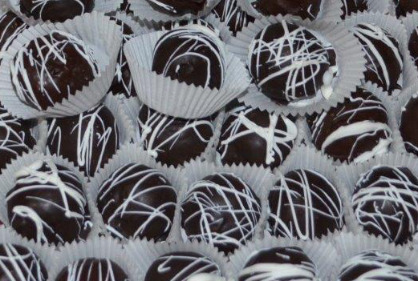
Oreo Cookie Balls
Ingredients
1 package Oreos
1 block of cream cheese
Candy Melts (color and flavor of your choice) –
one for dipping and one for decorating
Contributed by:
John and Heather Flaherty
Directions
Crush one package of Oreos in a food processor until finely ground. Do not over process them.
Add one block of cream cheese, softened, and mix until blended.
Roll into balls and place in refrigerator for 30 – 45 minutes to become firm.
In a microwave-safe bowl, add candy melts (this is the tricky part). Melt these slowly in 10 – 20 second intervals, using the heat of the bowl to help melt the candy.
Once melted, dip each ball into the melted candy and let sit.
Once all of the balls have been dipped, melt the decorating color candy using the same method.
Dip tines of a fork into the decorating color and drizzle over the balls.
Note: These must be kept refrigerated.
1968 British Green Camaro
Gateway Camaro Club
2016

Slide 21
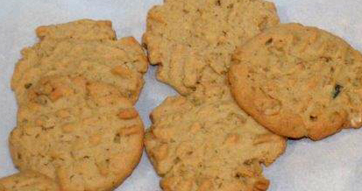
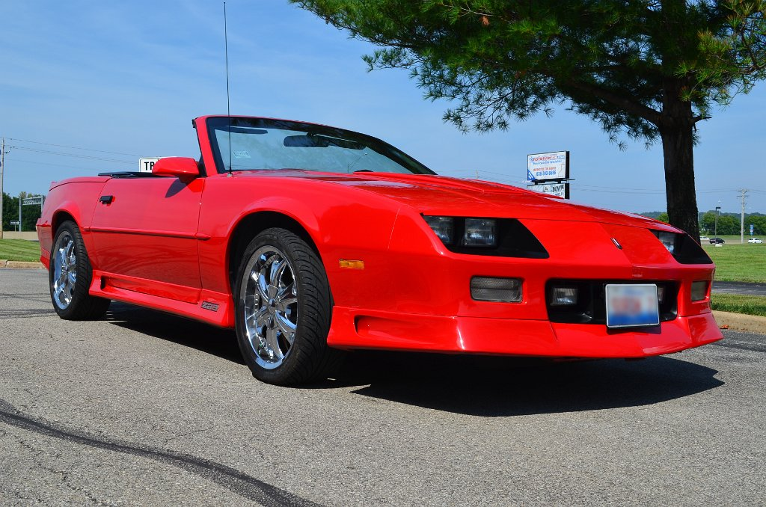
Peanut Butter Cookies
Servings: 4 dozen
Ingredients
1 ½ cups all-purpose flour
½ teaspoon baking powder
½ teaspoon baking soda
½ teaspoon salt
½ teaspoon ground cinnamon
2 ½ cups Heartland Natural Cereal Plain,
Coconut, or Raisin
1 cup creamy peanut butter
½ cup butter or margarine, softened
½ cup firmly packed brown sugar
½ cup granulated sugar
2 eggs
1 teaspoon vanilla
Contributed by:
Judy and Dennis Shoreack
Directions
Preheat oven to 375°F.
Sift together flour, baking powder, baking soda, salt, and cinnamon.
Stir in Heartland cereal, creamy peanut butter, and eggs.
Stir in vanilla, gradually add with dry ingredients.
Form a 1″ball, place on an ungreased cookie sheet.
Press flat with greased fork to create a waffle design.
Bake 8 – 10 minutes or until light brown.
1991 Red Z28
“Zoom”
Gateway Camaro Club
2016

Slide 22
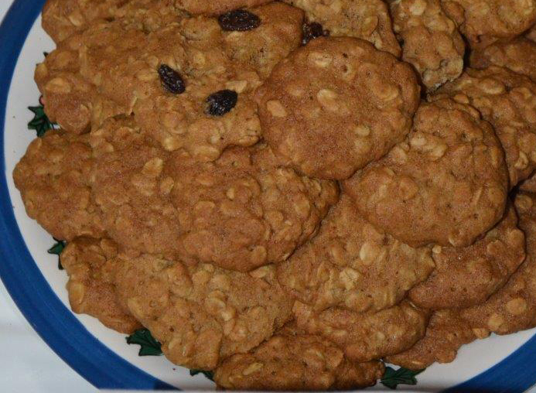
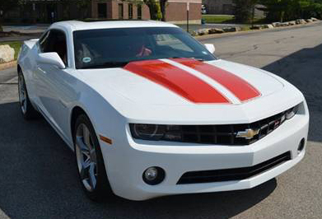
Oatmeal Cookies
Servings: 4 dozen
Contributed by:
Darryl and Jacquie Stanfield
Ingredients
1 cup (2 sticks) margarine or butter, softened
1 cup firmly packed brown sugar
½ cup granulated sugar
2 eggs
1 teaspoon vanilla
½ tablespoon honey
1 ½ cups all-purpose flour
1 teaspoon baking soda
1 ½ teaspoon cinnamon
½ teaspoon salt (optional)
3 cups Quaker Oats (old fashioned, uncooked)
1 cup raisins (optional)
Directions
1. Heat oven to 350°F.
2. Beat together margarine and sugars until creamy.
3. Add eggs and vanilla and honey; beat well .
4. Add combined flour, baking soda, cinnamon and salt; mix well.
5. Stir in oats (+ raisins); mix well.
6. Drop by rounded tablespoonfuls onto ungreased cookie sheet.
7. Bake 10 - 12 minutes or until golden brown.
8. Cool 1 minute on cookie sheet; remove to wire rack.
2010 Summit White & Inferno Orange RS LT
Gateway Camaro Club
2016

Slide 23
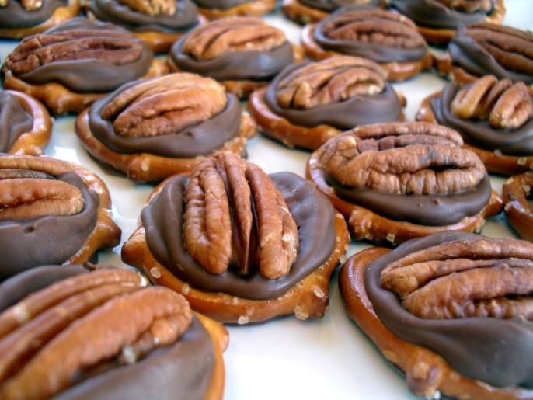
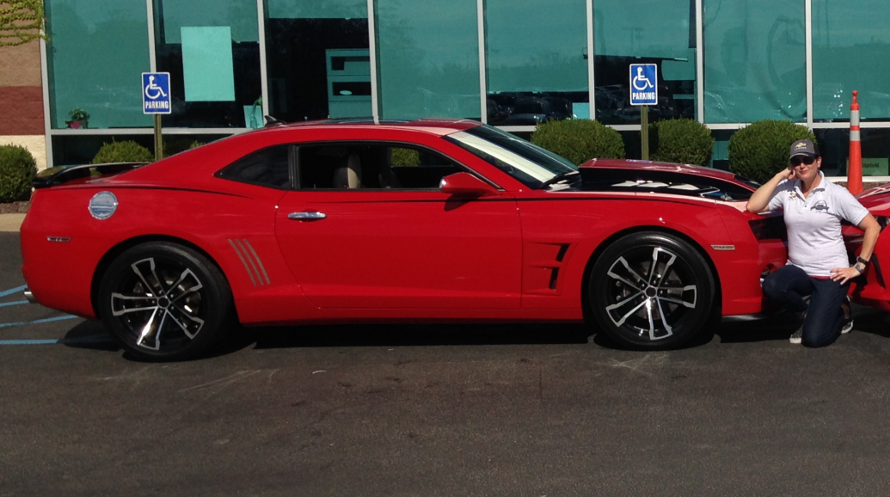
Rolo Pretzel Turtles
Total time: 7 minutes
Servings: Varies
Ingredients
Rolo chocolate Candies
Mini pretzels
Nuts – toasted (pecans/almonds/hazelnuts/walnuts)
Contributed by:
Christine Crocker
Directions
Preheat oven to 350°F.
Unwrap your Rolos.
Place pretzels on baking sheet. Top with a Rolo.
Bake in oven for 3-5 minutes, until the chocolate just begins to melt. The Rolo should be soft but not completely melted.
Remove from oven, place on cooling rack and immediately squish the chocolate with a nut. Watch the caramel ooze out.
Important: Eat as many as you can while they are still warm. Go ahead, I give you permission to stuff yourself with sugar.
2010 Victory Red SS/RS
“Sexy Beast!”
Gateway Camaro Club
2016

Slide 24
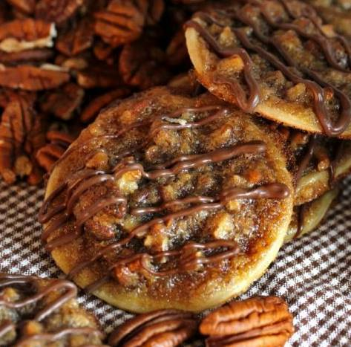
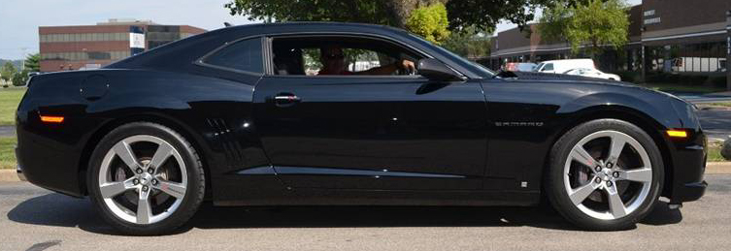
Pecan Pie Cookies
Total time: 25 minutes
Contributed by:
Vicki and Mark Church
Ingredients
Directions
1 prepared single pie crust
(homemade or Pillsbury)
2 tablespoons unsalted butter, melted
½ cup pecans, chopped
⅓ cup packed brown sugar
¼ cup corn syrup
2 eggs
⅛ teaspoon salt (optional, pie crust has salt)
¼ cup cinnamon chips for decorating
(crucial for more flavor!)
Preheat oven to 400°F.
Combine butter, pecans, brown sugar, corn syrup, salt and eggs.
While constantly stirring, cook on the stove top over medium-low heat just until thickened. (You don't want it dry, just slightly thickened, about the consistency of pudding). Remove from heat and set aside.
Unroll dough and using a 3" cookie cutter, cut out circles. Gently fold about ⅛″ - ¼ " up on the edges (optional).
Place pie crust on a parchment-lined pan (it's important to line it) and bake for 3-4 minutes, then top each circle with 1 tablespoon of the pecan mixture and cook for about 5 more minutes.
Remove from oven and cool on a wire rack.
Place chocolate chips in a small Ziploc bag (use brand name, the store brands tend to leak).
Microwave about 15 seconds or until mostly melted. Snip off a tiny corner of the baggie and drizzle chocolate over the cookies.
Cool until set.
2010 Black SS
“Terminator”
Gateway Camaro Club
2016

Slide 25
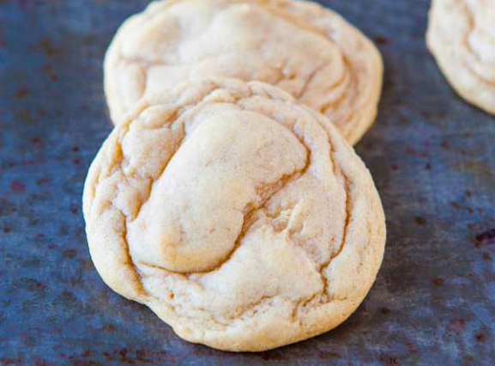
The Best Snickerdoodles
Total time: 90+ minutes
Servings: 14 cookies
Ingredients
Contributed by:
Vicki and Mark Church
Directions
Dough ½ cup unsalted butter, softened ½ cup granulated sugar ⅓ cup light brown sugar, packed 1 large egg 1 teaspoon vanilla extract 1 ½ cups all-purpose flour ½ teaspoon baking soda ¼ teaspoon cream of tartar ¼ teaspoon salt, optional and to taste
For Rolling ¼ cup granulated sugar 2 teaspoons cinnamon
Dough
With a stand mixer fitted with the paddle attachment (or large mixing bowl and electric mixer) combine the butter, sugars, and beat on medium-high speed until creamed and well combined, about 3 minutes.
Stop, scrape down the sides of the bowl, and add the egg, vanilla, and beat on medium-high speed until well combined, light and fluffy, about 3 minutes.
Stop, scrape down the sides of the bowl, and add the add the flour, baking soda, cream of tartar, optional salt, and beat on low speed until just combined, about 1 minute.
Using a medium 2-inch cookie scoop or your hands, form approximately 14 equal-sized mounds of dough (2 heaping tablespoons each), roll into balls, and flatten slightly.
Place mounds on a large plate or tray, cover with plastic wrap, and refrigerate for at least 1 hour, up to 5 days. Do not bake with unchilled dough because cookies will bake thinner, flatter, and be more prone to spreading.
Preheat oven to 350°F, line a baking sheet with a Silpat or spray with cooking spray.
For Rolling
In a small bowl, combine sugar, cinnamon, and stir to combine. Dredge each mound of dough through cinnamon-sugar.
Place dough mounds on baking sheet, spaced at least 2 inches apart and bake for about 9 minutes, or until edges have set and tops are just set, even if slightly undercooked, pale, and glossy in the center. Don't over bake for soft, pillowy cookies. For firmer cookies, bake a minute or two longer. Cookies firm up as they cool. Allow cookies to cool on baking sheet for about 10 minutes before serving.
Cookies will keep airtight at room temperature for up to 1 week or in the freezer for up to 6 months. Alternatively, unbaked cookie dough can be stored in an airtight container in the refrigerator for up to 5 days, or in the freezer for up to 4 months.
2010 Black SS
“Terminator”
Gateway Camaro Club
2016

Slide 26
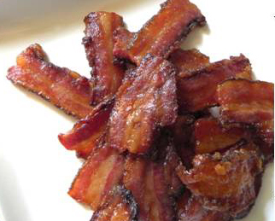
Sweet Synergy
(Caramelized Bacon)
Servings: Varies
Ingredients
½ cup light brown sugar, lightly packed
2 teaspoons sea salt
¼ cup mustard (spicy brown)
1 teaspoon freshly ground black pepper
½ pound thick-sliced bacon
You can also use these ingredients if you like to add your own unique taste:
Crushed pecans
Maple syrup
Cayenne pepper
Contributed by:
Tim Jezeski
Directions
Preheat the oven to 375°F.
Use aluminum foil for easy cleaning.
Combine the brown sugar, salt, and pepper in a mixing bowl.
Cut each bacon slice in half and line up the pieces in the baking sheet without touching.
With a baster, evenly spread the mustard on each piece of bacon.
With a spoon, evenly spread the brown sugar mixture on top of each piece of bacon, using all of the mixture.
Bake for 25-30 minutes, until the topping is very browned, but not burnt. If it is underbaked, the bacon won’t crisp as it cools.
While hot, transfer the bacon to a plate lined with wax paper and set aside to cool. Serve at room temperature. (The caramelized bacon can be made early in the day and stored at room temperature.) Enjoy!
2010 Synergy Green
“Synergy”
Gateway Camaro Club
2016

Slide 27
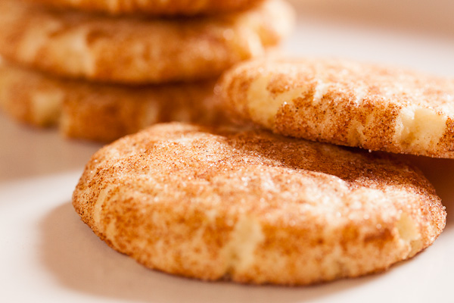
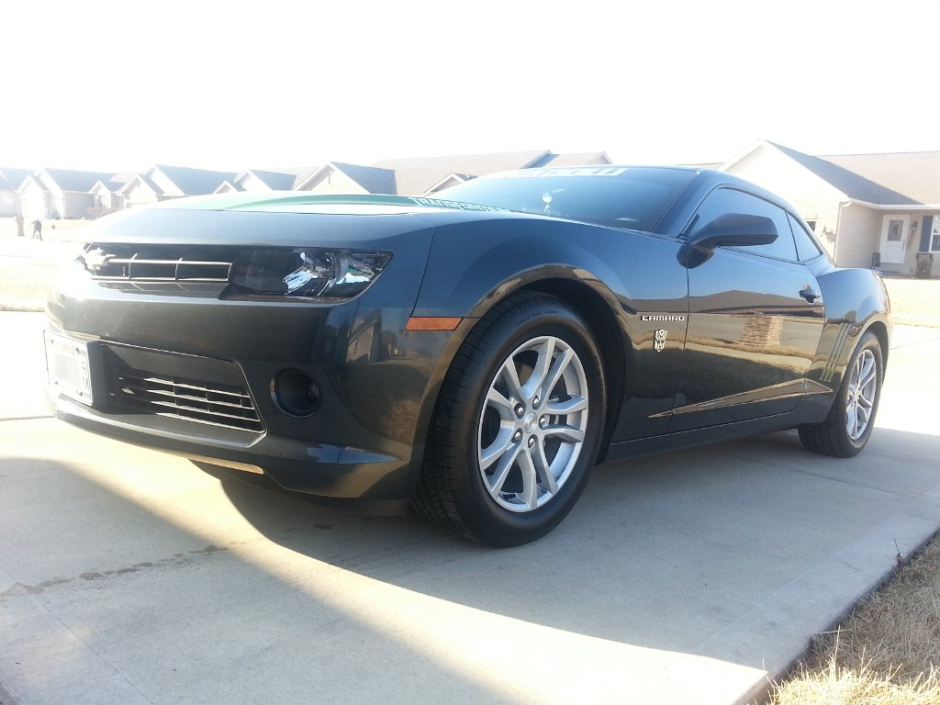
Shadow Doodles
(Snickerdoodles)
Servings: 66 cookies
Ingredients
3 ¾ cups all-purpose flour
½ teaspoon baking soda
½ teaspoon cream of tartar
1 cup butter or margarine
2 cups sugar
2 eggs
¼ cup milk
1 teaspoon vanilla
3 tablespoons sugar
1 teaspoon ground cinnamon
Contributed by:
Theresa Jezeski
Directions
Preheat oven to 375°F.
Grease cookie sheet.
Stir together flour, soda, cream of tartar, and ½ teaspoon salt.
Beat butter for 30 seconds; add the 2 cups sugar and beat until fluffy.
Add eggs, milk, and vanilla; beat well.
Add dry ingredients to beaten mixture, beat until well-combined.
Form dough into 1-inch balls; roll in mixture of 3 tablespoons sugar and cinnamon.
Place balls 2″ apart on the cookie sheet; flatten with the bottom of a drinking glass.
Bake for 8 minutes, or until lightly golden.
2014 Ashen Gray Metallic
“Shadow”
Gateway Camaro Club
2016

Slide 28
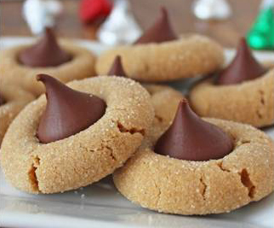
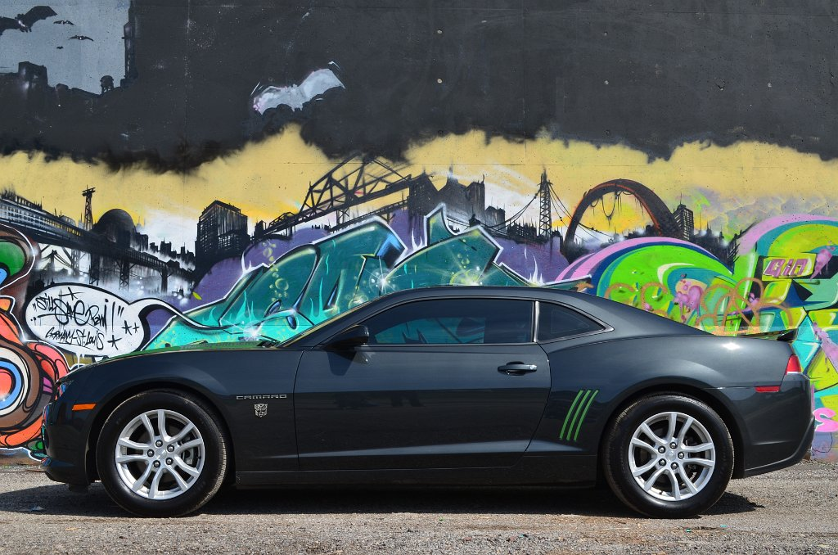
Autobot Blast/Autobot Blasters
(Peanut butter with Kisses)
(Peanut butter Biscoff with Kisses)
Servings: 48 cookies
Ingredients
1 ¼ cups all-purpose flour
¾ teaspoon baking soda
¼ teaspoon salt
½ cup peanut butter
½ cup granulated sugar
½ cup packed brown sugar
½ cup of Locus Biscoff Cookies ground fine (optional – Blaster part)
1 egg
½ teaspoon vanilla
1 package of Hersey Kisses
Contributed by:
Theresa Jezeski
Directions
Preheat oven to 375°F.
Stir together flour, soda, and salt.
In a mixer, beat butter for 30 seconds. Add peanut butter and sugars; beat until fluffy.
Add egg and vanilla; beat well.
Add dry ingredients to beaten mixture (using Biscoff to mix in); beat until well combined.
Shape dough into 1″ balls; roll in granulated sugar, if desired.
Place inches apart on an ungreased cookie sheet; crisscross with a fork.
Bake for about 10 minutes. Cool for one minute before removing to a wire rack.
Place a Hersey Kiss on top of each one for a treat!
2014 Ashen Gray Metallic
“Shadow”
Gateway Camaro Club
2016

Slide 29
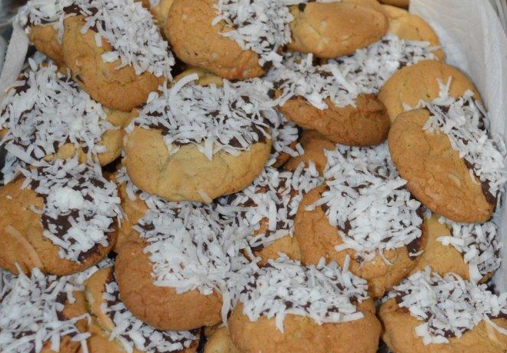
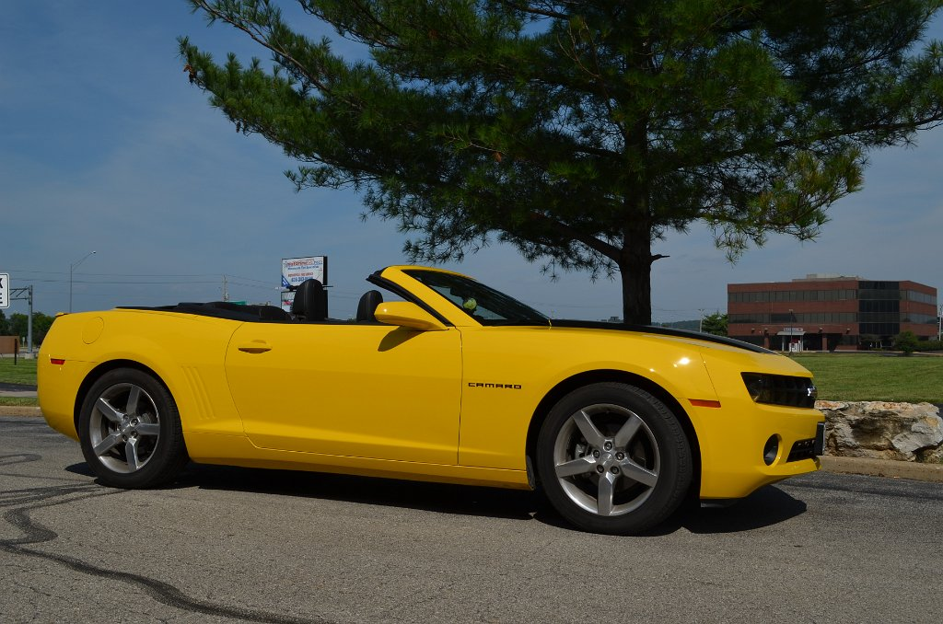
Chococonut Cookies
Contributed by:
Sharon Mariam
Directions
Ingredients
2 cups flour
1 tablespoon cornstarch
1 teaspoon baking soda
1 teaspoon salt
1 ½ sticks unsalted butter, melted
1 cup packed light brown sugar
½ cup granulated sugar
1 teaspoon almond extract
1 teaspoon vanilla extract
1 large egg, plus 1 egg yolk
3 cups semi-sweet chocolate chips
2 ⅓ cups sweetened, shredded coconut
2 teaspoons oil (not olive oil)
Preheat the oven to 350°F. Position racks in the upper and lower thirds of the oven.
Whisk the flour, cornstarch, baking soda, and salt in a medium bowl. Set aside.
Beat melted butter, brown sugar, granulated sugar, vanilla and almond extracts in a large bowl with a mixer on medium speed, until thick and creamy, about 2 minutes.
Beat in the egg and egg yolk.
Reduce mixer speed to low, beat in the flour mixture until just combined.
Stir in 1 cup each of the chocolate chips and shredded coconut.
Refrigerate the dough until firm enough to scoop, about 1 hour.
Line two baking sheets with parchment paper. Arrange tablespoon-sized scoops of dough about two inches apart on the baking sheets.
Bake, switching the pans halfway through, until lightly golden, about 12-14 minutes. Cool completely.
Put the remaining shredded coconut in a medium bowl.
Melt the remaining chocolate chips with the oil in a small saucepan over low heat, stirring constantly until smooth.
Dip each cookie partway in the melted chocolate, then immediately dip in the coconut.
Return to parchment-lined pans; refrigerate until set (30 minutes).
2013 Rally Yellow Convertible
Gateway Camaro Club
2016

Slide 30
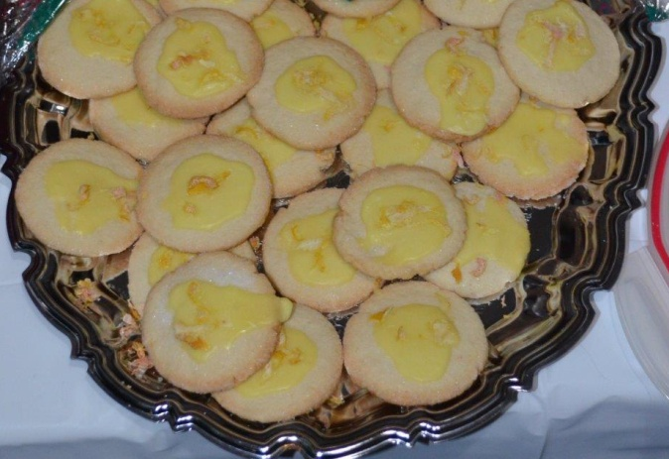
Double Lemon Delights
Contributed by:
Sharon Mariam
Ingredients
Directions
2 ¼ cups flour
½ teaspoon baking powder
½ teaspoon salt
1 cup softened butter
¾ cup granulated sugar
1 egg
2 tablespoons grated lemon peel, divided
1 teaspoon vanilla
Additional granulated sugar
1 cup powdered sugar
4-5 teaspoons lemon juice
Preheat oven to 375°F.
Combine flour, baking powder and salt in a small bowl. Set aside.
Beat butter and granulated sugar in a large bowl with electric mixer on medium speed until light and fluffy.
Beat in egg, 1 tablespoon lemon peel, and vanilla until well blended.
Drop dough by tablespoons onto parchment paper-lined cookie sheets, spacing 2″-3″ apart.
Flatten each cookie with the bottom of a small glass dipped in sugar.
Bake 10-12 minutes, or until the edges are golden brown.
Cool on the cookie sheets two minutes and remove to wire racks. Cool completely.
Combine powdered sugar, lemon juice, and remaining 1 tablespoon lemon peel in a small bowl.
Drizzle over cookies and let sit until icing is totally set.
2013 Rally Yellow Convertible
Gateway Camaro Club
2016

Slide 31
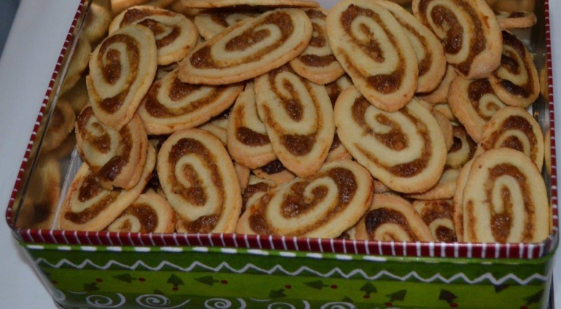
Apricot-Cream Cheese
Pinwheels
Contributed by:
Sharon Mariam
Ingredients
Pastry
1 cup unsalted butter at room temperature
1-8 ounce cream cheese at room temperature
¼ teaspoon salt
2 cups flour
Filling
2/3 cup apricot preserves
1 cup finely chopped walnuts
To assemble:
Roll the cold pastry into a 12″ x 14″ rectangle between two sheets of waxed paper on a floured pastry cloth with a floured rolling pin.
Spread filling to within ½ inch of the edges.
Roll up like a jelly roll from the long side; press seam firmly to seal.
Cut log in half. Wrap and chill until very firm or chill 30 minutes in the freezer.
Grease cookie sheets or use parchment paper.
With a very sharp knife, cut the rolls into ¼″ slices. Place ½″ apart on cookie sheets.
Bake 13 minutes, or until bottoms and edges are golden brown.
Remove from pans and place on racks to cool.
Directions
Preheat oven to 350°F.
To make pastry:
Beat butter, cream cheese, and salt in a large bowl with electric mixer until smooth.
With a fork, work in the flour until blended and mixture forms a smooth dough.
Using your hands, flatten the dough on plastic wrap to an 8 x 6″ rectangle.
Chill overnight.
To make filling:
Stir preserves and nuts in a small bowl until well blended.
2013 Rally Yellow Convertible
Gateway Camaro Club
2016

Slide 32
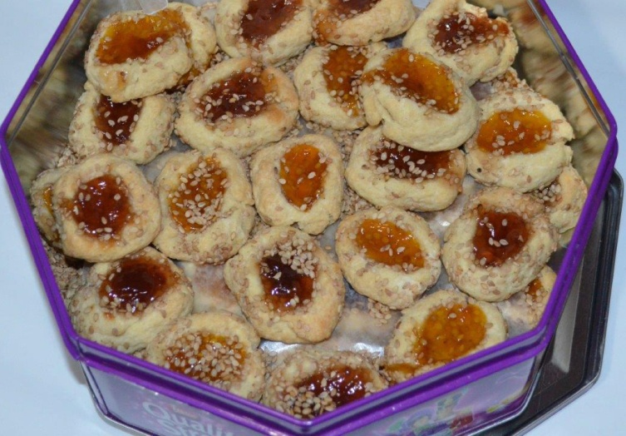
Apricot Sesame Thumbprint
Cookies
Ingredients
1 cup softened butter
½ cup sugar
1 teaspoon almond extract
2 cups flour
Toasted sesame seeds for rolling in
Apricot jam
1 egg, well beaten
Contributed by:
Sharon Mariam
Directions
Preheat oven to 400°F.
Cream butter and sugar until fluffy.
Add extract.
Add flour and salt and beat.
Add the beaten egg. Should be enough, but if not, beat another one and add just a little at a time for a good cookie consistency.
Roll into 1″ balls.
Roll in sesame seeds and then make an indentation with your thumb or with the rounded end of a baby spoon.
Fill with jelly and put on cookie sheets lined with parchment paper, about ½″ apart.
Bake for 12 minutes or until browned.
Photo of club member’s car
With or without club member’s photo
2013 Rally Yellow Convertible
Gateway Camaro Club
2016

Slide 33
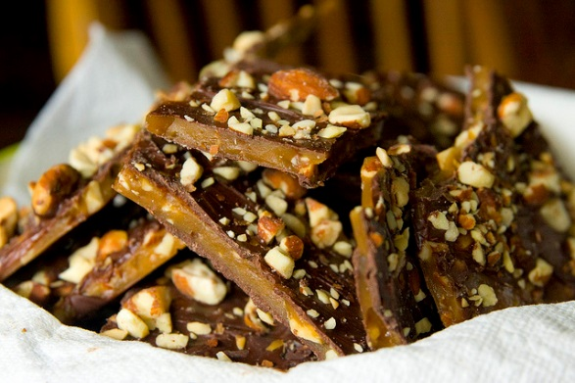
English Toffee
Total time: 30 minutes
Servings: 24 pieces
Contributed by:
Patty & Dan Wells
Ingredients
1 cup of chopped nuts (pecans or walnuts are best)
¾ cup of brown sugar, packed
½ cup of butter
½ cup of chocolate chips
Directions
Butter an 8x8 inch pan.
Spread the nuts in the bottom of the pan.
On medium heat, bring the sugar and butter to a boil and boil for 5 minutes.
Spread into the pan (pouring over the top of the nuts).
Sprinkle the chocolate chips on top. Do this while the sugar/butter is warm.
Let the chocolate chips melt for a few minutes the spread evenly.
Let candy cool completely before cutting into pieces.
Variations
White Chocolate with Macadamia Nuts or Dark Chocolate with Almonds
2010 2SS/RS Generation V
“Black Magic”
Gateway Camaro Club
2016

Slide 34
Christmas Snowballs
Total time: 45 minutes
Servings: 48 cookies
Ingredients
1 cup of butter, softened
½ cup of powdered sugar
1 teaspoon vanilla
2-1/4 cups of sifted flour
¼ teaspoon of salt
¾ cup of chopped walnuts
Extra powdered sugar for rolling backed cookies
Contributed by:
Dan and Patty Wells
Directions
Cream together butter and powdered sugar until light and fluffy; stir in vanilla.
Whisk together flour and salt; add gradually to butter mixture; still in chopped nuts.
Form dough into 1-1/4” balls and place onto parchment lined or ungreased baking sheets.
Bake at 400 degrees for 10-12 minutes or just until the cookies start to turn light golden brown; remove from oven and allow to cool slightly; while cookies are still warm, remove them from the baking sheets and roll in powdered sugar until coated.
Cookies may be rolled twice in the powdered sugar, but only after they have completely cooled to room temperature.
2010 2SS/RS Generation V
“Black Magic”
Gateway Camaro Club
2016

Slide 35
Cherry Dream Squares
Total time 45 minutes:
Servings: 12 squares
Ingredients (Preheat oven to 350 degrees)
For the crust
½ cup of butter
1 cup of flour
2 tablespoons of powdered sugar
(Blend together well, pour into a 8x8 square pan and press down)
For the filling
2 eggs
1 cup of brown sugar
¼ cup of flour
½ teaspoon of salt
2 teaspoons of baking powder
½ cup of cherries in a jar (chopped into large pieces)
1 teaspoon of vanilla
½ cup of chopped walnuts
½ cup of coconut
Contributed by:
Dan and Patty Wells
Directions
Beat eggs well, add sugar, flour, salt, baking powder and mix well. Add cherries, coconut, walnuts, and vanilla. Blend together. Pour mixture over crust and bake for 30 minutes. Test center with a tooth pick. If the center is runny place back in the oven and keeping checking until the center comes out clean.
2010 2SS/RS Generation V
“Black Magic”
Gateway Camaro Club
2016

