Slide 1
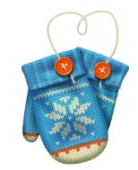
Holiday
COOKIE WALK
November 11, 2019

Slide 2
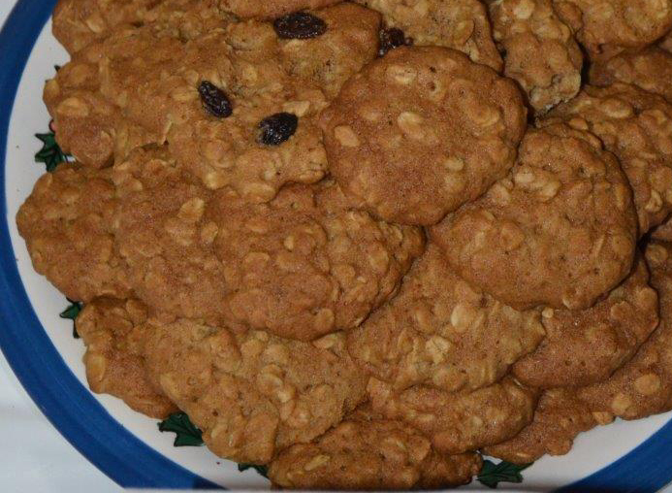
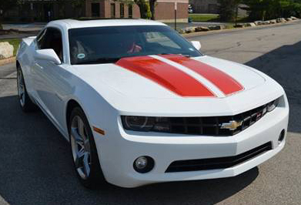
Oatmeal Cookies
Servings: 4 dozen
Contributed by:
Darryl and Jacquie Stanfield
Ingredients
1 cup (2 sticks) margarine or butter, softened
1 cup firmly packed brown sugar
½ cup granulated sugar
2 eggs
1 teaspoon vanilla
½ tablespoon honey
1 ½ cups all-purpose flour
1 teaspoon baking soda
1 ½ teaspoon cinnamon
½ teaspoon salt (optional)
3 cups Quaker Oats (old fashioned, uncooked)
1 cup raisins (optional)
Directions
1. Heat oven to 350°F.
2. Beat together margarine and sugars until creamy.
3. Add eggs and vanilla and honey; beat well .
4. Add combined flour, baking soda, cinnamon and salt; mix well.
5. Stir in oats (+ raisins); mix well.
6. Drop by rounded tablespoonfuls onto ungreased cookie sheet.
7. Bake 10 - 12 minutes or until golden brown.
8. Cool 1 minute on cookie sheet; remove to wire rack.
2010 Summit White & Inferno Orange RS LT
Gateway Camaro Club
2019

Slide 3
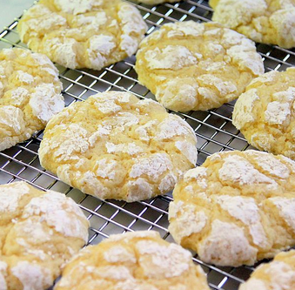
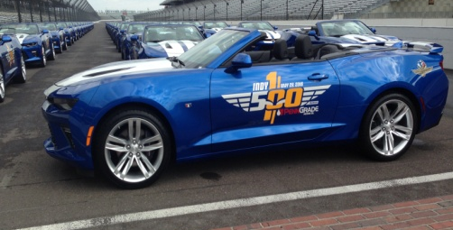
Gooey Butter Cookies
Total Time: 25 minutes
Servings: 25-30 cookies
Ingredients
1 (8 ounce) package cream cheese
½ cup butter, softened
1 egg
¼ teaspoon vanilla extract
1 package yellow cake mix
¾ cup confectioners sugar
Contributed by:
Jeanne & Kevin Walk
Directions
1. Heat oven to 350°F.
2. In a medium bowl, cream together the cream cheese and butter
3. Stir in the egg and vanilla
4. Add cake mix and stir until blended
5. Roll into 1 inch balls and roll the balls in the confectioners’ sugar
6. Place 2 inches apart onto a greased cookie sheet
7. Bake for 15 – 20 minutes in the oven
8. Lightly add more confectioners’ sugar
9. Remove from baking sheet to cool completely before storage
2016 Indy 500 Festival Car
Gateway Camaro Club
2019

Slide 4
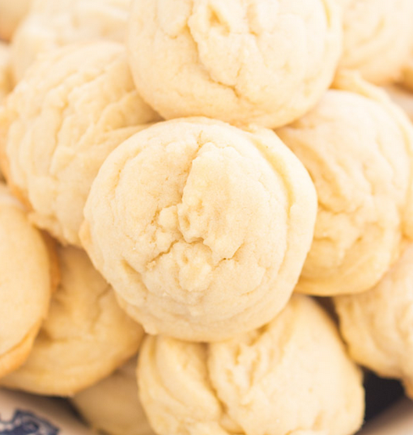
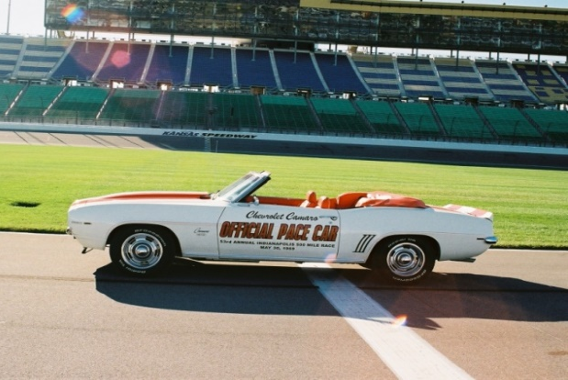
Amish Sugar Cookies
Total Time: 25 minutes
Servings: 4-5 dozen cookies
Contributed by:
Jeanne & Kevin Walk
Ingredients
1 cup butter, softened
1 cup vegetable oil
1 cup sugar
1 cup confectioners sugar
2 eggs
1 teaspoon vanilla extract
1 teaspoon almond extract
4-1/2 cups all purpose flour
1 teaspoon baking soda
1 teaspoon cream of tarter
Directions
1. Heat oven to 375°F.
In a large bowl, beat the butter, oil and sugars.
Beat in eggs until well blended.
Beat in vanilla & almond extract.
Combine the flour, baking soda and cream of tarter, gradually add to creamed mixture.
Drop small teaspoonfuls on ungreased baking sheets (small scooper).
Bake until lightly browned, 8 – 10 minutes. Remove and let cool (lighter cookies chewy and darker more crisp).
1969 Indy 500 Pace Car
Gateway Camaro Club
2019

Slide 5
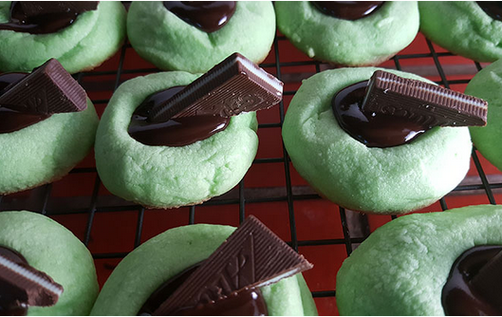
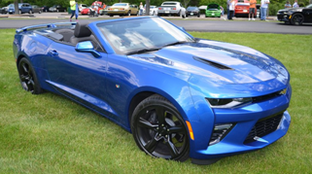
Chocolate Mint Thumprint Cookies
Servings: 36 cookies
Ingredients
1 cup butter softened
1 cup powdered sugar
1 ½ teaspoons peppermint extract
2 egg yolks
16 drops green food color
2 ¼ cups all-purpose flour
½ teaspoon baking powder
¼ teaspoon salt
¾ cup dark chocolate chips
3 tablespoons whipping cream
3 tablespoons butter
18 Andes Crème De Menthe candies cut in half diagonally
Contributed by:
Kathy & Mark Naylor
Directions
Heat oven to 350°.
Line cookie sheets with parchment paper.
In a large bowl, beat 1 cup butter and the powdered sugar with electric mixer on medium speed until light and fluffy.
Beat in peppermint extract, egg yolks and food color until blended.
On low speed, beat in flour, baking powder and salt.
Shape dough into 1-inch balls; place 2 inches apart on cookie sheets.
Using end of handle of wooden spoon, press a deep well into center of each cookie.
Bake 10 to 12 minutes or until set.
Reshape wells with end of handle of wooden spoon.
Cool 2 minutes; remove from cookie sheets to cooling racks. Cool completely, about 15 minutes.
In medium microwaveable bowl, microwave chocolate chips, cream and 3 tablespoons butter on high 1 minute, stirring frequently, until chocolate is melted and mixture is smooth.
Fill each well with about 1 teaspoon chocolate mixture; garnish with candy piece.
Let stand about 1 hour until chocolate is set.
2016 Hyper Blue Metallic Convertible
“Maximus”
Gateway Camaro Club
2019

Slide 6
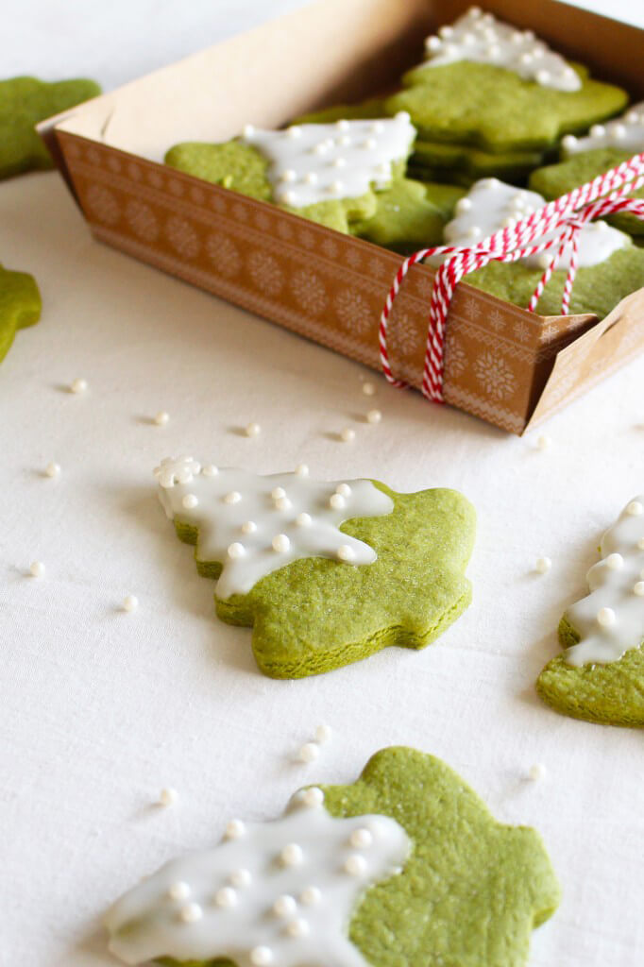
Christmas Tree Cookies
Servings: 20-24 cookies
Ingredients
Cookie
1 tablespoon Aiya Cooking Grade Matcha
2 cups all-purpose flour
1 teaspoon baking powder
5 ½ tablespoon unsalted butter
2/3 cup + 2 tablespoons sugar
1 egg
½ teaspoon vanilla extract
Frosting
1 cup powdered sugar
4 ½ -5 teaspoons water
A handful of white sugar pearl sprinkles
Other desired toppings
Contributed by:
Kathy & Mark Naylor
Directions
Sift the Matcha, flour, and baking powder together in a bowl.
Place butter in a bowl and allow it to come to room temperature. Once soft, mix it until it is smooth. Add the sugar in parts (1/3 to 1/2 at a time) until it is fully mixed into the butter and the entire mixture is white and smooth.
Beat the egg and mix into the butter/sugar mixture along with the vanilla extract. Once incorporated, fold the sifted ingredients into it in parts (1/3 to 1/2 at a time). Wrap the dough in plastic wrap, refrigerate for 30 minutes.
Lightly flour a working surface and roll out half the dough until it is about 1/10” thick. If the dough is too crumbly and dry, lightly knead the dough with a splash of water until a more solid dough forms. The edges of the dough may crack- this is normal. Place some water on your fingers and mend the cracks back together as best as you can.
Once rolled out, use a Christmas tree cookie cutter and place them on a cookie sheet lined with parchment.
Take the remaining scraps and combine it with the remaining dough. Repeat steps 4-5 with the rest of the dough.
Bake for about 10 minutes and allow the cookies to cool.
In a separate bowl, mix the powdered sugar and water. The icing should not be paste-like and not runny.
Once the cookies have cooled, spoon a small amount of icing on to the cookie, outlining where you want the “snow” to end. Once the outline is done, use the back of the spoon to smooth out the icing, making sure not to put too little or too much.
Add some white sugar pearl sprinkles (and any other desired toppings) and place on a drying rack to cool.
2016 Hyper Blue Metallic Convertible
“Maximus”
Gateway Camaro Club
2019

Slide 7
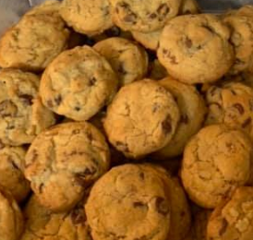
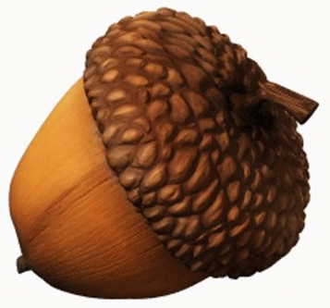
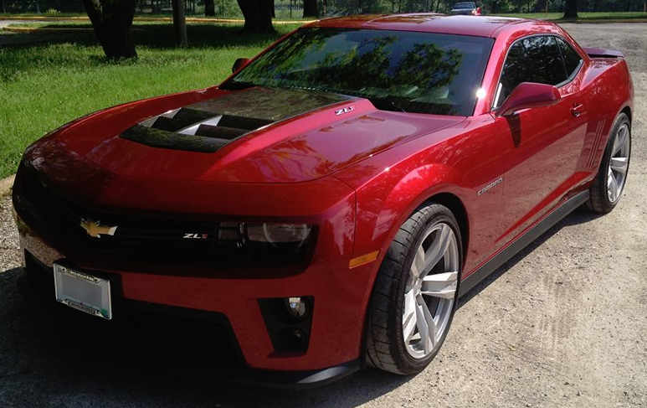
Chocolate Chip
Cookies
Servings: 5 dozen
Active time: 25 minutes
Total time: 40 minutes
Ingredients
2 ¼ cups flour
1 teaspoon baking soda
1 teaspoon salt
1 cup (2 sticks) butter, softened
¾ cup packed brown sugar
¾ cup granulated sugar
1 teaspoon vanilla extract
2 large eggs
2 cups Nestle’ Toll House Semi-Sweet Chocolate Morsels
1 cup chopped nuts
Directions
Preheat oven to 375 ̊F.
Combine flour, baking soda, and salt in small bowl.
Beat butter, granulated sugar, brown sugar, and vanilla extract in large mixer bowl until creamy.
Add eggs, one at a time, beating well after each addition.
Gradually beat in flour mixture.
Stir in morsels and nuts.
Drop by rounded tablespoon onto ungreased baking sheets.
Bake for 9 to 11 minutes or until golden brown.
Cool on baking sheets for 2 minutes; remove to wire racks to cool completely.
Contributed by:
Dee Troutt
2013 Crystal Red Tintcoat Camaro ZL1
Gateway Camaro Club
2019

Slide 8
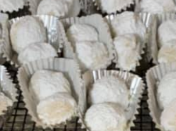
Butter Pecan Balls
Servings: 42-48 cookies
(Originally by Christy Augustin
of Pint Size Bakery on Watson Road)
Ingredients
¾ cup pecans
1 cup (2 sticks) butter
½ cup plus 1 tablespoon powdered sugar, plus more for dusting
½ teaspoon kosher salt
1 teaspoon vanilla extract
2 cups plus 2 tablespoons unbleached all-purpose flour
Contributed by:
Dee Troutt
Directions
Preheat oven to 350 ̊F.
Toast pecans 8-10 minutes, or until golden brown and fragrant. Chop into medium to small pieces, depending on desired texture.
Increase the oven to 375 ̊F. Blend together the butter, sugar, salt, and vanilla using the paddle attachment of a stand mixer or a handheld beater. Blend until the mix is light and fluffy.
Scrape the bowl well with a rubber spatula and add the flour. Mix just until combined. Add the cooled, chopped nuts and continue mixing until incorporated (this stage might be best done by hand if you do not have a good stand mixer).
Using a small cookie scoop (or tablespoon and your hands), scoop the cookies into uniform balls, chill thoroughly or freeze. Transfer to a parchment-lined cookie sheet and bake the chilled or frozen dough until very lightly golden (tops will take on very little color, but the bottoms will be darker and more firm), about 10 to 12 min. If desired, make only a partial batch and save the chilled or frozen dough balls for future use.
Cool the baked cookies for 5 minutes before tossing them in additional sifted powdered sugar. Let the cookies cool completely while resting in the sugar and then toss one more time for a beautiful coating. The trick of coating the cookies once while slightly warm makes a silky first layer of sugar that is almost like icing. The baked cookies will stay fresh for several days in a tightly sealed container.
2013 Crystal Red Tintcoat Camaro ZL1
Gateway Camaro Club
2019

Slide 9
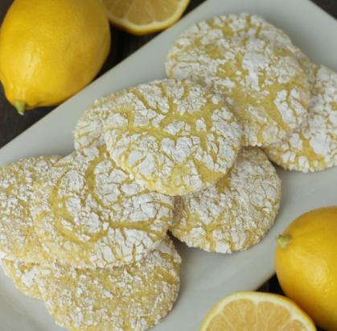
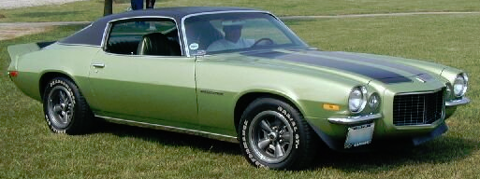
Lemon Snowflake Cookies
Ingredients
1 box lemon cake mix
2 cups Cool Whip
1 egg
Powdered sugar
Contributed by:
Mary and Chuck Connoyer
Directions
Preheat oven to 350 ̊F.
Mix lemon cake mix, Cool Whip, and egg together.
Roll dough into 1 inch balls and roll in powdered sugar
Bake for 10 minutes.
1972 Gulf Green
Camaro RS
Gateway Camaro Club
2019

Slide 10
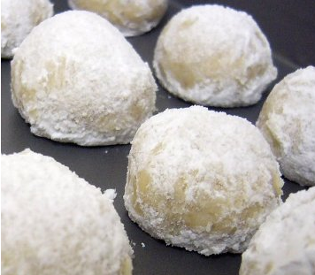
Russian Tea Cakes
Ingredients
1 cup butter
1 teaspoon vanilla
½ cup sifted powdered sugar
2 ¼ cup flour
½ teaspoon salt
¾ cup chopped pecans
Contributed by:
Mary and Chuck Connoyer
Directions
Preheat oven to 400 ̊F.
Mix all ingredients together and form into one large ball.
Chill mixture.
Make into small balls and place on an ungreased cookie sheet.
Bake for 10-12 minutes.
While still warm, roll in powdered sugar twice to completely coat.
1972 Gulf Green
Camaro RS
Gateway Camaro Club
2019

Slide 11
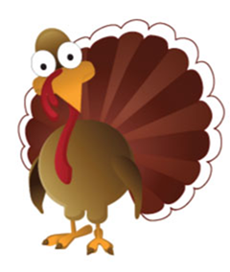
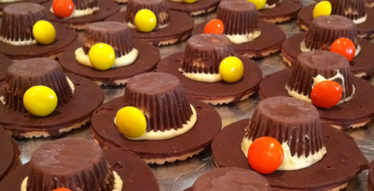
Pilgrim Hat Cookies
Servings: 48 cookies
Ingredients
Chocolate striped shortbread cookies
Miniature Reese’s Peanut Butter Cups
M&M’s or other decorations
Directions
Attach a Reese’s Peanut Butter Cup in the center of the shortbread cookie with icing.
Pipe more icing around the cup.
Decorate with an M&M or whatever for the buckle of the hat.
Contributed by:
Mary & Chuck Connoyer
1972 Gulf Green
Camaro RS
Gateway Camaro Club
2019

Slide 12
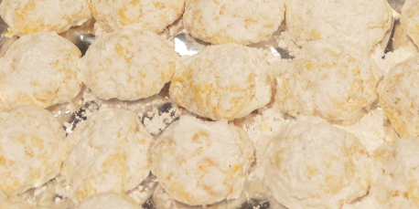
Gooey Butter Cookies
Servings: varies
Ingredients
1 yellow cake mix
1 8oz package of cream cheese, softened
1 stick butter, softened
1 teaspoon vanilla
1 egg
Powdered sugar
Contributed by:
Mary & Chuck Connoyer
Directions
Preheat oven to 350 ̊F.
Lightly grease cookie sheets.
Beat the butter, vanilla, egg, and cream cheese until light and fluffy.
Mix in the dry cake mix.
Cover and chill for 30 minutes.
Drop teaspoon-sized dough into a bowl of powdered sugar and roll into a ball.
Bake about 12 minutes until golden brown.
1972 Gulf Green
Camaro RS
Gateway Camaro Club
2019

Slide 13
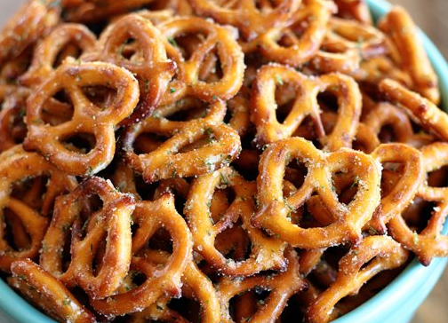
Crack Pretzels
Servings: varies
Ingredients
1 -16oz bag of mini pretzels
½ cup of oil
1 pkg of Hidden Valley Ranch Dressing (dry)
¼ teaspoon of onion powder
¼ teaspoon of garlic powder
¼ teaspoon of dill weed
Directions
Mix oil, dressing, and spices.
Pour mixture over pretzels in a large container.
Shake well to coat pretzels and place them on paper towels.
Once dry, place them in a covered/sealed container.
Contributed by:
Mary & Chuck Connoyer
1972 Gulf Green
Camaro RS
Gateway Camaro Club
2019

Slide 14
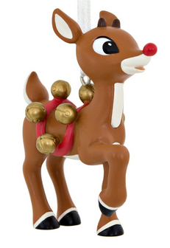
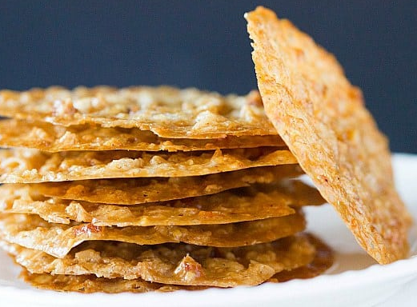
Thin Lace
Cookies
Ingredients
1 ½ cup Quick Quaker Oats
1 stick butter or margarine
¾ cup sugar
1 tablespoon flour
1 pinch of salt
1 teaspoon baking powder
1 egg, slightly beaten
1 teaspoon vanilla
Whole pecans
Contributed by:
Mary & Chuck Connoyer
Directions
Preheat oven to 350 ̊F.
Melt margarine and pour over oats; set aside.
Mix flour, sugar, salt, and baking powder in a separate bowl.
Add to oats and mix well.
Add egg and vanilla.
Line cookie sheet with aluminum foil.
Drop ½ tsp cookie dough on to cookie sheet.
Place whole pecan on top of dough (covering the dough).
Bake 10 minutes; cookies will spread.
Cool cookies before removing from foil.
1972 Gulf Green
Camaro RS
Gateway Camaro Club
2019

Slide 15
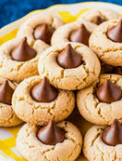
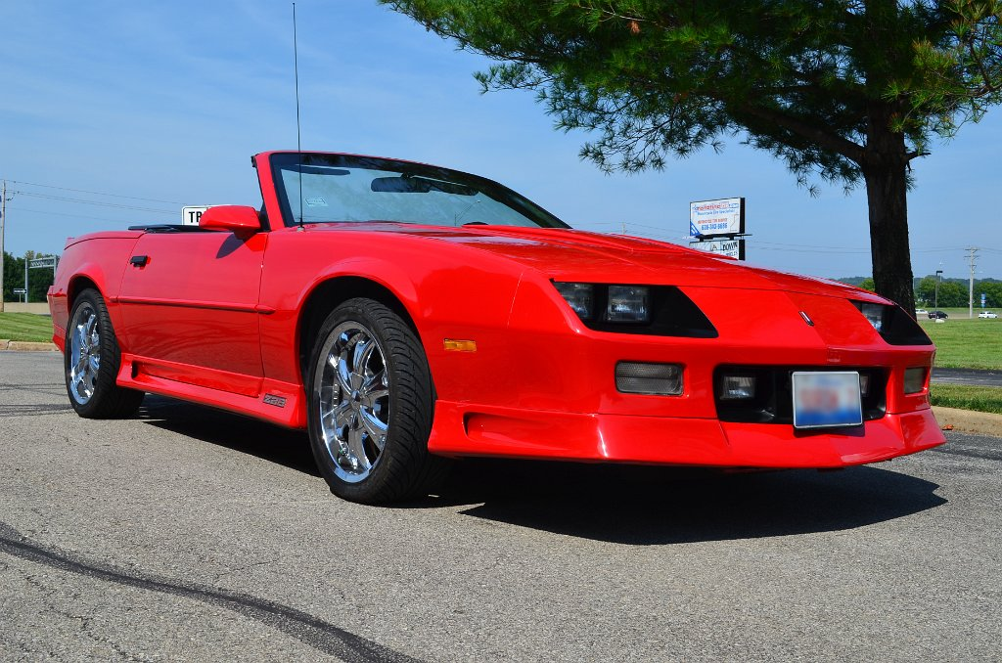
Peanut Butter Cookies with Kisses
Ingredients
1 cup white sugar
1 cup peanut butter
1 egg
1 teaspoon vanilla extract
30 chocolate Kisses
Directions
Contributed by:
Judy and Dennis Shoreack
Preheat oven to 350 degrees F.
Combine sugar, peanut butter, and egg.
Shape into 1 inch balls and place on ungreased cookie sheet. NOTE: If dough is too sticky, refrigerate 1/2 hour or until easy to handle.
Bake for 10 minutes. Remove cookies from oven. Press a chocolate kiss into the center of each warm cookie.
1991 Red Z28
“Zoom”
Gateway Camaro Club
2019

Slide 16
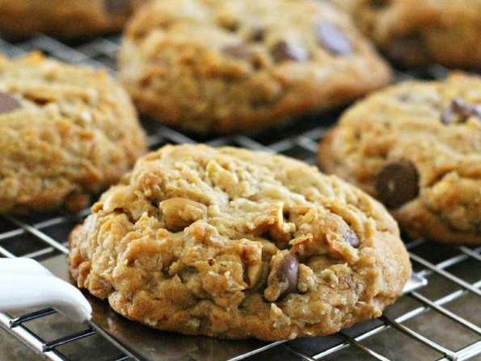
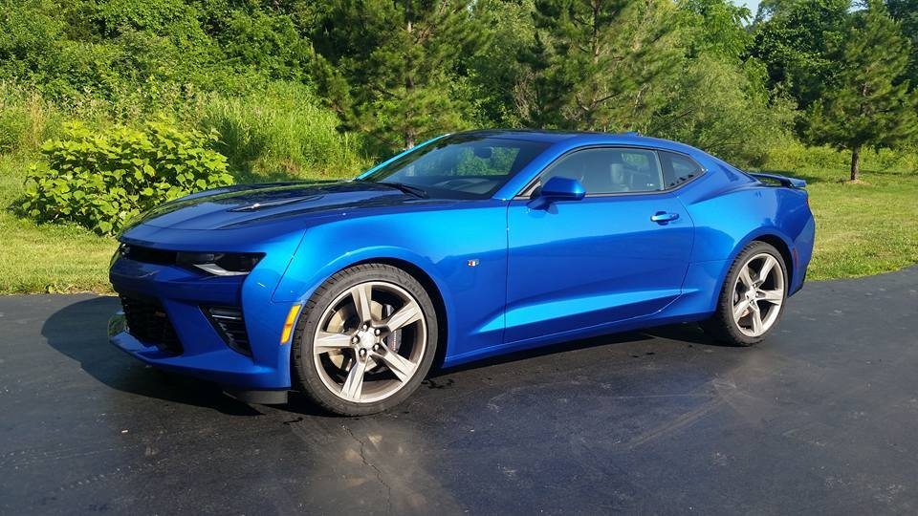
Cowboy Cookies
Ingredients
2 cups sifted flour
1 teaspoon baking soda
½ teaspoon salt
½ teaspoon baking powder
1 cup shortening (or butter)
1 cup sugar
2 eggs
1 teaspoon vanilla
2 cups Quaker – quick-one-minute oats
1 package chocolate chips
Contributed by:
Linda Kondrick
Directions
Preheat oven to 350°F.
Cream shortening, sugars, vanilla and eggs.
Beat well.
Stir in dry ingredients, then add oats and chips last.
Drop by teaspoon on greased cookie sheet.
Bake 13-15 minutes.
2016 Hyper Blue Metallic
“Blue Beauty”
Gateway Camaro Club
2019

Slide 17
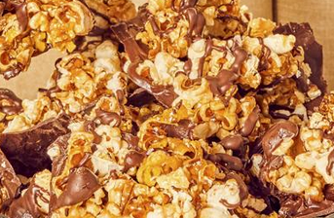
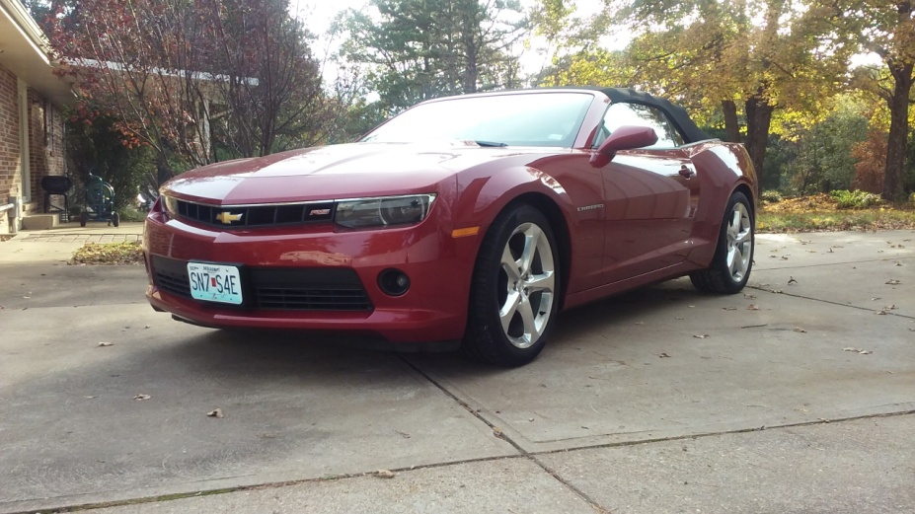
Dark Chocolate Popcorn Bark with Maple Caramel Glaze
Ingredients Maple-Caramel Glaze
¾ cup maple syrup
3 tablespoons whole milk
2 tablespoons unsalted butter
½ teaspoon baking soda
Pinch of salt
Dark Chocolate Popcorn Bark
10 cups plain popcorn
¾ cup maple-caramel glaze
1 ½ cups melted dark chocolate
Contributed by:
Bonnie & Louis Pfleckl
Directions
Maple-Caramel Glaze
In a small pot over medium heat, add maple syrup, and stir to bring the syrup to a boil.
Continue stirring approximately 15 minutes; syrup will start to bubble and stick to the sides of the pot
Lower the heat and add milk and butter, stirring occasionally until butter has melted. Remove from heat and whisk in baking soda and slat.
Allow to cool for 1-2 minutes before pouring over popcorn.
Dark Chocolate Popcorn Bark
Preheat oven to 275 ̊F and set rack to the middle of the oven.
Line a baking sheet with parchment paper and spread popcorn on top.
Pour maple-caramel glaze all over popcorn to coat.
Place pan in the oven and bake for 30-40 minutes, tossing popcorn every 15 minutes until desired consistency (30 minutes for semi-chewy and 40 minutes for more crunch).
Remove from the oven and cool to room temperature.
Line a rimmed baking sheet with parchment paper and pour ¾ of the melted dark chocolate onto it, reserving ¼ for later.
Scatter maple-caramel corn across the chocolate and drizzle the remaining chocolate on top of the popcorn; sprinkle with salt.
Set aside for the chocolate to cool completely; approximately 30 minutes at room temperature or
10-15 minutes in the refrigerator.
Once the chocolate has set, break the bark into chunks.
2015 Red Rock Metallic Convertible
“Cinnamon”
Gateway Camaro Club
2019

Slide 18
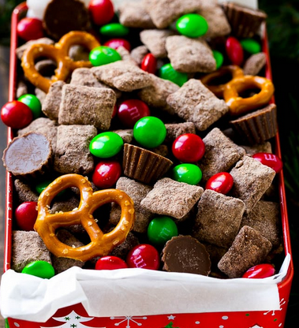
Reindeer Chow
Prep time 10 minutes
Cook time 1 minute
Total time 11 minutes
Servings 20
Calories 434kcal
Ingredients
6 cups Chex (rice, wheat, corn) cereal
1 cup semisweet chocolate chips
½ cup creamy peanut butter
1 cup dry brownie mix or 1 cup powdered sugar mixed with 1 ½ tbsp cocoa powder
1 bag Christmas M&M’s (10-12 oz bag)
Mini peanut butter cups (10-12 oz bag)
2 cups mini-pretzels
Contributed by:
Tim & Theresa Jezeski
Directions
Place the cereal in a large bowl. In a medium bowl, combine the chocolate chips and peanut butter. Microwave the chocolate mixture for 15 second intervals until melted; stir until smooth.
Pour the chocolate mixture over the cereal and use a spatula to gently toss the cereal in the chocolate until completely coated.
Place the brownie mix inside a resealable gallon-sized plastic bag. Add the chocolate-coated cereal. Seal, then shake gently until cereal is coated in the brownie mix.
Spread the cereal out in a single layer on a sheet of parchment paper; cool completely until dry.
Combine the cereal, M&M’s, peanut butter cups, and mini-pretzels, then serve.
2010 Synergy Green
“Synergy”
Gateway Camaro Club
2019

Slide 19
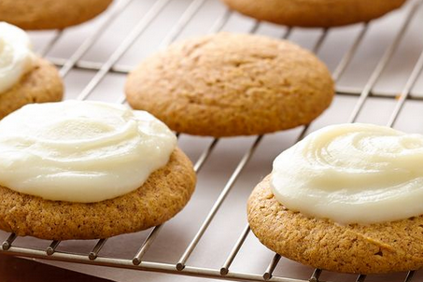
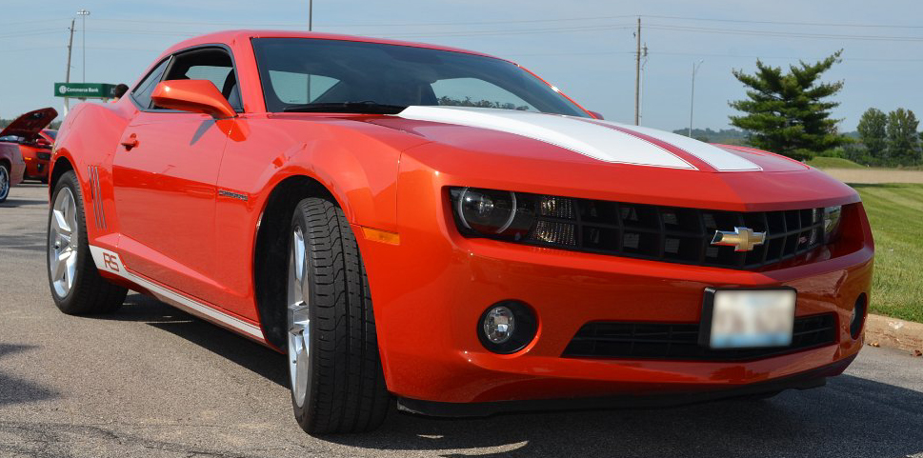
Pumpkin Cookies
Ingredients
Cookies
4 cups flour
2 cups oats, uncooked
2 teaspoon baking powder
2 teaspoon cinnamon
1 teaspoon salt
1-15oz can of pumpkin
1 cup nuts (optional)
2 teaspoon vanilla
1½ cups butter, softened
2 cups brown sugar
1 cup white granulated sugar
1 egg
1 cup chocolate chips
Cream cheese frosting
1 8oz cream cheese, softened
4 cups powdered sugar
2 tsp vanilla
¼ cup milk
Contributed by:
Vicki Schanuel & Dwayne Saul
Directions
Cookies
Preheat oven to 350 ̊F.
Combine flour, oats, baking powder, cinnamon, and salt; set aside.
Cream butter; gradually add sugars, beating until light and fluffy.
Add the egg and vanilla, mix well.
Alternate additions of dry ingredients and pumpkin, mixing well after each addition.
Stir in chocolate chips.
For each cookie, drop ¼ cup or a big spoonful of dough onto a lightly greased cookie sheet.
Bake 20-25 minutes, until cookies are firm and lightly browned.
Cream cheese frosting
In a separate bowl, slowly add the powdered sugar to the softened cream cheese.
Add the vanilla and then the milk; mix until stiff.
You may need to add more powdered sugar for stiffness.
2010 Inferno Orange RS
Gateway Camaro Club
2019

Slide 20
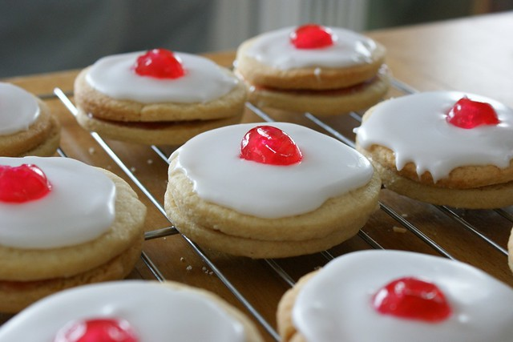
EMPIRE BISCUITS (COOKIES)
Total time: approx. 50 minutes
Servings: 24 cookies
Ingredients (Tender Tart Dough)
½ cup + 2 Tbsp unsalted butter, room temperature
½ cup + 2 Tbsp icing sugar, sifted
1 hard-boiled large egg yolk
1 large egg yolk
½ tsp vanilla extract
1 ¾ cup cake and pastry flour, sifted
¼ tsp salt
Icing and Assembly
⅓ cup raspberry jam
1 cup icing sugar, sifted
1-2 tablespoon warm water
¼ teaspoon almond or vanilla extract
6-8 glacée (candied) cherries, each chopped into 6 bits
Baking Directions: Tender Tart Dough
Beat the butter and icing sugar together until smooth.
Push the hard-boiled egg yolk through a sieve and stir the raw egg yolk and vanilla into it. Add this to the butter mixture and stir until blended.
Add the flour and salt to the butter mixture and stir until blended. Shape the dough into a disc (it will be very soft), wrap in plastic and chill until firm, about 2 hours.
Icing and Assembly
Preheat the oven to 325 F and line 2 baking trays with parchment paper.
On a lightly floured work surface, gently knead the dough just to soften it slightly. Roll out the dough to about ¼-inch thick and cut out cookies using a 2-inch fluted cookie cutter, placing the cookies on the baking trays, leaving ½-inch between them.
Bake the cookies for 10-12 minutes, until just lightly browned around the edges. Let the cookies cool completely on the baking trays before assembling.
Stir the raspberry jam to soften and spread a little on a cookie bottom and sandwich a second cookie on top, pressing gently to secure. Repeat with the remaining cookies.
For the icing, stir the whisk the icing sugar with 1 Tbsp of water and the almond or vanilla extract, add the remaining water if needed, until it is a thin icing consistency. Set aside.
Spread a thin layer of icing on top of each cookie, top with a piece of glacée cherry and set on a rack to dry. Let the cookies dry for about 3 hours before storing in an airtight container.
The cookies will keep, stored in an airtight container, for up to 3 days.
Contributed by:
Patty and Dan Wells

