Slide 1
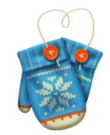
Holiday
COOKIE WALK
November 8, 2021

Slide 2
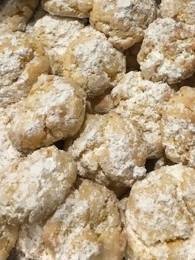
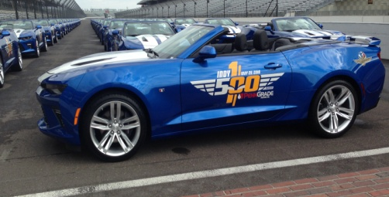
Gooey Butter Cookies
Total Time: 25 minutes
Yield: 25-30 cookies
Ingredients
Contributed by:
Jeanne & Kevin Walk
1 (8 ounce) package cream cheese
½ cup butter, softened
1 egg
¼ teaspoon vanilla extract
1 package yellow cake mix
¾ cup confectioner's sugar
Directions
1. Heat oven to 350°F.
2. In a medium bowl, cream together the cream cheese and butter.
3. Stir in the egg and vanilla.
4. Add cake mix and stir until blended.
5. Roll into 1-inch balls and roll the balls in the confectioners’ sugar.
6. Place balls 2 inches apart on a greased cookie sheet.
7. Bake for 15 to 20 minutes in the oven.
8. Lightly add more confectioners’ sugar.
9. Remove from baking sheet to cool completely before storage.
2016 Indy 500 Festival Car
Gateway Camaro Club
2021

Slide 3
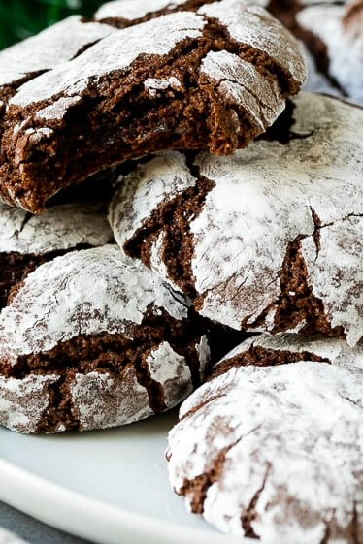
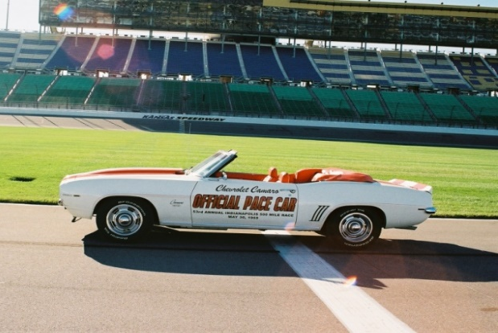
Chocolate Crinkle Cookie
Total Time: 1hr 50 minutes
Yield: 30 cookies
Ingredients
1 box Betty Crocker Super Moist devil’s food cake mix
1/3 cup vegetable oil
2 eggs
1 teaspoon vanilla
Powdered sugar
Contributed by:
Jeanne & Kevin Walk
Directions
Heat oven to 350°F (325°F for dark or nonstick cookie sheets).
In a large bowl, stir the cake mix, oil, eggs, and vanilla with spoon until dough forms.
Refrigerate the dough 15 to 30 minutes, or as needed for easier handling.
Shape dough into 1-inch balls; roll balls in powdered sugar.
On ungreased cookie sheets, place balls about 2 inches apart.
Bake 9 to 11 minutes or until set.
Cool 1 minute; remove from cookie sheets to cooling rack and cool completely, about 30 minutes.
Store tightly covered.
1969 Indy 500 Pace Car
Gateway Camaro Club
2021

Slide 4
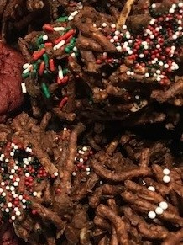
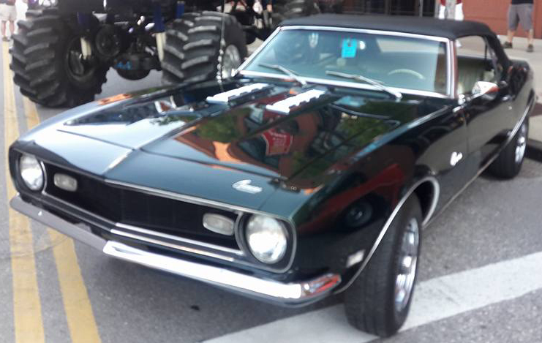
Holiday Haystacks
Active: 15 minutes
Total: 1 hr 15 minutes
Yield: 24 cookies
Ingredients
1 cup semisweet chocolate chips
1 cup milk chocolate chips
3 cups chow mein noodles
½ cup roughly chopped almonds
½ cup shelled pistachios
2 tablespoons assorted holiday sprinkles
Contributed by:
Heather and John Flaherty
Directions
Heat 2 inches of water in a pot to a simmer.
Add the semisweet and milk chocolate chips to a bowl and place over the pot of simmering water.
Allow chips to melt, stirring occasionally, 4 to 5 minutes.
Meanwhile, add the noodles, almonds, and pistachios to a large bowl and set aside.
When the chocolate has melted completely, pour over the noodle and nut mixture.
Mix until everything is well coated in the melted chocolate.
Using 2 spoons, drop tablespoon mounds onto 2 parchment-lined baking sheets;
sprinkle the holiday decorations over the top.
8. Allow to dry completely before storing, about 1 hour.
1968 British Green Camaro
Gateway Camaro Club
2021

Slide 5
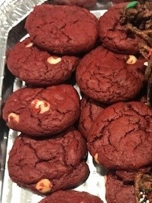
Red Velvet Cake Mix Cookie with White Chocolate Chips
Active: 10 minutes
Total: 45 minutes
Yield: 24 cookies
Ingredients
½ cup vegetable oil
½ teaspoon kosher salt
2 eggs
1 (15.25 oz) box of red velvet cake mix
¾ cup white chocolate chips
Directions
Preheat oven to 350°F.
In a medium-sized bowl, whisk together oil, salt,
and eggs until well combined.
Add the cake mix and mix until fully combined, about 2 minutes.
Refrigerate for 20 minutes.
Line 2 rimmed baking sheets with parchment paper.
Portion out heaping tablespoons of dough and roll them in your hands to form round balls.
Place each ball about 2 inches apart on the baking sheets.
(Note: the cookies will spread out considerably, so it is important to leave plenty of space.)
6. Bake in preheated oven for 10 to 12 minutes, just until the edges begin to brown slightly.
Allow the cookies to cool for 10 minutes on the baking sheet before removing them to a wire rack to
finish cooling.
Contributed by:
Heather and John Flaherty
1968 British Green Camaro
Gateway Camaro Club
2021

Slide 6
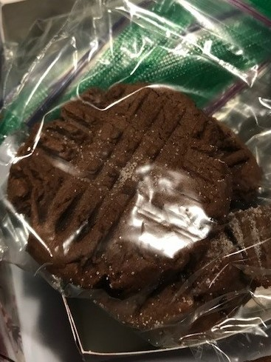
Chocolate Peanut Butter Cookies
Ingredients
½ cup shortening, regular or butter
flavored
¾ cup creamy peanut butter
1 ½ cups brown sugar, packed
3 tablespoons milk
1 teaspoon vanilla extract
1 large egg
1 ¼ cups all-purpose flour
½ cup unsweetened cocoa powder
1 teaspoon baking soda
½ teaspoon salt
Contributed by:
Tim & Theresa Jezeski
Directions
Preheat oven to 375°F.
In a large mixing bowl, beat together the shortening, peanut butter, brown sugar, milk, and vanilla with an electric mixer until well blended.
Add the egg and mix until just combined.
In a small mixing bowl, whisk together the flour, cocoa powder, baking soda, and salt.
Add the dry mixture to the wet mixture and stir until combined.
Scoop the cookie dough onto an ungreased cookie sheet to form 1 to 1 ½ inch dough balls.
Use a fork to press the dough down and create the traditional crisscross pattern on each cookie.
Bake for 7 to 8 minutes at 375°F, just until set around the edges.
Cool for 2 minutes on the cookie sheet, then transfer to a wire cooling rack.
2010 Synergy Green
“Synergy”
Gateway Camaro Club
2021

Slide 7
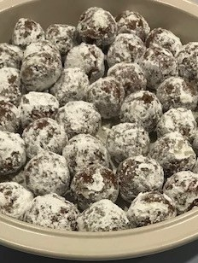
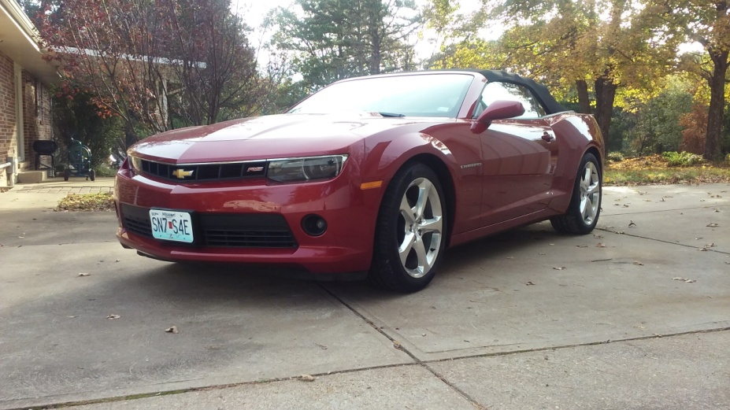
Easy, Festive (and Boozy!) Rum Balls
Total time: 30 minutes
Yield: 40 rum balls
Ingredients
3+ cups (311 g) vanilla wafers
(a whole box of Nilla wafers)
1 cup (120 g) confectioners’ sugar
(plus more for rolling)
2 tablespoons (10 g) cocoa powder
2 tablespoons (44 g) white corn syrup
1/3 cup rum, plus more, as needed
1 cup chopped walnuts
Contributed by:
Bonnie & Louis Pfleckl
Directions
Place vanilla wafers in a food processor and pulse into fine crumbs. (Alternatively, place vanilla wafers
into a Ziploc bag and bash them with a rolling pin until they are fine pieces).
2. Add confectioners’ sugar, cocoa, corn syrup, and walnuts and pulse until combined.
3. Add the 1/3 cup rum and pulse to combine.
4. If necessary, slowly add more rum to the food processor until the mixture comes together and forms a
mass around the blade or holds together when you pinch it.
5. Using a teaspoon, scoop out balls from the processor, roll them gently with your hands into irregular
shaped balls, and drop them into a plate (or shallow Tupperware) filled with a thin layer of
powdered sugar.
6. Shake the vessel to coat the balls, then transfer balls to an airtight storage container until you are
ready to serve them.
7. Store in the fridge or freeze for up to 3 months. (Bring to room temperature briefly before serving.)
2015 Red Rock Metallic Convertible
“Cinnamon”
Gateway Camaro Club
2021

Slide 8
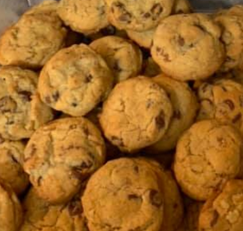
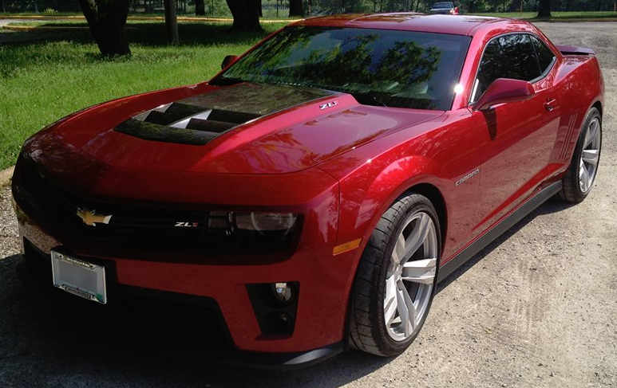
Chocolate Chip
Cookies
Active time: 25 minutes
Total time: 40 minutes
Yield: 5 dozen
Ingredients
2 ¼ cups flour
1 teaspoon baking soda
1 teaspoon salt
1 cup (2 sticks) butter, softened
¾ cup packed brown sugar
¾ cup granulated sugar
1 teaspoon vanilla extract
2 large eggs
2 cups Nestle’ Toll House Semi-Sweet Chocolate Morsels
1 cup chopped nuts
Directions
Preheat oven to 375 ̊F.
Combine flour, baking soda, and salt in small bowl.
Beat butter, granulated sugar, brown sugar, and vanilla extract in large mixer bowl until creamy.
Add eggs, one at a time, beating well after each addition.
Gradually beat in flour mixture.
Stir in morsels and nuts.
Drop by rounded tablespoon onto ungreased baking sheets.
Bake for 9 to 11 minutes or until golden brown.
Cool on baking sheets for 2 minutes; remove to wire racks to cool completely.
Contributed by:
Dee Troutt
2013 Crystal Red Tintcoat Camaro ZL1
Gateway Camaro Club
2021

Slide 9
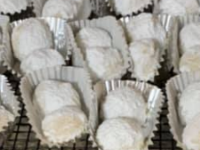
Butter Pecan Balls
Yield: 42-48 cookies
(Originally by Christy Augustin
of Pint Size Bakery on Watson Road)
Ingredients
¾ cup pecans
1 cup (2 sticks) butter
½ cup plus 1 tablespoon powdered sugar, plus more for dusting
½ teaspoon kosher salt
1 teaspoon vanilla extract
2 cups plus 2 tablespoons unbleached all-purpose flour
Contributed by:
Dee Troutt
Directions
Preheat oven to 350 ̊F.
Toast pecans 8 to 10 minutes, or until golden brown and fragrant; chop into medium to small pieces, depending on desired texture.
Increase the oven to 375 ̊F. Blend together the butter, sugar, salt, and vanilla using the paddle attachment of a stand mixer or a handheld beater; blend until the mix is light and fluffy.
Scrape the bowl well with a rubber spatula and add the flour; mix just until combined; then add the cooled, chopped nuts and continue mixing until incorporated (this stage might be best done by hand if you do not have a good stand mixer).
Using a small cookie scoop (or tablespoon and your hands), scoop the cookies into uniform balls, chill thoroughly or freeze. Transfer to a parchment-lined cookie sheet and bake the chilled or frozen dough until very lightly golden (tops will take on very little color, but the bottoms will be darker and firmer), about 10 to 12 min. If desired, make only a partial batch and save the chilled or frozen dough balls for future use.
Cool the baked cookies for 5 minutes before tossing them in additional sifted powdered sugar. Let the cookies cool completely while resting in the sugar and then toss one more time for a beautiful coating. The trick of coating the cookies once while slightly warm makes a silky first layer of sugar that is almost like icing. The baked cookies will stay fresh for several days in a tightly sealed container.
2013 Crystal Red Tintcoat Camaro ZL1
Gateway Camaro Club
2021

Slide 10
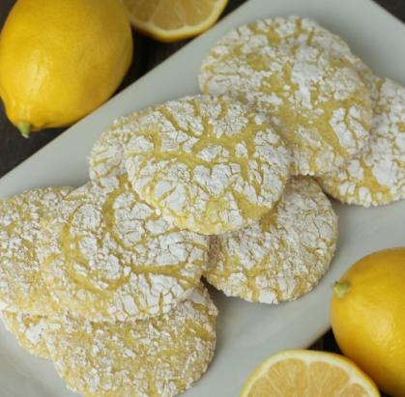
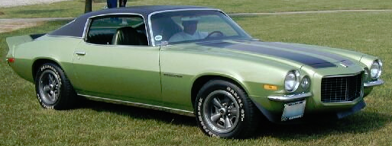
Lemon Snowflake Cookies
Ingredients
1 box lemon cake mix
2 cups Cool Whip
1 egg
Powdered sugar
Contributed by:
Mary and Chuck Connoyer
Directions
Preheat oven to 350 ̊F.
Mix lemon cake mix, Cool Whip, and egg together.
Roll dough into 1-inch balls and roll in powdered sugar
Bake for 10 minutes.
1972 Gulf Green
Camaro RS
Gateway Camaro Club
2021

Slide 11
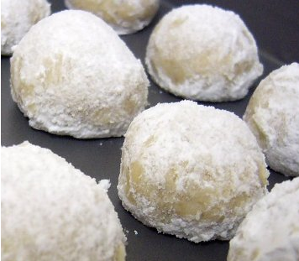
Russian Tea Cakes
(Snowballs)
Ingredients
1 cup butter
1 teaspoon vanilla
½ cup sifted powdered sugar
2 ¼ cup flour
½ teaspoon salt
¾ cup chopped pecans
Contributed by:
Mary and Chuck Connoyer
Directions
Preheat oven to 400 ̊F.
Mix all ingredients together and form into one large ball.
Chill mixture.
Make into small balls and place on an ungreased cookie sheet.
Bake for 10 to 12 minutes.
While still warm, roll in powdered sugar twice to completely coat.
1972 Gulf Green
Camaro RS
Gateway Camaro Club
2021

Slide 12
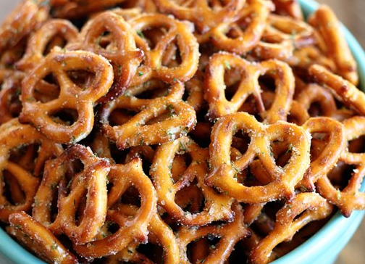
Crack Pretzels
Servings: varies
Ingredients
1 -16oz bag of mini pretzels
½ cup of oil
1 pkg of Hidden Valley Ranch Dressing (dry)
¼ teaspoon of onion powder
¼ teaspoon of garlic powder
¼ teaspoon of dill weed
Contributed by:
Mary & Chuck Connoyer
Directions
Mix oil, dressing, and spices.
Pour mixture over pretzels in a large container.
Shake well to coat pretzels and place them on paper towels.
Once dry, place them in a covered/sealed container.
1972 Gulf Green
Camaro RS
Gateway Camaro Club
2021

Slide 13
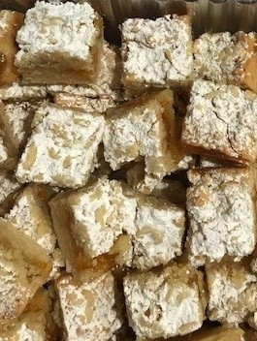
Orange Marmalade Crumble Bars
(or whatever flavor marmalade you love)
Bake time: 45 minutes
Yield: 1 8-inch square pan
(36 cookie bars)
Ingredients (Basic Icebox Cookie Dough)
1 cup unsalted butter, cut into pieces and at room
temperature
1 cup icing sugar, sifted
1 large egg, at room temperature
1 teaspoon vanilla extract
2 ½ cups all-purpose flour
½ teaspoon salt
Directions
Using electric beaters or in a stand mixer fitted with the paddle attachment, beat the butter until smooth.
Add the icing sugar and start on low speed to work it in, and then increase the speed to medium-high beating until fluffy, about 2 minutes.
Beat in the egg and vanilla.
Add the flour and salt and beat until the dough comes together.
Prepare the cookies as below.
Contributed by:
Patty and Dan Wells
Ingredients (Crumble Bars)
1 recipe icebox cookie dough (shown above)
zest of 1 orange
1 cup orange marmalade
Icing sugar, for dusting
Directions
Add the orange zest to the cookie dough, when beating the butter and icing sugar together.
Shape the dough into 2 discs, wrap in plastic wrap and chill for 2 hours.
Preheat the oven to 325°F.
Lightly grease and line an 8-inch square pan with parchment paper, so that the paper comes up the sides.
Use a box grater to grate the chilled cookie dough.
Press about two-thirds of this into the bottom of the prepared pan and then spread the marmalade over top.
Sprinkle the remaining grated cookie dough over the marmalade and press gently.
Bake for about 45 minutes, until you can see browning at the edges.
Cool the pan on a rack completely before dusting with icing sugar and cutting into squares.

Slide 14
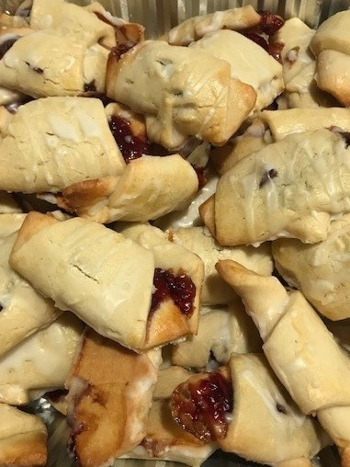
Raspberry/Chocolate Crescents
(Rugelach)
Prep time: 20 minutes
Bake time: 18 minutes
Yield: 4 dozen cookies
Ingredients (Basic Icebox Cookie Dough)
1 cup unsalted butter, cut into pieces and at room
temperature
1 cup icing sugar, sifted
1 large egg, at room temperature
1 teaspoon vanilla extract
2 ½ cups all-purpose flour
½ teaspoon salt
Directions
Using electric beaters or in a stand mixer fitted with the paddle attachment, beat the butter until smooth.
Add the icing sugar and start on low speed to work it in, and then increase the speed to medium-high beating until fluffy, about 2 minutes.
Beat in the egg and vanilla.
Add the flour and salt and beat until the dough comes together.
Prepare the cookies as below.
Contributed by:
Patty and Dan Wells
Ingredients (Crescents)
1 recipe icebox cookie dough (shown above)
Zest of 1 lemon
¾ cup raspberry jam or whatever you like...you can also add chocolate
1 egg whisked with 2 tablespoons water (for brushing)
Cinnamon sugar (for sprinkling)
Directions
Add the lemon zest to the cookie dough when beating the butter and icing sugar together.
Shape the dough into 6 small discs, wrap in plastic wrap and chill for 2 hours.
Preheat the oven to 325°F and line 2 baking trays with parchment paper.
Lightly knead the first disc of dough to soften it just a little.
Roll the disc out into a circle roughly 8-inches across on a lightly floured surface and trim the edges.
Cut the circle into 8 wedges.
Spoon a little jam at the wide end of each wedge and then roll the dough up, croissant-like in shape.
Place the cookies on the trays, leaving 1 ½-inches between them; repeat with the remaining discs of dough.
Brush the cookies with egg wash and sprinkle with cinnamon sugar.
Bake the cookies for about 18 minutes, until the cookies brown a little just at the edges.
Cool the cookies on the tray before removing to store in an airtight container.
The cookies will keep for up to a week.

Slide 15
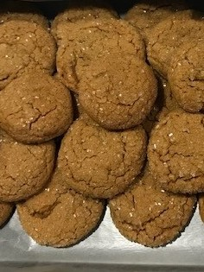
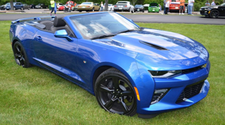
Spiced Molasses Drops
Active: 30 minutes
Total: 50 minutes
Yield: 4 dozen cookies
Ingredients
½ cup unsalted butter, softened
¾ cup packed light brown sugar
¼ cup light molasses
1 teaspoon vanilla extract
1 large egg
2 cups all-purpose flour
1 ½ teaspoon baking powder
½ teaspoon baking soda
¼ teaspoon kosher salt
¼ teaspoon ground cinnamon
¼ teaspoon ground ginger
¼ teaspoon black pepper
½ cup sanding sugar or sparkling sugar
Contributed by:
Kathy & Mark Naylor
Directions
Preheat oven to 375°F with oven racks in top 1/3 and bottom 1/3 of oven.
Beat butter and brown sugar with an electric mixer on medium speed until light and fluffy, about 2 minutes.
Add molasses and vanilla and beat on low speed, just until combined.
Add the egg, and beat on medium speed until mixture thickens slightly, about 30 seconds.
Whisk together flour, baking powder, baking soda, salt, cinnamon, ginger, and pepper in a medium bowl.
Gradually add to butter mixture and beat on low speed just until combined after each addition.
Place sanding sugar in a shallow dish or bowl and drop dough by heaping tablespoonfuls into sugar, rolling to coat.
Place half of coated dough balls about 2 inches apart on parchment-lined baking sheets.
Bake in preheated oven until cookies are just set, 8 to 9 minutes, switching pans top rack to bottom rack halfway through baking.
Cool on pans 5 minutes; remove cookies to wire racks and cool completely, about 30 minutes.
Repeat with remaining cookie dough.
2016 Hyper Blue Metallic Convertible
“Maximus”
Gateway Camaro Club
2021

Slide 16
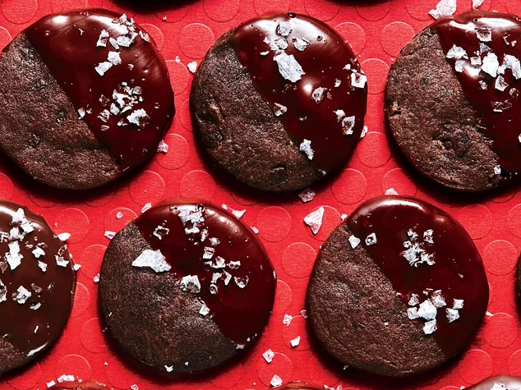
Dark Chocolate
Sables
Active: 20 minutes
Total: 1hour, 40 minutes
Yield: 4 ½ dozen cookies
Ingredients
1 cup salted butter, softened
1 cup powdered sugar
1 teaspoon vanilla extract
2 cups all-purpose flour
1/3 cup unsweetened cocoa
½ teaspoon kosher salt
2 ½ (4oz) 60% cacao bittersweet chocolate baking bars
Sea salt or chopped, toasted pecans (optional)
Contributed by:
Kathy & Mark Naylor
Directions
Beat butter and sugar with an electric mixer on medium speed until combined.
Stir together flour, cocoa, and salt.
Gradually add flour mixture to butter mixture, beating at low speed until combined after each addition.
Finely chop one of the bittersweet chocolate baking bars and stir into cookie dough until well incorporated.
Divide dough in half; shape each into an 8-inch-long log.
Wrap each log tightly in plastic wrap and chill until firm, about 30 minutes. (Dough may be frozen up to one month.)
Preheat oven to 350°F.
Cut dough into ¼-inch thick slices; place 2 inches apart on parchment paper-lined baking sheets. (Keep logs refrigerated.)
Bake until bottoms are lightly browned, 11 to 13 minutes.
Cool on pans for 5 minutes; remove cookies to wire racks and cool completely, about 20 minutes.
Chop remaining 1 ½ bittersweet chocolate baking bars and place in a small microwave-safe bowl.
Microwave on HIGH until chocolate is melted and smooth, 1 to 1 ½ minutes, stirring every 30 seconds.
Dip half of each cookie in the melted chocolate; sprinkle lightly with sea salt or chopped toasted pecans, if desired.
Place cookies on parchment paper-lined baking sheets and chill until chocolate sets, about 15 minutes.
Layer cookies between wax paper and store in an air-tight container at room temperature up to 5 days.
2016 Hyper Blue Metallic Convertible
“Maximus”
Gateway Camaro Club
2021

Slide 17
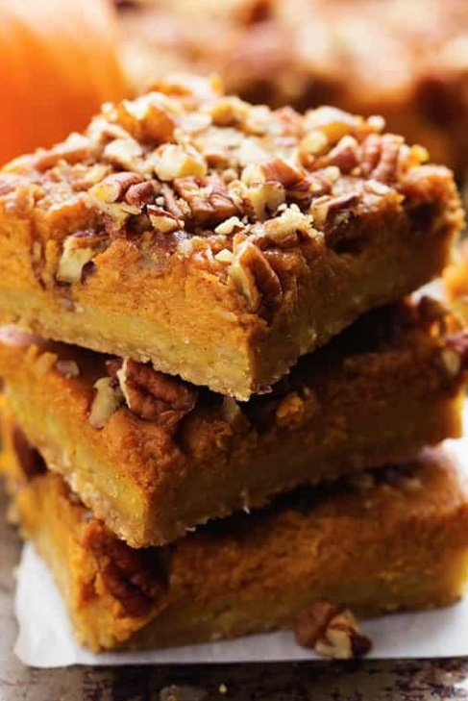
Pumpkin Pie Bars
Yield: About 12 bars
Ingredients
Crust:
1 ½ cups all-purpose flour
6 tablespoons sugar
¼ teaspoon kosher salt
¾ cup cold unsalted butter, cubed
Filling:
2/3 cup sugar
2 tablespoons all-purpose flour
½ teaspoon kosher salt
2/3 cup light corn syrup
2 tablespoon unsalted butter, melted
1 teaspoon vanilla extract
2 large eggs
1 cup coarsely chopped pecans
Garnish: melted chocolate
Contributed by:
Kathy & Mark Naylor
Directions
Preheat oven to 350°F.
Crust: Line a 9-inch square baking pan with foil with excess extending over sides of pan; spray foil with baking spray with flour.
In a medium bowl, whisk together flour, sugar, and salt; using a pastry cutter, cut in cold butter until mixture is crumbly.
Press mixture into bottom of prepared pan and bake until lightly browned around edges of crust, about 17 minutes.
Let cool on a wire rack for 15 minutes.
Filling: In a medium bowl, combine sugar, flour, and salt, then whisk in corn syrup, melted butter, vanilla, and eggs.
Sprinkle pecans onto prepared crust.
Pour corn syrup mixture over pecans.
Bake until set, 25-30 minutes. (Note: The center should not be jiggly. Inserted toothpick should come out clean.)
Let cool completely on a wire rack.
Remove from pan and cut into bars.
Garnish with melted chocolate, if desired.
2016 Hyper Blue Metallic Convertible
“Maximus”
Gateway Camaro Club
2021

Slide 18
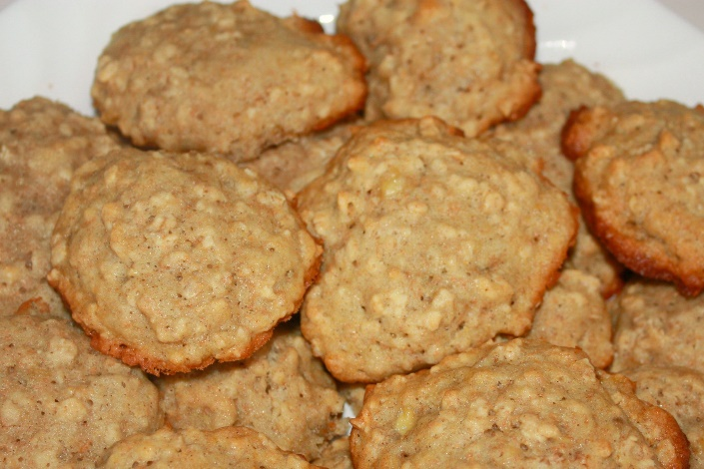
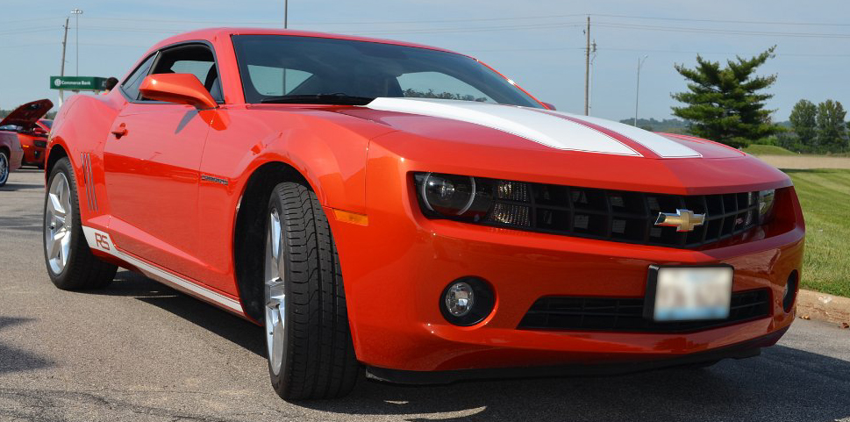
Banana Bread Cookies
Ingredients
1 overripe banana, mashed 1/2 cup vegetable oil or melted butter 3/4 cup brown sugar, packed 1 egg yolk 1 teaspoon vanilla extract 1 1/3 cups flour 1/2 teaspoon baking soda 2 teaspoon cinnamon 1/2 teaspoon salt
Contributed by:
Vicki Schanuel & Dwayne Saul
Directions
1. In a large bowl, combine the melted butter, brown sugar, and mashed banana; mix to combine.
2. Add the egg yolk and vanilla extract and mix well.
3. Add flour, salt, baking soda, and cinnamon.
4. Stir until combined and no streaks of flour remain.
5. Set aside to let the flour hydrate in the dough while the oven preheats.
6. Line a cookie sheet with parchment paper and preheat the oven to 350°F.
7. Once the oven is preheated, use a cookie scoop or a spoon to scoop out about 1-inch dough balls,
rolling them in your hands.
8. Place balls 2 inches apart on the prepared cookie sheet and bake for 10 to 11 minutes or until the
edges are set and the cookies have puffed up, but the middle is still underbaked.
9. Allow to cool before eating.
2010 Inferno Orange RS
Gateway Camaro Club
2021

Slide 19
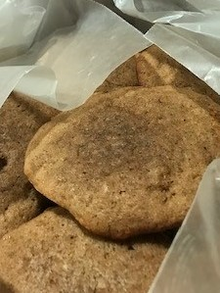
Banana Bread Chocolate Chip Cookies
Ingredients
1 overripe banana, mashed 1/2 cup vegetable oil or melted butter 3/4 cup brown sugar, packed 1 egg yolk 1 teaspoon vanilla extract 1 1/3 cups flour 1/2 teaspoon baking soda 2 teaspoon cinnamon 1/2 teaspoon salt 2/3 cup chocolate chips
Contributed by:
Vicki Schanuel & Dwayne Saul
Directions
1. In a large bowl, combine the melted butter, brown sugar, and mashed banana; mix to combine.
2. Add the egg yolk and vanilla extract and mix well.
3. Add flour, salt, baking soda, and cinnamon.
4. Stir until combined and no streaks of flour remain.
5. Finally, fold in the chocolate chips.
6. Set aside to let the flour hydrate in the dough while the oven preheats.
7. Line a Cookie sheet with parchment paper and preheat the oven to 350°F.
8. Once the oven is preheated, use a cookie scoop or a spoon to scoop out about 1-inch dough balls,
rolling them in your hands.
9. Place balls 2 inches apart on the prepared cookie sheet and bake for 10 to 11 minutes or until the edges
are set and the cookies have puffed up, but the middle is still underbaked.
10. Allow to cool before eating.
2010 Inferno Orange RS
Gateway Camaro Club
2021

Slide 20
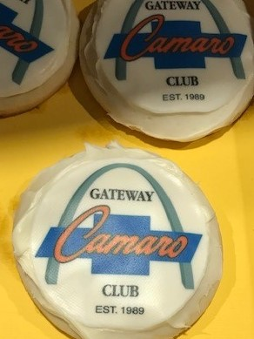
Soft Cream Cheese Cookies with Icing
Ingredients
3 cups + 2 tablespoons all-purpose flour
1 ½ teaspoons baking powder
1 cup butter, softened to room temperature
5 ounces cream cheese, softened to room temperature
1 cup granulated sugar
1 large egg, at room temperature
3 teaspoons vanilla extract
Contributed by:
Wendy Toettcher
Directions
Whisk flour, baking powder, and salt together in a large bowl; set aside.
In a large bowl, using a hand-held mixer or stand mixer, beat butter and cream cheese together on medium-high speed until completely smooth and creamy, about 2 minutes.
Add the granulated sugar and beat until mixture is fluffy and combined, about 1 minute.
Add the egg and vanilla extract; beat on high-speed until combined, about 1 minute; scrape down the sides and the bottom of the bowl and beat again, as needed.
Add the dry ingredients to the wet ingredients and mix on low-speed until combined; dough will be very soft and creamy.
Generously flour your hands and rolling pin.
Divide the dough into 2 equal parts; roll each portion out on a lightly floured piece of parchment paper or silicone baking mat to about ¼ inch thickness. (The rolled-out dough can be any shape as long as it is evenly ¼ inch thick.)
Lightly dust one of the rolled-out doughs with flour and place a piece of parchment paper on top.
Place the second rolled-out dough on top of the first.
Cover with plastic wrap or aluminum foil and refrigerate for at least 2 hours and up to 2 days.
Once chilled, preheat the oven to 350°F (or 325°F for dark, non-stick pans).
Line 2-3 large baking sheets with parchment paper or silicone mats.
Carefully, remove the top dough piece from the refrigerator. (If the dough is sticking at the bottom, run your hand under it to help remove it.)
Using a cookie cutter, cut the dough into shapes; reroll the remaining dough and continue cutting until all the dough is used up; repeat with the second piece of dough.
Arrange cookies on the baking sheet 3 inches apart and bake 12 to 13 minutes (13 to 15 minutes for dark, nonstick pans), until very lightly browned around the edges.
Leave on the parchment sheet for 5 minutes and then transfer to a wire rack to cool completely before decorating.
Cover with vanilla icing and decorate however you wish.
Note: Plain or decorated sugar cookies will freeze well for up to 3 months. Wait for icing to set completely before layering the cookies between parchment paper in a freezer-friendly container.

Slide 21
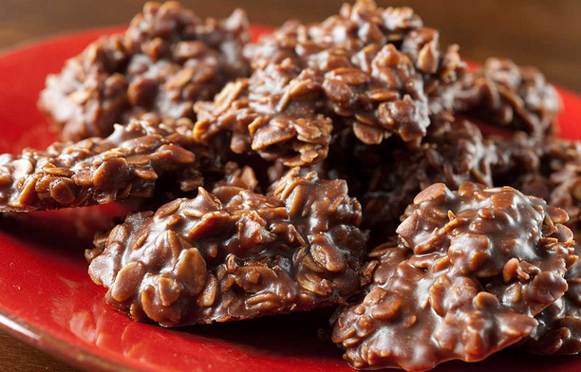
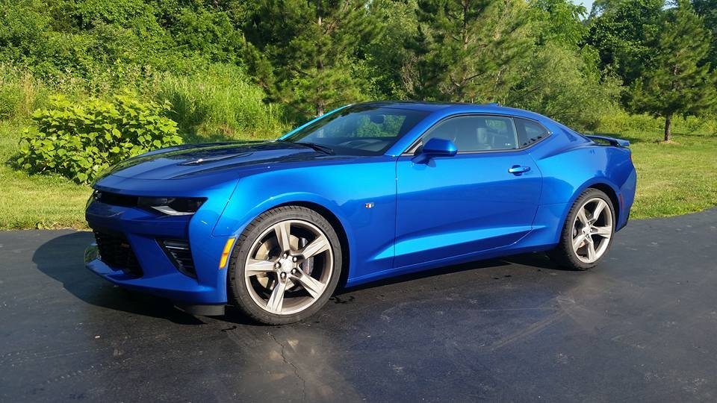
No Bake Cookies
Ingredients
2 cups sugar
¼ cup cocoa
¼ cup butter
Pinch of salt
½ cup milk
1 teaspoon vanilla
½ cup peanut butter
3 cups small quick oats
Contributed by:
Linda and John Kondrick
Directions
In a saucepan, bring sugar, cocoa, butter, milk, and salt to a rapid boil for 1 minute.
Add quick cooking oats, peanut butter, and vanilla; mix well.
Working quickly, drop by teaspoonfuls onto wax paper and let cool.
2016 Hyper Blue Metallic
“Blue Beauty”
Gateway Camaro Club
2021

