Slide 1
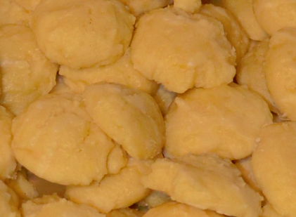
Soft Lemon Cheesecake Cookies
Ingredients
For the cookies:
3/4 cup white sugar
1/4 cup (4 Tbsp) butter
4 ounces full-fat cream cheese
1 large egg
1 teaspoon vanilla extract
1 teaspoon lemon extract
2 teaspoon fresh lemon juice
1 tablespoon lemon zest
1 1/4 cups white flour
1/2 teaspoon baking powder
1/4 teaspoon salt
1/2 teaspoon cornstarch
2 tablespoon lemon-flavored
pudding mix, dry
Contributed by:
Anna Thacker
For the glaze:
1/2 cup powdered sugar
2-3 teaspoon fresh lemon juice
Directions
Bring butter, cream cheese and egg to room temperature before starting. (Do not melt or soften ingredients in the microwave.)
In a large bowl, cream together the sugar and butter until fluffy.
Add in the cream cheese and continue to beat until the batter is completely smooth.
Beat in the egg, vanilla extract, lemon extract, lemon juice and lemon zest.
In a separate bowl, combine the flour, baking powder, salt, cornstarch, and pudding mix. Stir together.
Add the combined dry ingredients into the wet ingredients and mix until JUST combined. Over-mixing will result in dense cookies.
Cover the dough and refrigerate for 20 minutes.
While the dough is chilling, preheat the oven to 350 degrees F.
Use a one-tablespoon scoop to measure the cookie dough into small cookie balls onto a baking sheet.
Bake at 350 degrees F for 8-10 minutes. Remove from oven and place immediately onto a cooling rack to cool completely. (Be careful not to over-bake as cookies will develop a biscuit-like texture.)
Once cooled, prepare the glaze by whisking together the lemon juice and powdered sugar. Add only enough lemon juice to create a thick glaze and drizzle it over the cooled cookies. Allow glaze to set.
2010 Summit White SS
“Marilyn”
Gateway Camaro Club
2017

Slide 2
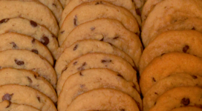
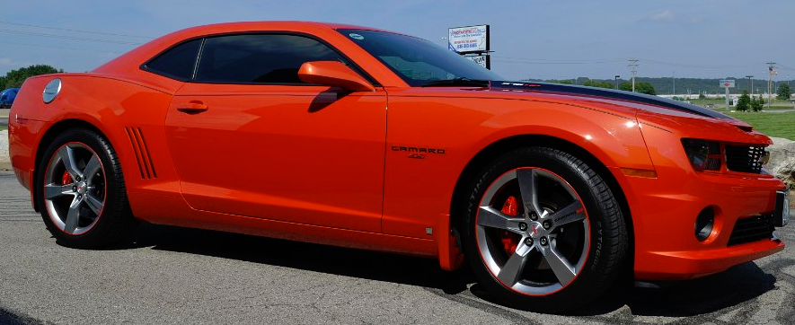
Best-Ever
Chocolate Chip Cookies
Servings: varies
Ingredients
3/4 cup unsalted butter, softened
3/4 cup brown sugar
1/4 cup granulated sugar
1 egg
2 teaspoon vanilla extract
2 cup all purpose flour
2 teaspoon cornstarch
1 teaspoon baking soda
1/2 teaspoon salt
1 cup bittersweet chocolate chips
Contributed by:
Danielle Corcoran
Directions
1. Preheat oven to 350 ̊F.
2. In the bowl of a stand mixer fitted with a paddle attachment, cream together butter and sugars until fluffy and light in color.
3. Add egg and vanilla and blend.
4. Mix in flour, cornstarch, baking soda, and salt.
5. Stir in chocolate chunks.
6. Using a standard-sized cookie scoop or tablespoon, drop dough onto a prepared baking sheet.
7. Bake for 8-10 minutes, until barely golden brown around the edges. (The tops will not brown; do NOT cook longer than ten minutes.)
8. Place the baking sheet on a wire rack and cool for five minutes.
9. Remove cookies from the baking sheet and let cool completely.
2010 Camaro 2SS
Inferno Orange
Gateway Camaro Club
2017

Slide 3
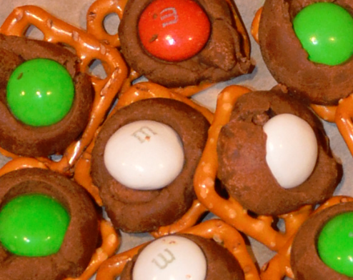
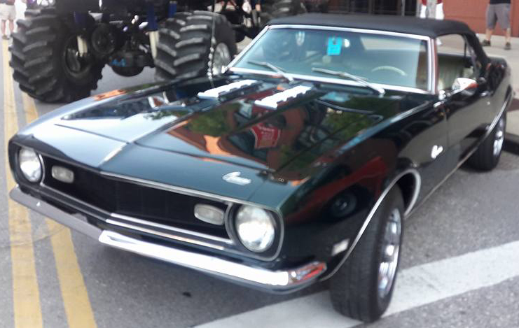
Holiday Pretzels
Servings: varies
Ingredients
Pretzels (mini)
Hershey Kisses (any flavor)
Mint M&M’s (or other flavor)
Directions
Preheat oven to 350 ̊F.
Place one Hershey Kiss on each pretzel.
Bake for 2 ½ minutes.
Remove from oven.
Top each cookie with a mint M&M.
Contributed by:
Heather and John Flaherty
1968 British Green Camaro
Gateway Camaro Club
2017

Slide 4
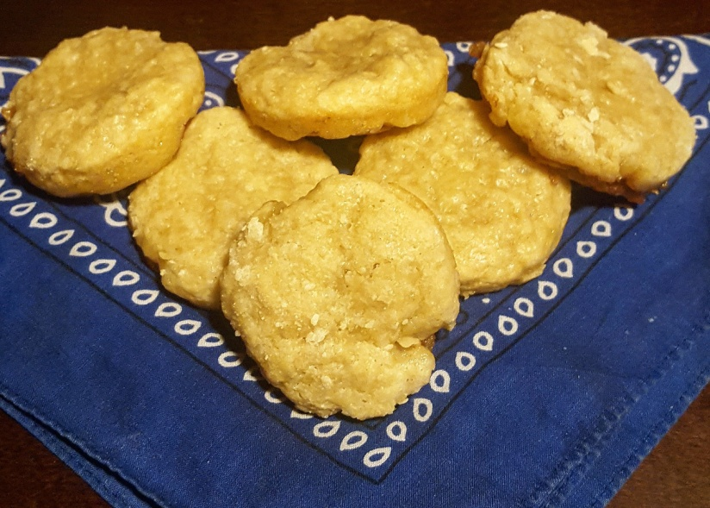
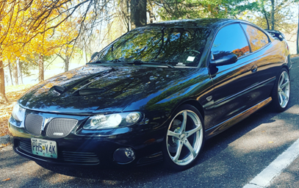
Dutch Apple Pie
Cookies
Servings: 2 ½ dozen
Ingredients
1 roll of refrigerated pie dough
5 small Granny Smith apples, peeled, cored, finely diced
¼ C granulated sugar
1 teaspoon ground cinnamon
2 tablespoons lemon juice
1 tablespoon cornstarch
Streusel topping:
2 ¼ cups all purpose flour
2/3 cup brown sugar
2/3 cup granulated sugar
Pinch of salt
¾ cup plus 2 tablespoons butter, melted
Contributed by:
Krista Gleiforst
Directions
Preheat oven to 350 ̊F.
Spray the wells of a standard size muffin pan with nonstick spray.
Roll out dough onto a lightly floured surface and cut out circles about 2 inches in diameter.
Gather and re-roll unused dough and cut additional circles.
Place circles in the bottom of each muffin well.
Add the apples, sugar, cinnamon, lemon juice, and cornstarch to a medium sauce pan.
Cook on medium heat, stirring occasionally for 5-10 minutes, until the apples have softened slightly and the juices begin to thicken; remove from heat.
Add about one tablespoon of apple filling on top of each circle of pie dough.
In a medium bowl, mix flour, brown sugar, granulated sugar, and salt.
Add melted butter and mix until well incorporated.
Add a heaping tablespoon of this streusel topping to each muffin well and pat it down over the apples.
Bake 17-20 minutes. Allow cookies to cool in muffin tin for at least 1-15 minutes before removing.
2005 Pontiac GTO
“Vader”
Gateway Camaro Club
2017

Slide 5
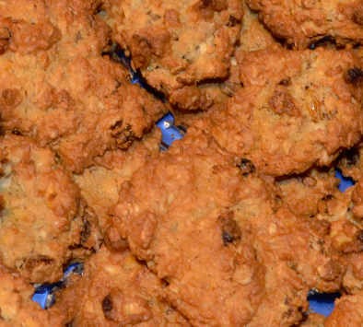
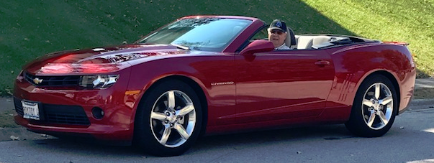
Mom Kessler’s Ranger Cookies
Servings: 6-7 dozen
Ingredients
1 ½ cups butter
1 ½ cups granulated sugar
1 ½ cups brown sugar
3 eggs
1 teaspoon vanilla
3 cups flour
1 ½ teaspoons baking powder
1 ½ teaspoons baking soda
¾ teaspoon salt
3 cups old-fashioned oats
3 cups Corn Flakes
1 ½ cups coconut flakes
1 ½ cups golden raisins
1 ½ cups chopped pecans
Contributed by:
Roy & Gwin Kessler
Directions
Preheat oven to 350 ̊F.
Cream together butter and sugars.
Add vanilla and eggs to butter mixture and cream together.
In separate bowl, mix flour, baking powder, baking soda, and salt together.
In another bowl mix the oats, Corn Flakes, coconut flakes, raisins, and pecans with your hands.
Combine the butter, flour, and oats mixtures with your hands (I burned out two mixers!)
Spoon onto baking sheet and bake at 350 ̊F for 11 minutes.
2014 Camaro
Crystal Red
Gateway Camaro Club
2017

Slide 6
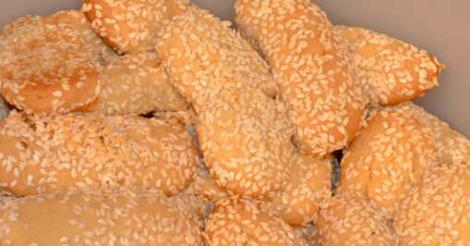
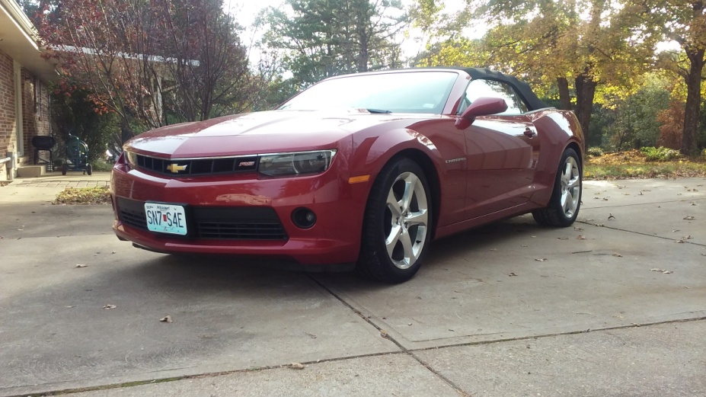
Italian Sesame Seed Sugar Cookies
Servings: varies
Ingredients
2 sticks softened butter
1 cup white granulated sugar
1 cup powdered sugar
2 eggs
1 cup oil
4 ½ cups flour
1 teaspoon baking soda
1 teaspoon cream of tartar
1 teaspoon vanilla
Sesame seeds
Contributed by:
Bonnie & Louis Pfleckl
Directions
Preheat oven to 375 ̊F.
Mix ingredients in order given.
Chill 1 hour to overnight.
Take small portions and roll into finger-sized thickness, then roll in sesame seeds.
Bake on ungreased cookie sheet at 375 for 10 - 15 minutes depending on size of cookie.
Remove when bottoms are brown.
2015 Red Rock Metallic Convertible
“Cinnamon”
Gateway Camaro Club
2017

Slide 7
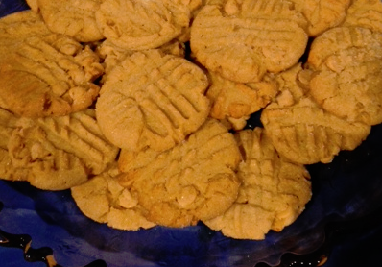
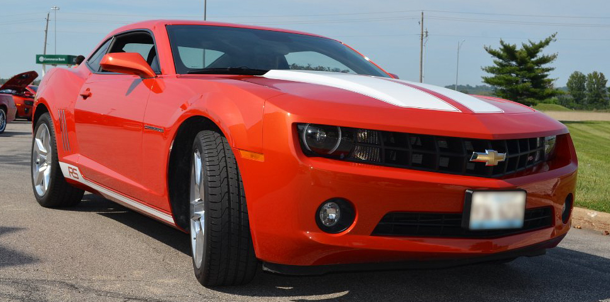
Irresistible
Peanut Butter
Cookies
Servings: 3 dozen
Ingredients
¾ cup Jif Creamy Peanut Butter
½ stick Crisco Baking Sticks Butter Flavor
All-Vegetable Shortening OR ½ cup Crisco
Butter Flavor All-Vegetable Shortening
1 ¼ cups firmly packed brown sugar
3 tablespoons milk
1 tablespoon vanilla extract
1 large egg
1 ¾ cups Pillsbury Best All Purpose Flour
¾ teaspoon baking soda
¾ teaspoon salt
(Optional: 10oz bag Reese’s Peanut Butter chips)
Contributed by:
Vicki Schanuel & Dwayne Saul
Directions
Preheat oven to 375°F.
Combine peanut butter, shortening, brown sugar, milk, and vanilla in large bowl.
Beat at medium speed of electric mixer until well blended.
Add egg and beat just until blended.
Combine flour, baking soda and salt, and add to creamed mixture at low speed.
Mix just until blended.
Fold in 10oz. bag of Reese Peanut Butter chips (optional).
Drop by rounded measuring tablespoon of dough 2-inches apart onto greased baking sheet.
Flatten slightly in a crisscross pattern with the tines of a fork.
Bake one baking sheet at a time for 7 to 8 minutes, or until set and just beginning to brown.
Cool two minutes on the baking sheet.
Remove cookies to cooling racks to cool completely.
2010 Inferno Orange RS
Gateway Camaro Club
2017

Slide 8
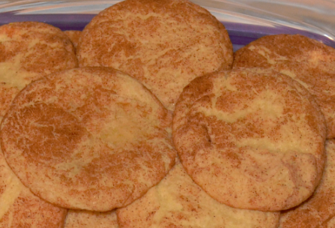
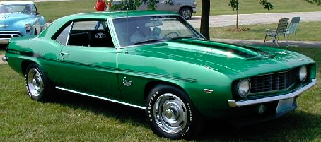
Snickerdoodles
Servings: 6 dozen
Ingredients
½ cup butter or margarine, softened
½ cup shortening
1 ½ cups sugar
2 eggs
2 ¾ cups all-purpose flour
2 teaspoons cream of tartar*
1 teaspoon baking soda*
¼ teaspoon salt*
2 tablespoons sugar
2 teaspoons cinnamon
*If using self-rising flour, omit cream of tartar,
soda and salt
Contributed by:
Sarah Shockley
Directions
Preheat oven to 400 ̊F.
Mix thoroughly butter, shortening, 1 ½ cups sugar and the eggs.
Blend in four, cream of tartar, soda and salt.
Shape dough by rounded teaspoonfuls into balls.
Mix 2 tablespoons sugar and the cinnamon; roll balls in mixture.
Place 2 inches apart on ungreased baking sheet
Bake 8-10 minutes or until set.
Immediately remove from baking sheet.
1969 Rallye Green
Yenko Camaro
Gateway Camaro Club
2017

Slide 9
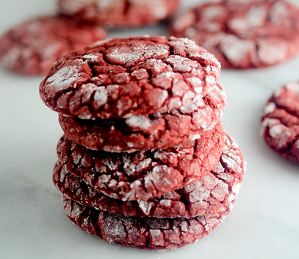
Red Velvet Crinkle Cookies
Servings: 30 cookies
Prep time: 25 minutes
Cook time: 15 minutes
Total time: 2 hours 40 minutes
Ingredients
3 cups all-purpose flour
¼ cup unsweetened cocoa powder*
2 teaspoons baking powder
¼ teaspoon baking soda
¾ teaspoon salt
¾ cup unsalted butter, softened
1 1/3 cups granulated sugar
3 large eggs
1 tablespoon milk or buttermilk
1 ½ teaspoon vanilla bean paste or vanilla
2 teaspoons lemon juice
5 teaspoons red food coloring
1 cup white chocolate chips
1 cup powdered sugar
Contributed by:
Angie Shockley
Directions
Preheat oven to 350 ̊F.
In a mixing bowl whisk together flour, cocoa powder, baking powder, baking soda and salt for 30 seconds, set aside.
In the bowl of an electric stand mixer fitted with the paddle attachment, whip butter and granulated sugar until pale and fluffy.
Mix in eggs 1 at a time, blending until combined after each addition.
Mix in milk, vanilla bean paste, lemon juice and red food coloring.
With mixer set on low speed, slowly add in dry ingredients and mix just until combined. Stir in white chocolate chips.
Cover bowl with plastic wrap and chill 2 hours or until firm enough to shape into balls.
Pour powdered sugar into a bowl.
Remove dough from refrigerator, scoop dough out and with buttered hands, shape into medium balls
(about 2 ½ tablespoons each).
Roll cookie dough balls into powdered sugar and evenly coat.
Transfer to Silpat or parchment paper-lined baking sheets and flatten slightly.
Bake for 13-14 minutes.
Allow to rest on cookie sheet several minute, then transfer to a wire rack to cool completely. Store in an airtight container.
*For a more chocolately cookie, replace 2-3 tablespoons of the flour with 2-3 additional tablespoons of cocoa powder.
1969 Rallye Green
Yenko Camaro
Gateway Camaro Club
2017

Slide 10
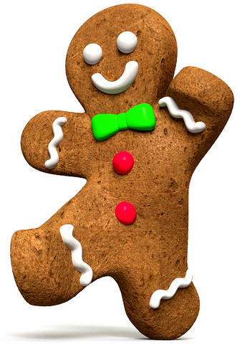
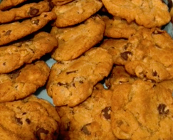
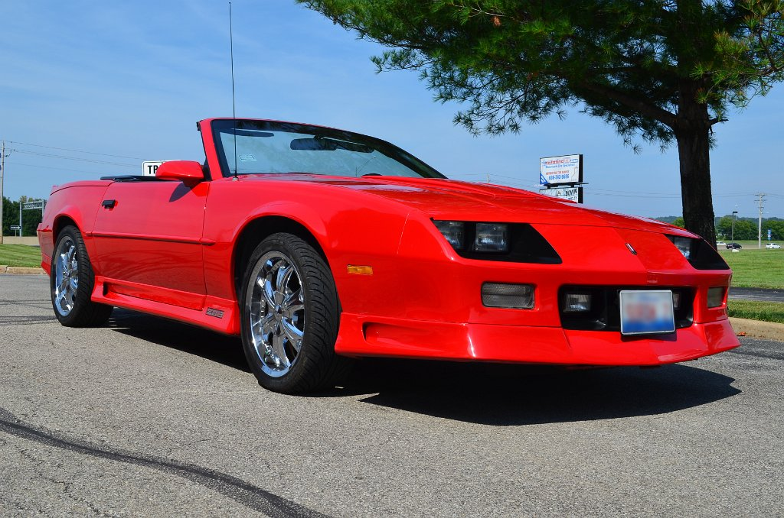
Chocolate Chip
Cookies
Servings: varies
Ingredients
2 ¼ cups flour
1 teaspoon baking soda
½ teaspoon salt
½ cup butter
½ cup shortening
¾ cup brown sugar
¾ cup white sugar
1 teaspoon vanilla
2 eggs
½ cups chopped nuts
1 (18oz) package chocolate chips
½ teaspoon water
Contributed by:
Judy & Dennis Shoreack
Directions
Preheat oven to 375 ̊F.
Sift together flour, baking soda, and salt. Set aside.
Blend butter, shortening, sugar, vanilla, and water.
Beat in eggs.
Add flour mixture and mix well.
Stir in chocolate chips and nuts.
Drop by half teaspoonful on cookie sheet.
Bake for 10-12 minutes.
1991 Red Z28
“Zoom”
Gateway Camaro Club
2017

Slide 11
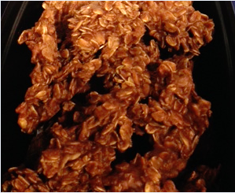
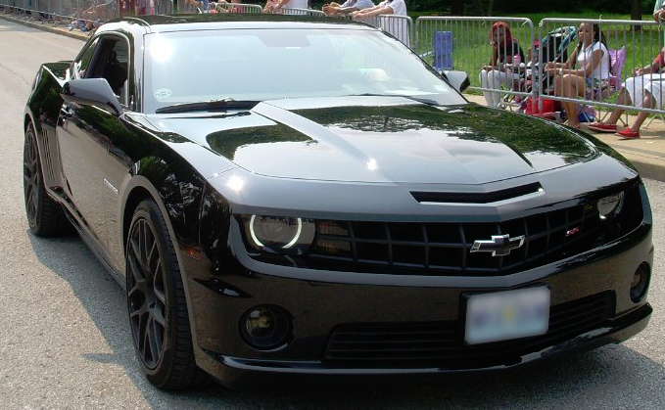
No Bake
Cookies
Servings: varies
Ingredients
2 cups white sugar
½ cup butter
½ cup milk
3 tablespoons cocoa powder
3 cups quick cooking oats
1 teaspoon vanilla extract
Contributed by:
Dawn & Ken Snodgrass
Directions
Mix together sugar, butter or margarine, and milk in a saucepan.
Bring to a boil and boil for one minute, stirring constantly.
Remove from heat and mix in cocoa, quick oatmeal and vanilla.
Drop by spoonful on waxed paper.
2011 Chevy Camaro SS2
“Night Fury”
Gateway Camaro Club
2017

Slide 12
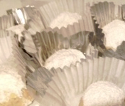
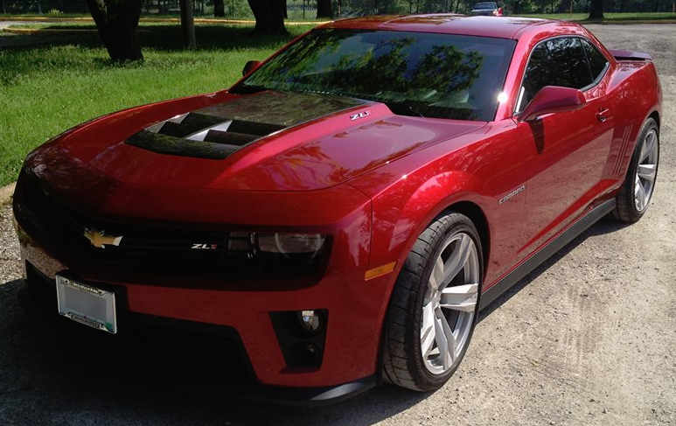
Butter Pecan Balls
Servings: 42 to 48 cookies
Ingredients
¾ cup pecans
1 cup (2 sticks) butter
½ cup plus 1 tablespoon powdered sugar, plus more for dusting
½ teaspoon kosher salt
1 teaspoon vanilla extract
2 cups plus 2 tablespoons unbleached all-purpose flour
Contributed by:
Dee Troutt
(Originally by Christy Augustin of Pint Size Bakery on Watson Road)
Directions
Preheat oven to 350 ̊F.
Toast pecans 8-10 minutes, or until golden brown and fragrant. Chop into medium to small pieces, depending on desired texture.
Increase the oven to 375 ̊F. Blend together the butter, sugar, salt, and vanilla using the paddle attachment of a stand mixer or a handheld beater. Blend until the mix is light and fluffy.
Scrape the bowl well with a rubber spatula and add the flour. Mix just until combined. Add the cooled, chopped nuts and continue mixing until incorporated (this stage might be best done by hand if you do not have a good stand mixer).
Using a small cookie scoop (or a tablespoon and your hands), scoop the cookies into uniform balls and chill thoroughly or freeze. Transfer to a parchment-lined cookie sheet and bake the chilled or frozen dough until very lightly golden (the tops will take on very little color, but the bottoms will be darker and more firm), about 10 to 12 minutes. If desired, make only a partial batch and save the chilled or frozen dough balls for future use.
Cool the baked cookies for 5 minutes before tossing them in additional sifted powdered sugar. Let the cookies cool completely while resting in the sugar and then toss one more time for a beautiful coating. The trick of coating the cookies once while slightly warm makes a silky first layer of sugar that is almost like icing. The baked cookies will stay fresh for several days in a tightly sealed container.
2013 Crystal Red Tintcoat Camaro ZL1
Gateway Camaro Club
2017

Slide 13
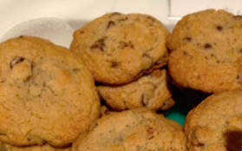
Chocolate Chip
Cookies
Servings: 5 dozen
Active time: 25 minutes
Total time: 40 minutes
Ingredients
2 ¼ cups flour
1 teaspoon baking soda
1 teaspoon salt
1 cup (2 sticks) butter, softened
¾ cup packed brown sugar
¾ cup granulated sugar
1 teaspoon vanilla extract
2 large eggs
2 cups Nestle’ Toll House Semi-Sweet Chocolate Morsels
1 cup chopped nuts
Contributed by:
Dee Troutt
Directions
Preheat oven to 375 ̊F.
Combine flour, baking soda, and salt in small bowl.
Beat butter, granulated sugar, brown sugar, and vanilla extract in large mixer bowl until creamy.
Add eggs, one at a time, beating well after each addition.
Gradually beat in flour mixture.
Stir in morsels and nuts.
Drop by rounded tablespoon onto ungreased baking sheets.
Bake for 9 to 11 minutes or until golden brown.
Cool on baking sheets for 2 minutes; remove to wire racks to cool completely.
2013 Crystal Red Tintcoat Camaro ZL1
Gateway Camaro Club
2017

Slide 14
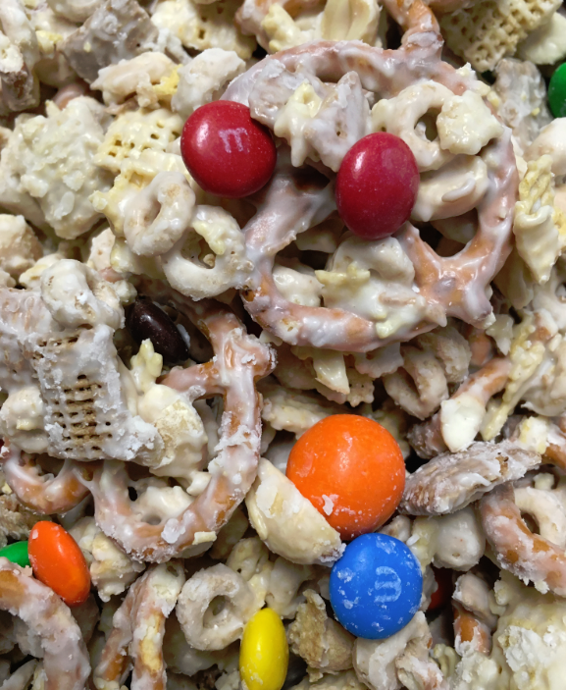
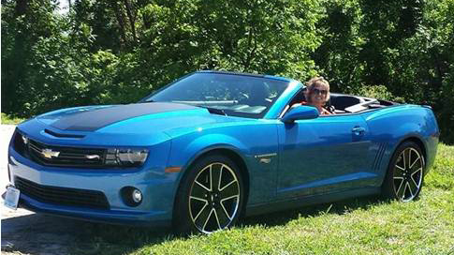
Chex Mix
Servings: 12-14 cups
Ingredients
2 cups of Rice Chex
2 cups of Corn Chex
2 cups of Wheat Chex
2 cups of Cheerios
2 cups of pretzel twist (the small ones)
1 cup of peanuts, lightly salted, dry roasted
1 cup of M&M’s (2lb. bag)
9 squares of white Almond Bark
(NOTE: Buy it at Dierberg’s, so you don’t
have to mess with cutting it!)
Contributed by:
Gina and Greg Wilkerson
Directions
In a large metal pot, mix together first six ingredients.
In a microwave safe dish, melt Almond Bark just until melted; start with 1 minute, then 30 seconds intervals.
When Almond Bark has melted, stir until smooth, then quickly pour over cereal mixture and coat thoroughly.
Spread coated mixture over waxed paper in a thin layer.
Sprinkle with M&M’s and let harden.
After mixture cools and hardens, break into bite sized pieces and store in an air-tight container.
2013 Hot Wheels Special Edition
“Sizzler”
Gateway Camaro Club
2017

Slide 15
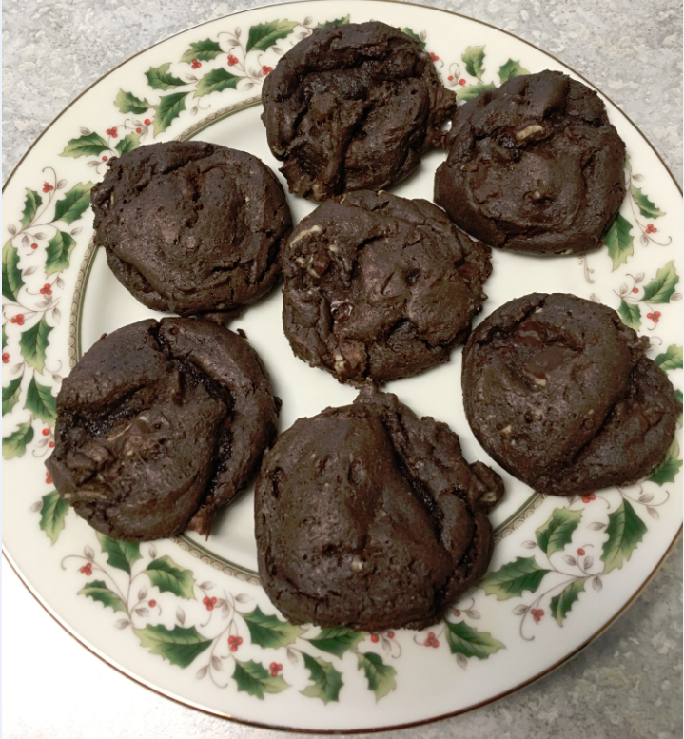
Easy Andes Mint Chocolate Cake Mix Cookies
Servings: varies
Ingredients
1 box Better Crocker Super Moist Dark Chocolate Cake Mix (15.25 oz)
½ cup Vegetable or Canola Oil
2 eggs
1 bag Andes Mint Baking Chips (10 oz.) OR use approx.. 1 ½ cups chopped Andes Mints
Contributed by:
Gina and Greg Wilkerson
Directions
1. Combine cake mix, eggs, and oil in large mixing bowl, and beat well.
2. Stir in Andes Mint pieces.
3. Chill dough in refrigerator for 1 hour.
4. Preheat the oven to 350 ̊after the dough is in the refrigerator for 45 minutes.
5. Drop onto ungreased cookie sheet in rounded balls.
6. Bake for approximately 7 – 9 minutes, or until done. ENJOY!
2013 Hot Wheels Special Edition
“Sizzler”
Gateway Camaro Club
2017

Slide 16
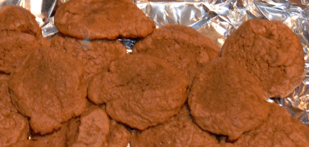
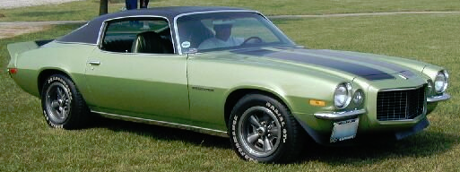
Chocolate Banana Cookies
Servings: 2 dozen
Ingredients
½ cup semi-sweet chocolate chips
½ cup sugar
1/3 cup margarine or butter, softened
½ cup (1 medium) sliced, ripe banana
1 egg
1 ¼ cups all purpose or unbleached flour
1 teaspoon baking powder
¼ teaspoon baking soda
¼ teaspoon salt
Contributed by:
Mary & Chuck Connoyer
Directions
Preheat oven to 400 ̊F.
Grease cookie sheets.
Melt chocolate chips in a small saucepan over low heat; cool slightly.
In a large bowl, combine sugar, margarine, banana, and chocolate; beat until light and fluffy.
Add egg; blend well.
Lightly spoon flour into measuring cup; level off.
Add flour, baking powder, baking soda, and salt; mix well.
Drop by heaping teaspoonfuls 2 inches apart onto greased cookie sheets.
Bake for 5 to 8 minutes or until set.
Cool 1 minute; remove from cookie sheets.
*High altitude – Above 3,500 feet, increase flour to 1 1/3 cups. Bake as directed.
1972 Gulf Green
Camaro RS
Gateway Camaro Club
2017

Slide 17
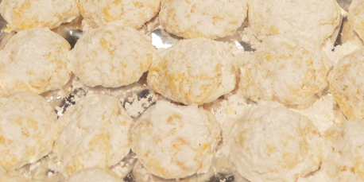
Gooey Butter Cookies
Servings: varies
Ingredients
1 yellow cake mix
1 8oz package of cream cheese, softened
1 stick butter, softened
1 teaspoon vanilla
1 egg
Powdered sugar
Contributed by:
Mary & Chuck Connoyer
Directions
Preheat oven to 350 ̊F.
Lightly grease cookie sheets.
Combine the cake mix, cream cheese, vanilla, butter, and egg.
Refrigerate 2 hours or overnight.
Cover fingers in powdered sugar and roll teaspoon-sized dough into a ball.
Bake about 8-10 minutes.
Remove from the pan and sprinkle with powdered sugar.
1972 Gulf Green
Camaro RS
Gateway Camaro Club
2017

Slide 18
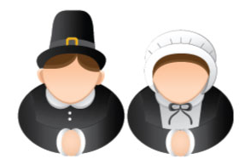
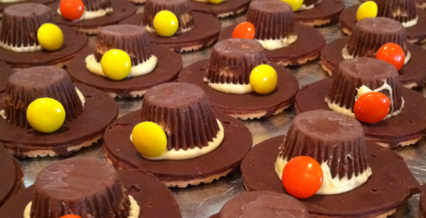
Pilgrim Hat Cookies
Servings: 48 cookies
Ingredients
Chocolate striped shortbread Cookies
Miniature Reese’s Peanut Butter Cups
M&M’s or other decorations
Directions
Attach a Reese’s Peanut Butter Cup in the center of the shortbread cookie with icing.
Pipe more icing around the cup.
Decorate with an M&M or whatever for the buckle of the hat.
Contributed by:
Mary & Chuck Connoyer
1972 Gulf Green
Camaro RS
Gateway Camaro Club
2017

Slide 19
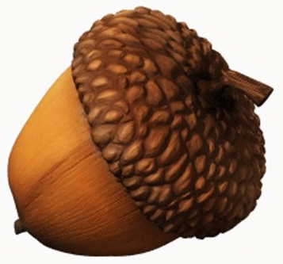
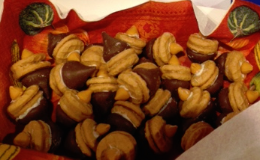
Acorn
Cookies
Servings: 48 cookies
Ingredients
Nutter Butter Bite Cookies
Hershey Kisses
Butter Scotch morsels
Directions
Attach a Hershey’s Kiss on one side of a Nutter Butter cookie with icing.
Attach a Butter Scotch morsel on the other side of the Nutter Butter cookie with icing.
Contributed by:
Mary & Chuck Connoyer
1972 Gulf Green
Camaro RS
Gateway Camaro Club
2017

Slide 20
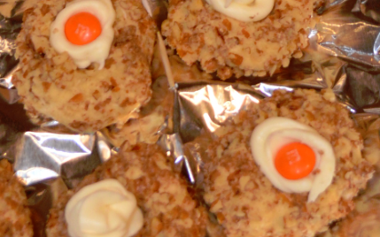
Grandma’s Thumbprint Cookies
Servings: 48 cookies
Ingredients
Cookies
½ cup firmly packed brown sugar
1 cup margarine or butter, softened
2 eggs, separated
2 cups all purpose or unbleached flour
1/8 teaspoon salt
1 ½ cups finely chopped pecans
Frosting
2 cups powdered sugar
1/8 teaspoon salt
3 tablespoons margarine or butter, softened
½ teaspoon vanilla
Food color
1 to 2 tablespoons milk
Directions
Preheat oven to 325 ̊F.
Lightly grease cookie sheets.
In a large bowl, beat brown sugar and 1 cup margarine until light and fluffy.
Add egg yolks; blend well.
Lightly spoon flour into measuring cup; level off.
Add flour and 1/8 teaspoon salt to the sugar mixture; mix well.
In a small bowl, slightly beat egg whites.
Shape dough into ¾-inch balls.
Dip balls in egg whites; roll in pecans.
Place cookie balls 2 inches apart on the greased cookie sheet.
With thumb, make imprint in the center of each cookie.
Bake about 10-15 minutes until edges are a light golden brown.
Immediately remove from the cookie sheet to cool and fill with the frosting.
Contributed by:
Mary & Chuck Connoyer
1972 Gulf Green
Camaro RS
Gateway Camaro Club
2017

Slide 21
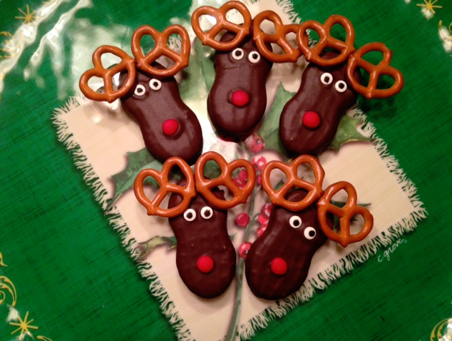
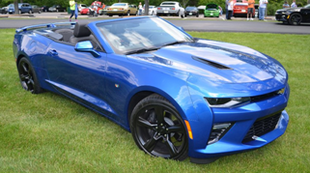
Nutter Butter Reindeer
Servings: 3 dozen cookies
Ingredients
Nutter Butter Cookies
Dark chocolate chips, melted
Mini pretzels
Candy eyes
Red hot candies
Contributed by:
Kathy & Mark Naylor
Directions
Melt chocolate chips either by microwaving for
30 seconds stirring and repeating until melted or on
the stove over a double boiler. Allow to cool for 2-3 minutes.
Dip a Nutter Butter in melted chocolate and spoon mixture over cookie to coat completely.
Place on a wire rack to let excess drip off, use a spoon to smooth any finger spots.
Press 2 candy eyes into each cookie.
Press 1 Red Hot in for the nose.
Dip ends of each pretzel in melted chocolate and position as antlers. (This can be done after the chocolate has set on the cookie.)
Place in refrigerator for 10 minutes to set completely.
2016 Hyper Blue Metallic Convertible
“Maximus”
Gateway Camaro Club
2017

Slide 22
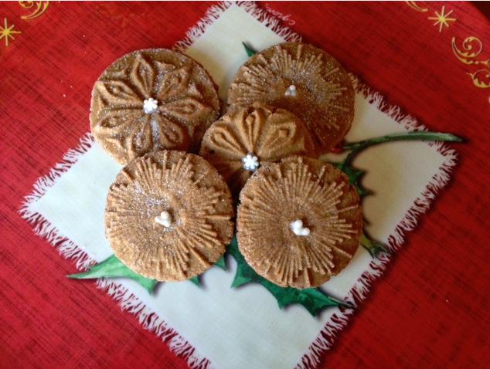
Starry Night Gingerbread Cookies
Servings: 4 dozen cookies
Ingredients
3 ¾ cups flour
1 tablespoon cocoa
1 tablespoon ginger
2 teaspoon ground cloves
3 teaspoon cinnamon
1 ½ teaspoon salt
1 cup unsalted butter, room temperature
1 cup sugar
1 large egg
½ cup molasses
Contributed by:
Kathy & Mark Naylor
Directions
Preheat the oven to 350 ̊ F.
Sift together flour, spices and salt in medium mixing bowl and set aside.
In mixer, cream butter and sugar on medium speed until light and creamy. Scrape sides of the mixer and add the egg. Mix thoroughly.
Add molasses and blend. Scrape again and with the mixer on low, add flour mixture and blend thoroughly.
Refrigerate for at least 2 hours, but less than a day.
Spoon dough into golf ball-sized balls. Roll into balls in your hands and then roll in sugar before placing on cookie sheet.
Press with cookie stamps until you begin to see dough coming out on edges.
Bake for 10-14 minutes.
2016 Hyper Blue Metallic Convertible
“Maximus”
Gateway Camaro Club
2017

Slide 23
