Slide 1
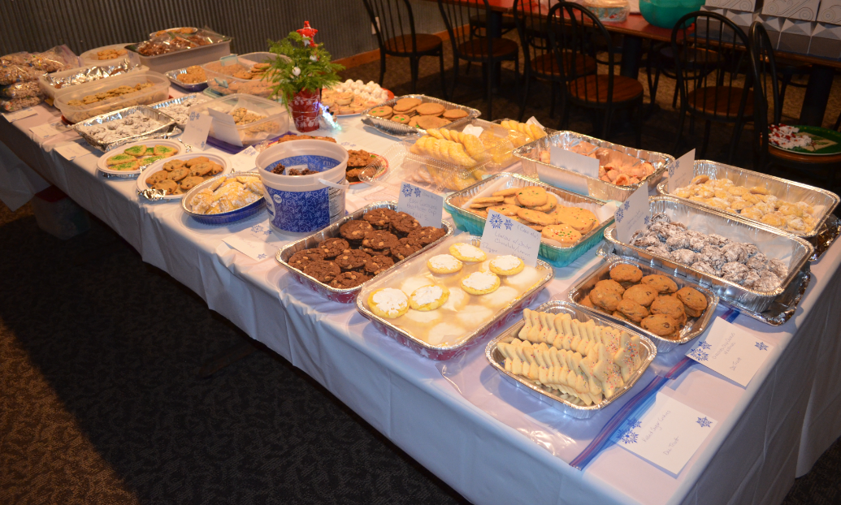
Holiday
COOKIE WALK
2018

Slide 2
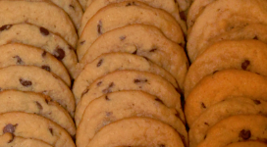
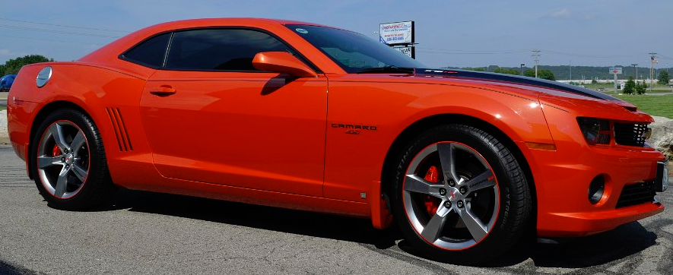
Best-Ever
Chocolate Chip Cookies
Servings: varies
Ingredients
¾ cup unsalted butter, softened
¾ cup brown sugar
¼ cup granulated sugar
1 egg
2 teaspoon vanilla extract
2 cup all purpose flour
2 teaspoon cornstarch
1 teaspoon baking soda
½ teaspoon salt
1 cup bittersweet chocolate chips
Contributed by:
Danielle Corcoran
Directions
1. Preheat oven to 350 ̊F.
2. In the bowl of a stand mixer fitted with a paddle attachment, cream together butter and sugars until fluffy and light in color.
3. Add egg and vanilla and blend.
4. Mix in flour, cornstarch, baking soda, and salt.
5. Stir in chocolate chunks.
6. Using a standard-sized cookie scoop or tablespoon, drop dough onto a prepared baking sheet.
7. Bake for 8-10 minutes, until barely golden brown around the edges. (The tops will not brown; do NOT cook longer than ten minutes.)
8. Place the baking sheet on a wire rack and cool for five minutes.
9. Remove cookies from the baking sheet and let cool completely.
2010 Camaro 2SS
Inferno Orange
Gateway Camaro Club
2017

Slide 3
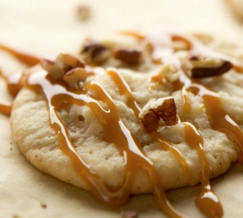
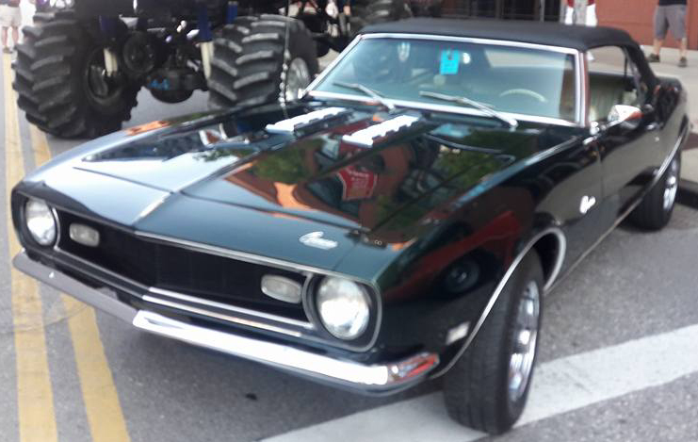
Pecan Spice Cookies with Salted
Caramel Drizzle
Servings: varies
Ingredients
1 box of Spice Cake mix
½ cup vegetable oil
2 eggs (room temperature)
2 cups chopped pecans
1 jar of Salted Caramel Sauce
Contributed by:
Heather and John Flaherty
Directions
Sift cake mix and add oil.
Add eggs, one at a time; mix thoroughly.
Drop cookie dough onto parchment-lined baking sheets; flatten cookie slightly with fingers.
Bake in preheated 350 ̊F oven for 10 minutes.
After baking, leave on cookie sheet for 2 minutes before transferring to a wire cooling rack.
After completely cooled, drizzle the top of each cookie with Salted Caramel Sauce.
1968 British Green Camaro
Gateway Camaro Club
2018

Slide 4
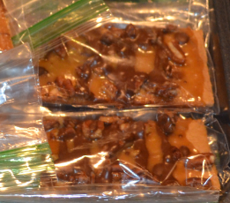
Quick Praline Bars
Servings: (14) 2” x 5” bars
Ingredients
14 2″ x 5″ graham crackers
½ cup packed brown sugar
½ cup butter or margarine
½ teaspoon vanilla
1 cup chopped pecans
½ cup dark chocolate
Contributed by:
Tim & Theresa Jezeski
Directions
Heat oven to 350 ̊F.
Arrange graham crackers in a single layer on an ungreased 11″ x 17″ cookie sheet.
In a 2-quart saucepan, heat brown sugar and butter to boiling; boil 1 minute, stirring constantly.
Remove from the heat and stir in vanilla.
Pour sugar mixture over crackers; spread evenly. Sprinkle with pecans.
Bake 8 – 10 minutes or until bubbly; cool slightly.
Melt dark chocolate and drizzle over semi-cooled bars.
Cut between graham crackers into bars.
2010 Synergy Green
“Synergy”
Gateway Camaro Club
2018

Slide 5
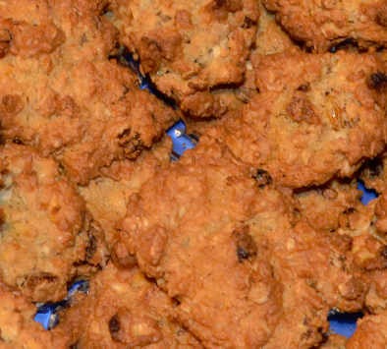
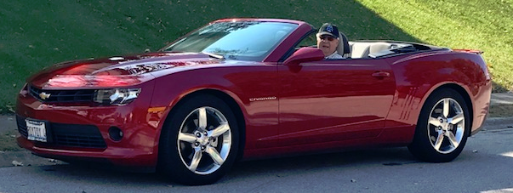
Mom Kessler’s
Ranger Cookies
Servings: 6-7 dozen
Ingredients
1 ½ cups butter
1 ½ cups granulated sugar
1 ½ cups brown sugar
3 eggs
1 teaspoon vanilla
3 cups flour
1 ½ teaspoons baking powder
1 ½ teaspoons baking soda
¾ teaspoon salt
3 cups old-fashioned oats
3 cups Corn Flakes
1 ½ cups coconut flakes
1 ½ cups golden raisins
1 ½ cups chopped pecans
Contributed by:
Roy & Gwin Kessler
Directions
Preheat oven to 350 ̊F.
Cream together butter and sugars.
Add vanilla and eggs to butter mixture and cream together.
In separate bowl, mix flour, baking powder, baking soda, and salt together.
In another bowl mix the oats, Corn Flakes, coconut flakes, raisins, and pecans with your hands.
Combine the butter, flour, and oats mixtures with your hands (I burned out two mixers!)
Spoon onto baking sheet and bake at 350 ̊F for 11 minutes.
2014 Camaro
Crystal Red
Gateway Camaro Club
2018

Slide 6
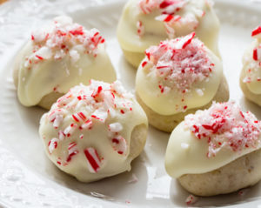
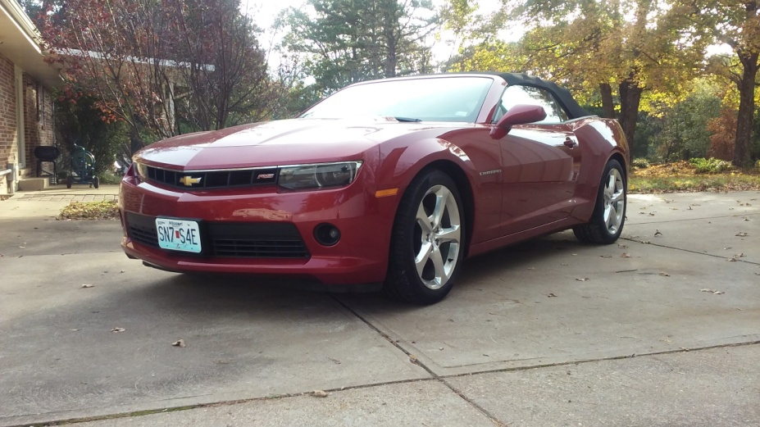
Peppermint
Holiday Cookies
Servings: varies
Ingredients
Cookie: 1 cup butter, softened ¾ cup white sugar 1 egg, beaten 3 cups all purpose flour ¼ teaspoon salt ½ cup crushed peppermint candy canes
Glaze: ¾ cup confectioners’ sugar 5 teaspoons warm water 2 tablespoons crushed peppermint candy canes
Contributed by:
Bonnie & Louis Pfleckl
Directions
Preheat oven to 350 ̊F.
Beat the butter and white sugar with an electric mixer in a large bowl until smooth.
Beat egg into butter mixture until completely incorporated. Mix flour and salt into the butter mixture until just incorporated.
Fold crushed candy canes into the batter, mixing just enough to evenly combine.
Roll dough into balls 1 tablespoon at a time, arrange on baking sheets.
Bake in the preheated oven until firm, 8 - 10 minutes. Allow cookies to cool on the baking sheet for 1 minute before removing to a wire rack to cool completely.
Whisk confectioners’ sugar and warm water together in a small bowl until you have a smooth icing.
Dip top of each cookie in the icing. Top with additional crushed candy cane, if desired. Set aside to let the icing dry, at least 5 minutes.
2015 Red Rock Metallic Convertible
“Cinnamon”
Gateway Camaro Club
2018

Slide 7
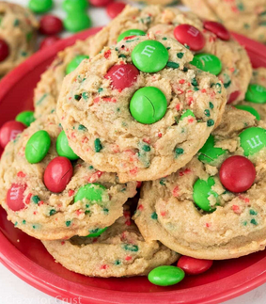
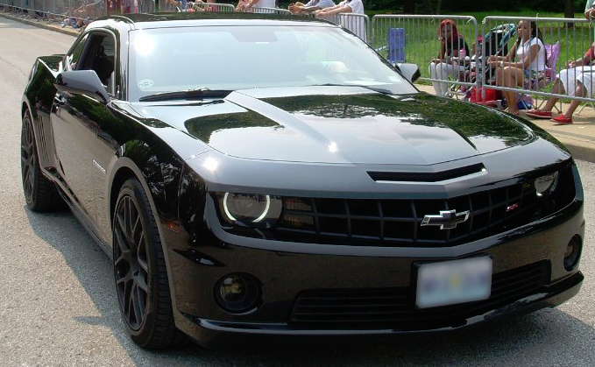
Ken’s Delights
Servings: 36 cookies
Ingredients
1 cup brown sugar
1 cup granulated sugar
½ cup butter
½ cup oil
2 eggs
1 teaspoon baking soda
1 teaspoon salt
1 teaspoon baking powder
1 teaspoon vanilla
3 cups flour
½ cup sprinkles (or mini chocolate chips)
1 cup M&Ms
Directions
Preheat oven to 350°F.
Cream butter, oil, and sugars.
Add eggs and beat until fluffy.
Add baking soda, salt, baking powder, vanilla, and flour. Mix well.
Fold in sprinkles. Use cookie scoop to put on dough on greased cookie trays. Top each cookie with 4-5 M&Ms.
Bake for 7-8 minutes. Cool completely.
Contributed by:
Ken & DawnSnodgrass
2011 Chevy Camaro SS2
“Night Fury”
Gateway Camaro Club
2018

Slide 8
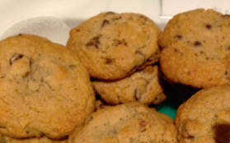
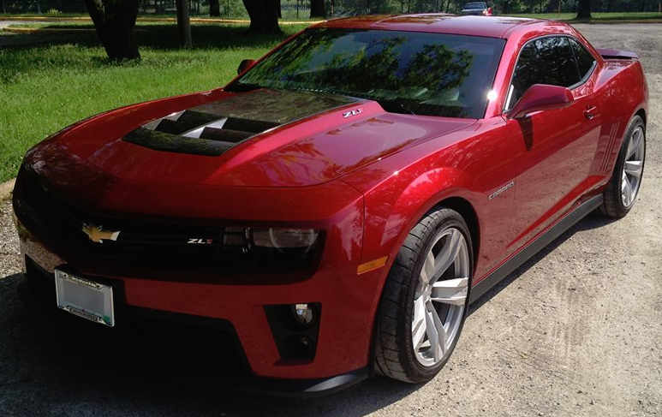
Chocolate Chip
Walnut Cookies
Servings: 5 dozen
Active time: 25 minutes
Total time: 40 minutes
Ingredients
2 ¼ cups flour
1 teaspoon baking soda
1 teaspoon salt
1 cup (2 sticks) butter, softened
¾ cup packed brown sugar
¾ cup granulated sugar
1 teaspoon vanilla extract
2 large eggs
2 cups Nestle’ Toll House Semi-Sweet Chocolate Morsels
1 cup chopped nuts
Contributed by:
Dee Troutt
Directions
Preheat oven to 375 ̊F.
Combine flour, baking soda, and salt in small bowl.
Beat butter, granulated sugar, brown sugar, and vanilla extract in large mixer bowl until creamy.
Add eggs, one at a time, beating well after each addition.
Gradually beat in flour mixture.
Stir in morsels and nuts.
Drop by rounded tablespoon onto ungreased baking sheets.
Bake for 9 to 11 minutes or until golden brown.
Cool on baking sheets for 2 minutes; remove to wire racks to cool completely.
2013 Crystal Red Tintcoat Camaro ZL1
Gateway Camaro Club
2018

Slide 9
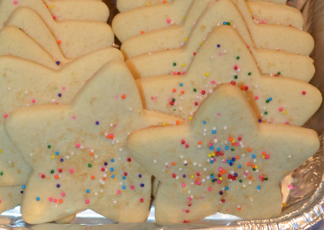
Rolled Sugar
Cookies
Servings: varies
Ingredients
1 cup sugar
1 cup butter, softened
3 tablespoons cream or milk
1 teaspoon vanilla
1 egg
3 cups flour
1 ½ teaspoons baking powder
½ teaspoon salt
Contributed by:
Dee Troutt
Directions
In large bowl, combine the first 5 ingredients and blend well.
Stir in remaining ingredients and blend well.
Chill dough for easier handling.
Preheat the oven to 400°F.
Roll 1/3 of the dough on flour surface to 1/8” thickness.
Cut the dough with floured cookie cutter.
Place on ungreased cookie sheet.
If desired, sprinkle with sugar.
Bake at 400°F for 5-8 minutes or until edges are light brown.
Immediately remove from cookie sheet.
2013 Crystal Red Tintcoat Camaro ZL1
Gateway Camaro Club
2018

Slide 10
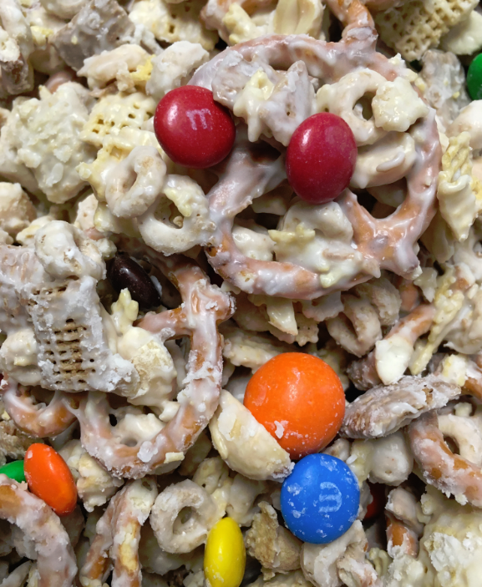
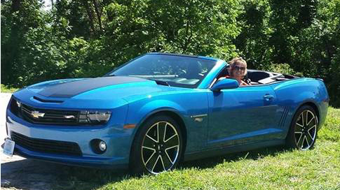
Chex Mix
Servings: 12-14 cups
Ingredients
2 cups of Rice Chex
2 cups of Corn Chex
2 cups of Wheat Chex
2 cups of Cheerios
2 cups of pretzel twist (the small ones)
1 cup of peanuts, lightly salted, dry roasted
1 cup of M&M’s (2lb. bag)
9 squares of white Almond Bark
(NOTE: Buy it at Dierberg’s, so you don’t
have to mess with cutting it!)
Contributed by:
Gina and Greg Wilkerson
Directions
In a large metal pot, mix together first six ingredients.
In a microwave safe dish, melt Almond Bark just until melted; start with 1 minute, then 30 seconds intervals.
When Almond Bark has melted, stir until smooth, then quickly pour over cereal mixture and coat thoroughly.
Spread coated mixture over waxed paper in a thin layer.
Sprinkle with M&M’s and let harden.
After mixture cools and hardens, break into bite sized pieces and store in an air-tight container.
2013 Hot Wheels Special Edition
“Sizzler”
Gateway Camaro Club
2018

Slide 11
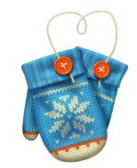
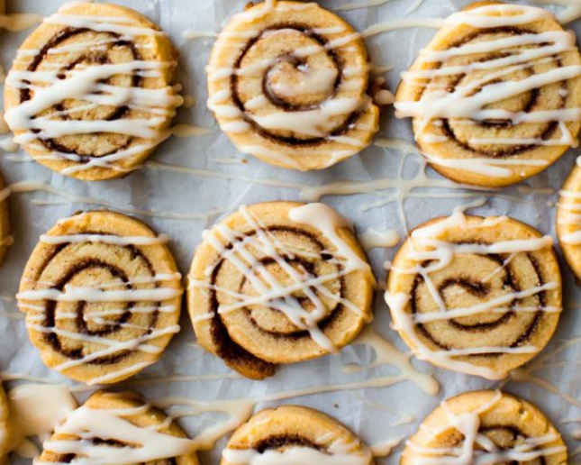
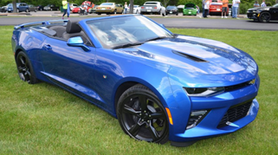
Cinnamon Roll Cookies
Servings: 36 cookies
Ingredients
2 ¼ cups all-purpose flour
½ teaspoon baking powder
¼ teaspoon salt
¾ cup unsalted butter, softened to room temperature
¾ cup granulated sugar
1 large egg, at room temperature
2 teaspoons pure vanilla extract
Filling
2 tablespoons butter, melted and slightly cooled
¼ cup granulated sugar
1 tablespoon ground cinnamon
Icing
1 cup confectioners' sugar
3 tablespoons milk
½ teaspoon pure vanilla extract
Contributed by:
Kathy & Mark Naylor
Directions
Make the dough: Whisk the flour, baking powder, and salt together. Set aside.
Beat the butter for 1 minute on high speed until creamy. On medium-high speed, beat in the granulated sugar until completely creamed and smooth, about 2 minutes.
Add the egg and vanilla extract and beat on high until combined, about 1 minute. Scraping down the sides.
Add the dry ingredients to the wet ingredients and mix on low until combined.
Divide the dough into 2 equal parts. Roll each portion out in a rectangle (about 9” x 7”) to ¼” thickness. Spread 1 tablespoon melted butter onto each rectangle. Mix the sugar/cinnamon together then sprinkle evenly over each.
Tightly roll up each rectangle into a 9-inch log. If the dough is cracking at all, use your fingers to smooth it out.
Chill the logs for at least 2 hours.
Preheat oven to 350°F. Line a large baking sheet with parchment paper.
Remove dough logs from the refrigerator. Cut into 1/2 inch slices. Place slices onto baking sheets about 2 inches apart.
Bake for 10-11 minutes, until lightly browned on the sides. Remove from the oven, allow to cool on the baking sheet for 5 minutes, then transfer to a wire rack to cool completely before icing.
Whisk the icing ingredients together. Drizzle over cookies. Store covered cookies at room temperature for up to 5 days.
2016 Hyper Blue Metallic Convertible
“Maximus”
Gateway Camaro Club
2018

Slide 12
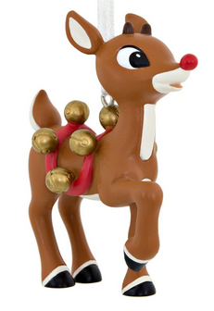
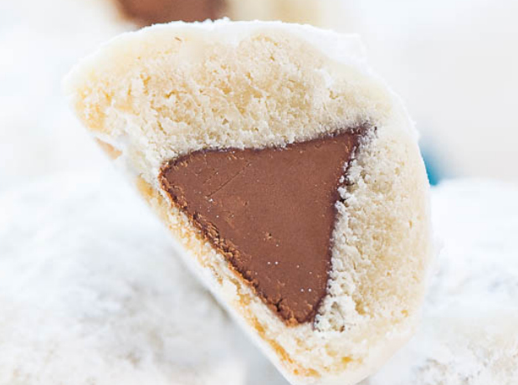
Chocolate Kiss
Powder Puff Cookies
Servings: 15 cookies
Ingredients
1 sheet pie crust that makes a 9-inch pie, thawed 15 chocolate kisses (Dark chocolate, Mini Peanut Butter Cups, or Rolos) ¾ cup confectioners’ sugar, for dredging
Contributed by:
Kathy & Mark Naylor
Directions
Preheat oven to 350°F. Line a baking sheet with a Silpat or spray with cooking spray; set aside.
Place pie crust on a lightly floured surface and using a pizza wheel, slice into approximately 16 sections, about 2-inch squares.
Place one chocolate kiss in the center of each section.
Using your fingertips, seal the dough at the top to fully contain the kiss. Pat smooth with your palms and flatten slightly into a mound OR pinch together like . Place mound on prepared baking sheet; repeat with remaining crust sections and kisses until gone.
Bake for about 15 to 17 minutes, or until crust is just set and done; puffs firm up as they cool. The tops will appear fairly pale while the undersides will be more golden; do not overbake or the undersides could burn. Watch puffs closely starting at about 13 minutes since all ovens and ingredients vary.
Allow puffs to cool for 15 minutes or until cool enough to handle before dredging in confectioners’ sugar.
Puffs will keep airtight for up to 1 week at room temp or in the freezer for up to 4 months.
2016 Hyper Blue Metallic Convertible
“Maximus”
Gateway Camaro Club
2018

Slide 13
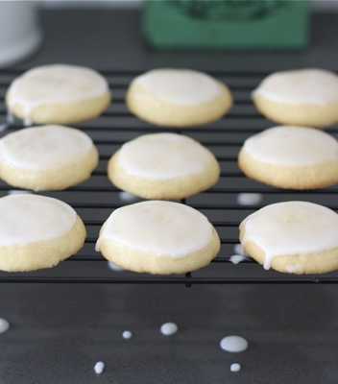
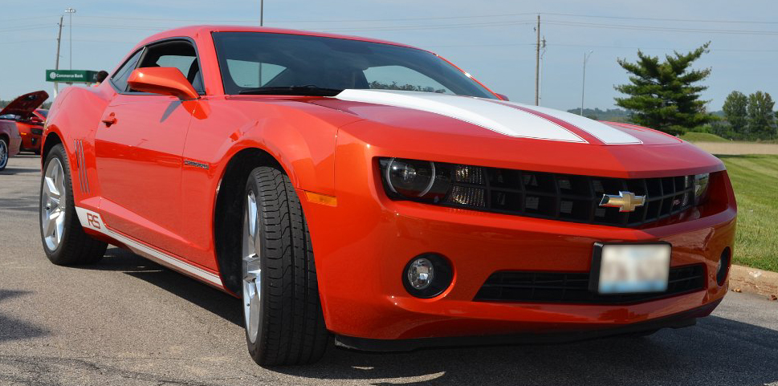
Easy Lemon Cake Mix Cookie
Servings: approximately 2 dozen cookies
Ingredients
1 box (lemon cake mix)
1/3 cup vegetable oil
2 tablespoons water
2 eggs
White chocolate for drizzle
Directions
COMBINE cake mix, oil, water, and eggs in large bowl. Drop by rounded tablespoon onto ungreased baking sheets.
BAKE in preheated 350°F oven for 10-12 minutes or until centers are just set. Let stand for 2 minutes: remove to wire racks to cool completely.
Contributed by:
Vicki Schanuel & Dwayne Saul
2010 Inferno Orange RS
Gateway Camaro Club
2018

Slide 14
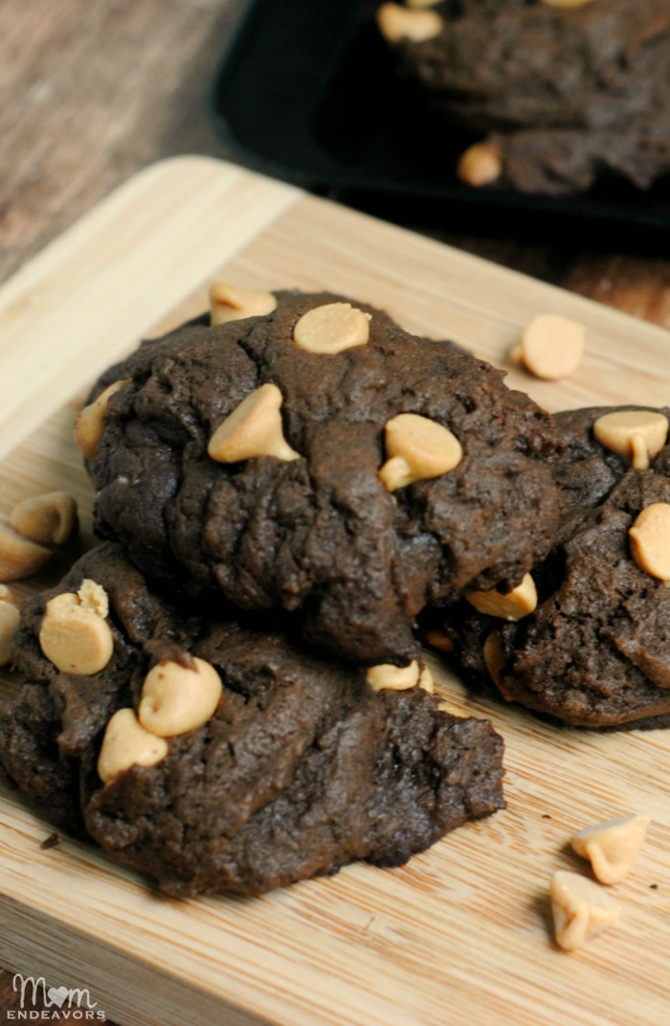
Easy Peanut Butter Chip Chocolate Cookies
Servings: approximately 3 dozen cookies
Ingredients
1 box (chocolate cake mix)
½ cup vegetable oil
2 eggs
2 cups (12-ounce package) Reese’s Peanut Butter Chips
Directions
COMBINE cake mix, oil and eggs in large bowl. Stir in Reese’s chips. Drop by rounded tablespoon onto ungreased baking sheets.
BAKE in preheated 350°F oven for 8 to 10 minutes or until centers are just set. Let stand for 2 minutes: remove to wire racks to cool completely.
Contributed by:
Vicki Schanuel & Dwayne Saul
2010 Inferno Orange RS
Gateway Camaro Club
2018

Slide 15
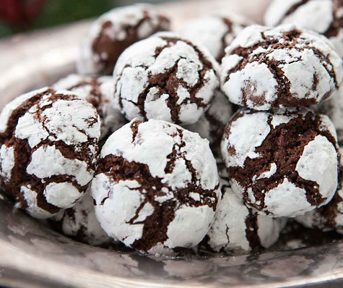
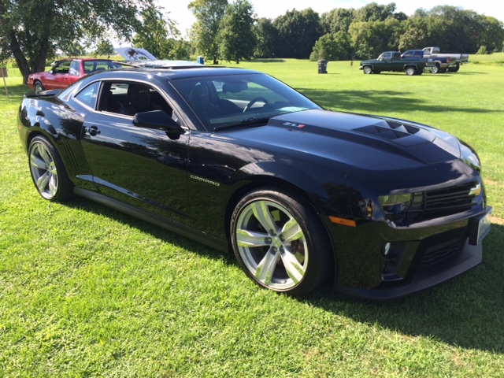
Fudge Crinkle Cookies
Servings: varies
Ingredients
1 box Super Moist Devils Food Chocolate cake mix
1/3 cup Vegetable Oil
2 eggs
1 teaspoon Vanilla
Powdered Sugar
1 cup mini semi-sweet chocolate chips
Contributed by:
Jeanne and Kevin Walk
Directions
Heat oven to 350°F (325°F for dark or nonstick pans).
In large bowl, stir dry cake mix, oil, eggs and vanilla.
Mix well by hand or a mixer; after mixed, stir chocolate chips in by hand.
Refrigerate dough for 15 minutes to make them easier to handle.
Shape dough into 1 inch balls and roll in powdered sugar.
Place on lightly greased cookie sheet 2 inches apart.
Bake 9-12 minutes or until set.
Cool 2 minutes and remove from cooking sheet and then allow to cool completely before storage.
2012 ZL1
Gateway Camaro Club
2018

Slide 16
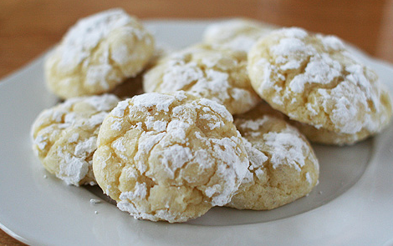
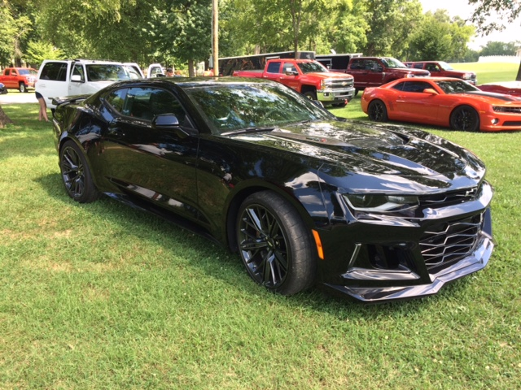
Gooey Butter
Cookies
Servings: varies
Ingredients
1 8 oz package cream cheese
½ cup butter – softened
1 egg
¼ teaspoon vanilla extract
1 box Yellow Cake mix
Powdered sugar
Contributed by:
Jeanne and Kevin Walk
Directions
Heat oven to 350°F (325°F for dark or nonstick pans).
In large bowl, cream together the cream cheese, butter, egg, vanilla.
Add in cake mix and mix well with mixer.
Refrigerate dough for 15 minutes to make them easier to handle.
Shape dough into 1 inch balls and roll in powdered sugar.
Place on lightly greased cookie sheet 2 inches apart.
Bake 12-15 minutes or until set.
Cool 2 minutes and remove from cooking sheet and then allow to cool completely before storage. Add more powder sugar sprinkling if needed.
2017 ZL1
Gateway Camaro Club
2018

Slide 17
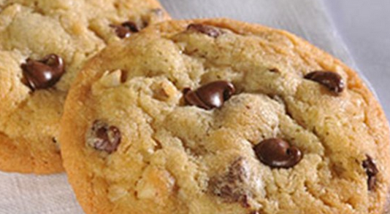
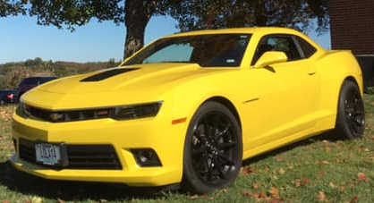
Chocolate Chip Cookies
Servings: 60 cookies
Ingredients
2 ¼ cups all-purpose flour
1 teaspoon baking soda
1 teaspoon salt
1 cup butter, softened
¾ cup granulated sugar
¾ cup packed brown sugar
1 teaspoon vanilla extract
2 large eggs
2 cups NESTLE TOLL HOUSE Semi-Sweet
Chocolate Morsels
1 cup chopped nuts
Contributed by:
Amanda Michaels
Directions
Preheat oven to 375°F.
Combine flour, baking soda and salt in small bowl.
Beat butter, granulated sugar, brown sugar and vanilla extract in large mixer bowl until creamy.
Add eggs, one at a time, beating well after each addition.
Gradually beat in flour mixture.
Stir in morsels and nuts.
Drop by rounded tablespoon onto ungreased baking sheets.
Bake for 9 to 11 minutes or until golden brown.
Cool on baking sheets for 2 minutes; remove to wire racks to cool completely.
2014 Lola
Gateway Camaro Club
2018

Slide 18
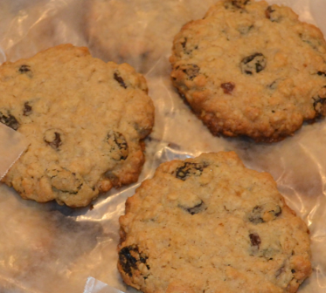
The Best Oatmeal Raisin Cookies
Servings: 45 cookies
Ingredients
2 cups all purpose flour
1 teaspoon baking powder
1 teaspoon salt
1 teaspoon apple pie spice, or ¾ teaspoon
cinnamon + ¼ teaspoon nutmeg
3 sticks (1 ½ cups) unsalted butter, softened
1 cup granulated sugar
1 cup brown sugar
2 large eggs
1 teaspoon vanilla extract
3 cups old fashioned oats
1 ½ cups raisins
Contributed by:
Keli and Jeff Bohrer
Directions
Preheat oven to 375°F.
Line several baking sheets with parchment paper.
In a medium bowl, combine flour, baking powder, salt, and apple pie spice.
In the bowl of an electric mixer, cream the butter and both sugars on high until light and fluffy, about 3-4 minutes.
Scrape the bowl with a spatula, then beat in the vanilla and eggs.
Turn the mixer on low and slowly add the flour mixture.
Scrape the bowl again, then turn the mixer on low and mix in the oats and raisins.
Using a 1 ½ tablespoon cookie scoop, scoop the dough into equal portions and spread the balls out two inches apart on the prepared cookie sheets.
Bake for 12-14 minutes, until slightly golden around the edges.
Cool for 5 minutes on the baking sheets before moving.
*For thicker, puffier cookies, chill the dough for 30-60 minutes, then bake for 15+ minutes.

Slide 19
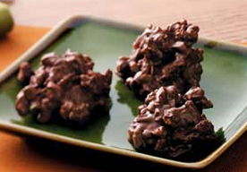
Granola Chocolate Clusters
Servings: varies
Ingredients
1 12-14 oz box of granola cereal
6-8 1.55 oz Hershey's Milk Chocolate bars
Optional: nuts, raisins, dry fruit cut into small pieces
Contributed by:
Chris Frisch & family
Directions
In the microwave, melt 3 Hershey ‘s bars at a time, usually 90 seconds.
Add and stir in enough granola cereal to coat the cereal completely.
Spoon the coated cereal by tablespoon onto a cookie sheet* and chill.
Continue this process until you have used all of the Hershey bars and cereal or until you have as many as you want.
* The clusters may be decorated with sprinkles or colored sugar before chilling.

Slide 20
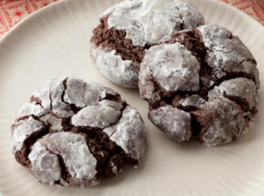
Chocolate Gooey Butter Cookies
Servings: 2 dozen cookies
Ingredients
1 8oz brick cream cheese, room temperature
1 stick butter, room temperature
1 egg
1 teaspoon vanilla extract
1 18oz box moist chocolate cake mix
Confectioner’s (powdered) sugar, for dusting
Contributed by:
Larry and Julie McCracken
Directions
Preheat oven to 350°F.
In a large bowl with an electric mixer, cream the cream cheese and butter until smooth.
Beat in the egg.
Then beat in the vanilla extract and the cake mix.
Cover and refrigerate for 2 hours to firm up, so you can roll the batter into balls.
Roll the chilled batter into tablespoon-sized balls and then roll in confectioner’s sugar.
Place cookies on an ungreased cookie sheet, 2 inches apart.
Bake for 12 minutes.
The cookies will remain soft and “gooey.”
Cool completely and sprinkle with more confectioner’s sugar, if desired.

Slide 21
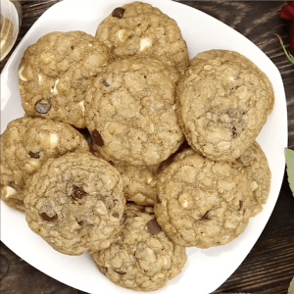
Marry Me Cookies
Total time: approx. 50 minutes
Servings: 24 cookies
Ingredients
1 cup (226g) butter
1 ¼ cup (250g) dark brown sugar
½ cup (100g) granulated sugar
2 large eggs room temperature
1 teaspoon pure vanilla extract
2 cups (256g) all-purpose flour
1 cup (90g) old-fashioned oats
½ teaspoon baking soda
½ teaspoon salt
¼ teaspoon ground cinnamon
1 cup white chocolate chips
1 cup milk chocolate chips
Contributed by:
Patty Wells
Instructions
In a medium saucepan, melt the butter until melted, over medium-low heat. Remove from the heat.
Add the dark brown sugar and granulated sugar and stir until sugars are incorporated and smooth. Chill the mixture for 10 minutes. (Do not skip this step. You can also transfer the mixture to a different bowl so that it is no longer being heated from the pan.)
Remove the mixture from the refrigerator and stir in the eggs and vanilla.
Add the flour, oats, baking soda, 1/2 teaspoon salt, and cinnamon and mix together with a spoon.
Gently fold in the white chocolate chips and chocolate chips.
Chill dough until it is firm enough to be hand rolled, about 30 minutes in the fridge.
Roll by hand into 24 medium-size balls or use a scoop, and place on a parchment lined cookie sheet.
Refrigerate for 30 minutes or freeze for 10 minutes.
While the dough is chilling, heat the oven to 325 degrees F.
Bake for 12 to 14 minutes, or until the edges just start to turn golden. (Do not overbake.)

Slide 22
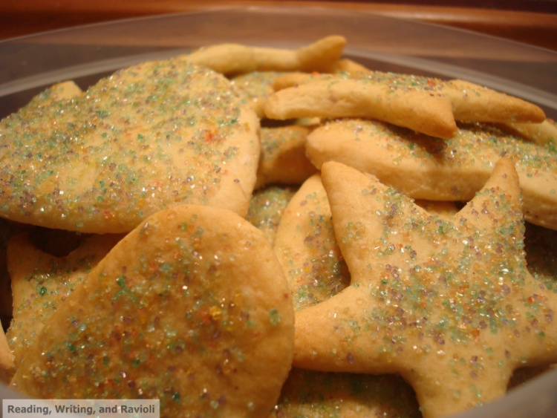
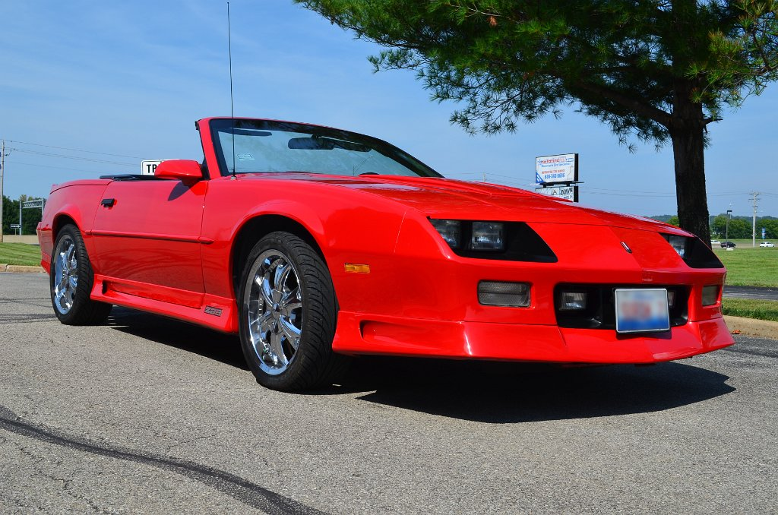
Sugar Cookies
Servings:
Ingredients
Contributed by:
Dennis & Judy Shoreack
Directions
1991 Red Z28
“Zoom”
Gateway Camaro Club
2018

Slide 23
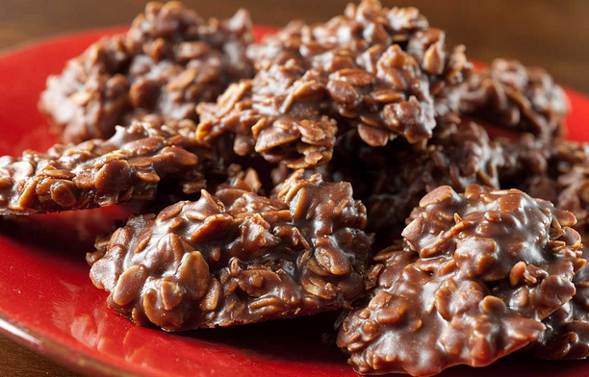
No Bake
Cookies
Servings:
Ingredients
Contributed by:
Linda and John Kondrick
Directions

Slide 24
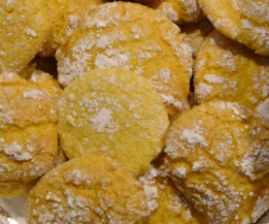
Lemon
Cookies
Servings:
Ingredients
Contributed by:
Chuck Pilliod
Directions

Slide 25
Brickle Chip
Cookies
Servings:
Ingredients
Contributed by:
Julie Thompson
Directions

